Slide 1
Building a small house using Solidworks and blender for second life
AGbell

Slide 2
Since I started in Second Life back in 2018 I have wanted to build models that could be uploaded so one of my first questions in the Second Life Forum was “how to build and upload my own model”. The first person to advise me was Chin Aeon in the Second Life Forum and she used her Small House YouTube video as an example.
The physics model should be a model that is as simple as you can make it. In this case, you would model the door openings but not the windows.
https://www.youtube.com/watch?v=g6SJjFc4P_k

Slide 3
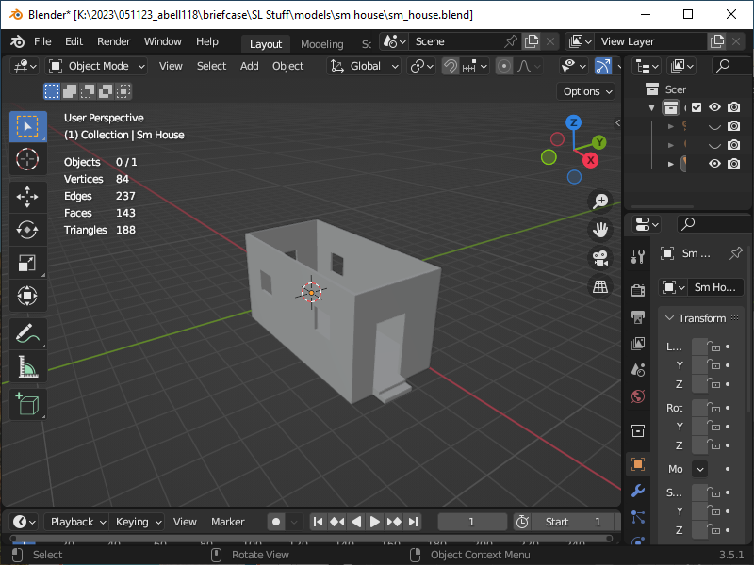
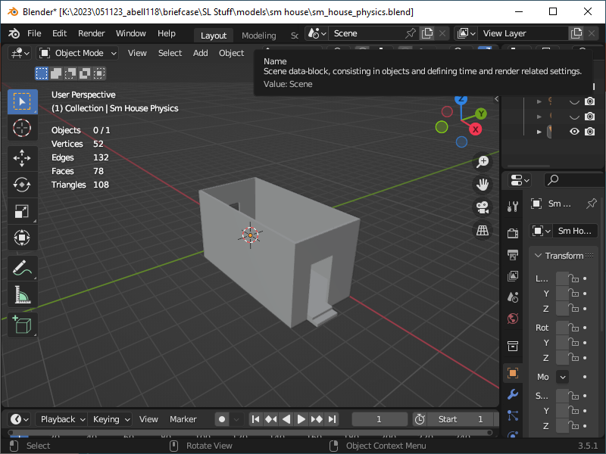
In my case, I built the small house in Solidworks and then saved it as an STL file. STL files can be used if you want to 3D print things. The STL file will be imported into Blender and used to convert the model into a DAE file which is used by Second Life.
Created with 188 Triangles which is good
Created with 108 Triangles which is better
Mesh Model
Physics Mesh Model

Slide 4
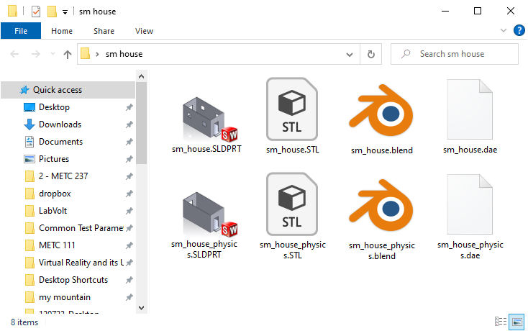
Both models will be needed to upload to Second Life as DAE files. The files are created as an export in Blender.
SLDPRT >> STL >> BLEND >> DAE
Solidworks >> Blender >> Second Life

