Slide 1
Building a Small House using
Solidworks and Blender for
Second Life
AGBell

Slide 2
Since I started in Second Life back in 2018 I have wanted to build models that could be uploaded so one of my first questions in the Second Life Forum was “how to build and upload my own model”. The first person to advise me was Chin Aeon in the Second Life Forum and she used her Small House YouTube video as an example.
The physics model should be a model that is as simple as you can make it. In this case, you would model the door openings but not the windows.
https://www.youtube.com/watch?v=g6SJjFc4P_k

Slide 3
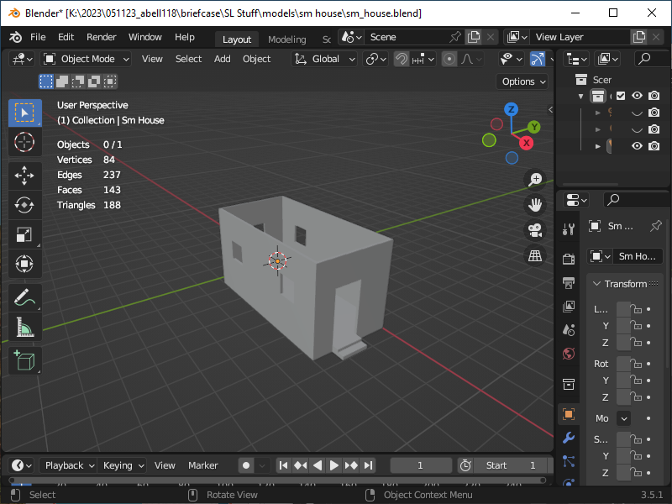
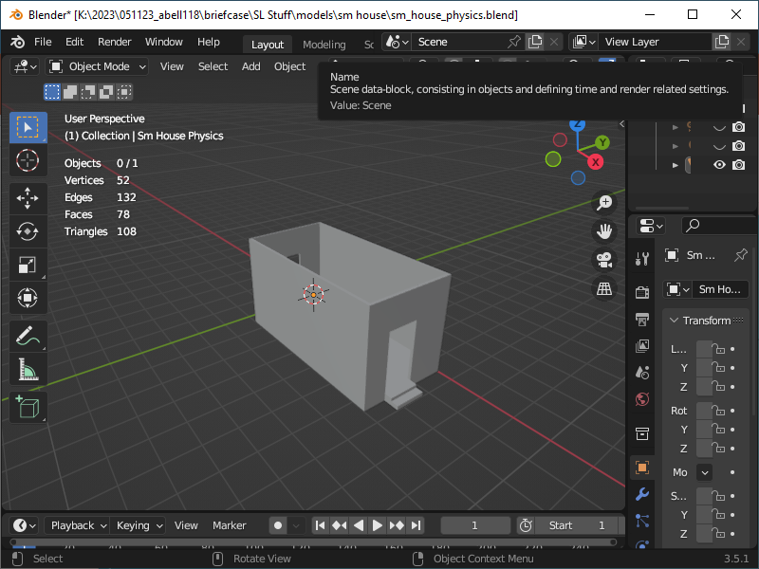
In my case, I built the small house in Solidworks and then saved it as an STL file. STL files can be used if you want to 3D print things. The STL file will be imported into Blender and used to convert the model into a DAE file which is used by Second Life.
Created with 188 Triangles which is good
Created with 108 Triangles which is better
Mesh Model
Physics Mesh Model

Slide 4
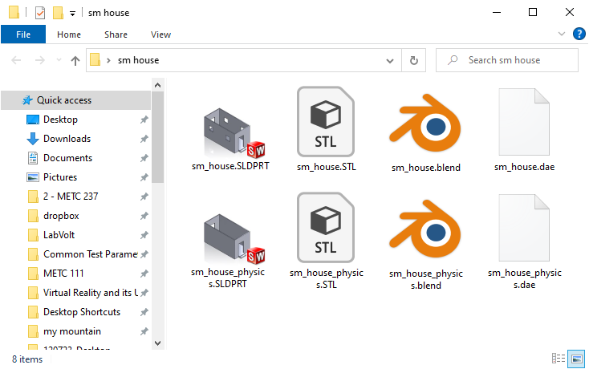
Both models will be needed to upload to Second Life as DAE files. The files are created as an export in Blender. It is also possible to apply different materials to different faces in Blender. This will allow you to apply multiple textures in Second Life.
SLDPRT >> STL >> BLEND >> DAE
Solidworks >> Blender >> Second Life

Slide 5
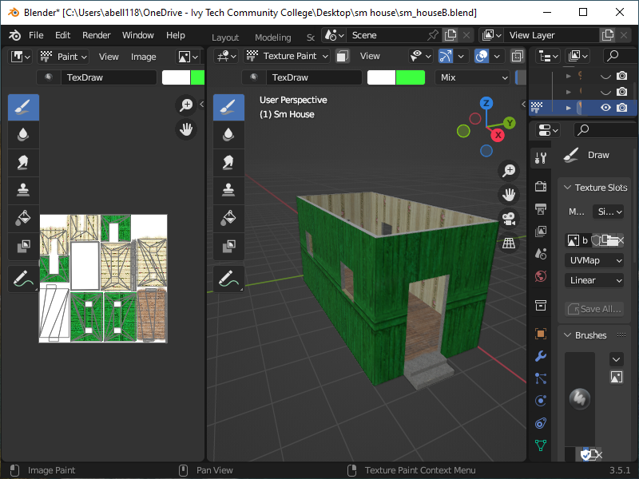
It is also possible to add a texture to the model in Blender and then this texture would also be uploaded with the model. This process includes:
1.) Find an image or picture you want to use on the object. Perhaps at
https://polyhaven.com/textures or https://www.textures.com/
You can find something you like then download and use it…
2.) The overall texture size cannot be larger than
2K for Second Life. You can edit the image
(texture) in Paint or some other program to
merge multiple textures. Or if it is a single
texture you can apply it as a UVMap in
Blender to the sections of the object you want
to paint.
3.) Or you can texture faces in Second Life that
have been associated with the materials in
Blender.

Slide 6
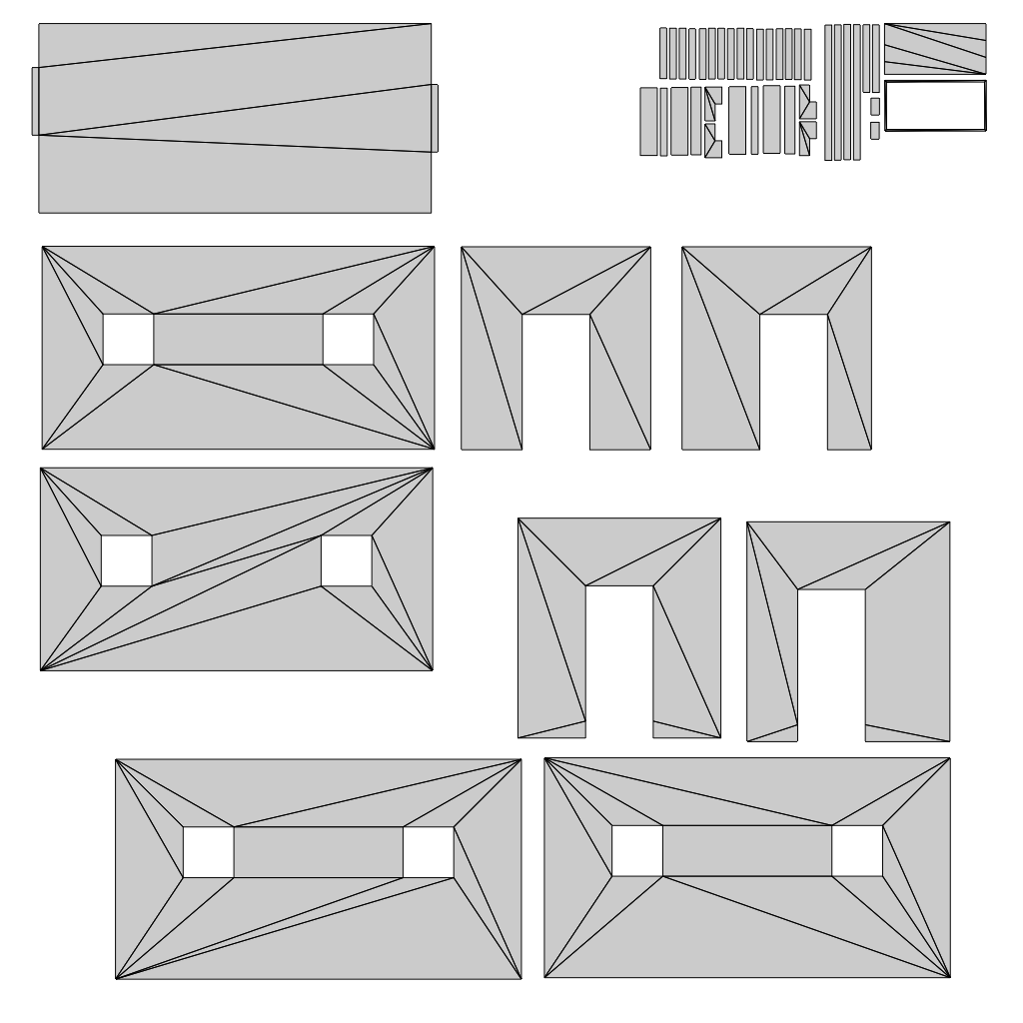
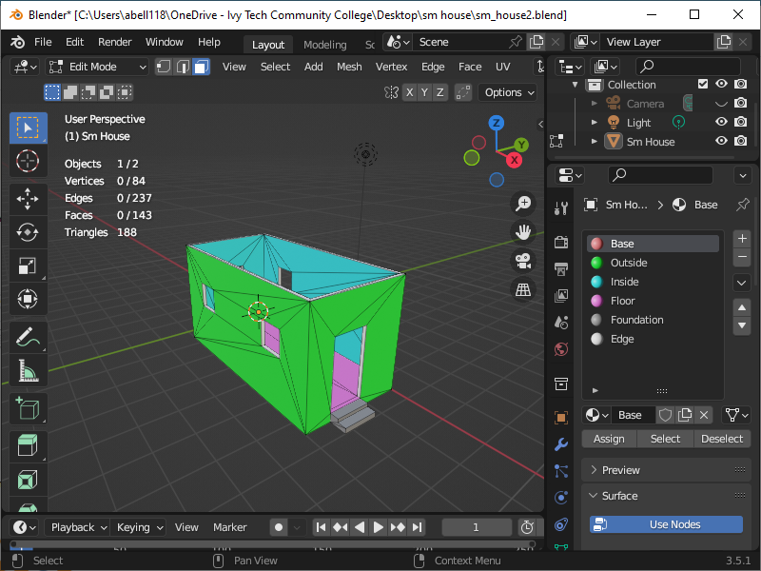
For option 3 I have created five materials and a base material that can be used to verify that everything has been assigned to a material. All the outside walls would have a common material. Likewise, the inner walls and floor would each have individual assigned materials. The materials would become embedded in the DAE file and you could texture surfaces in-world.
Floor
Other faces
Inside walls
Outside walls
UVMap

Slide 7
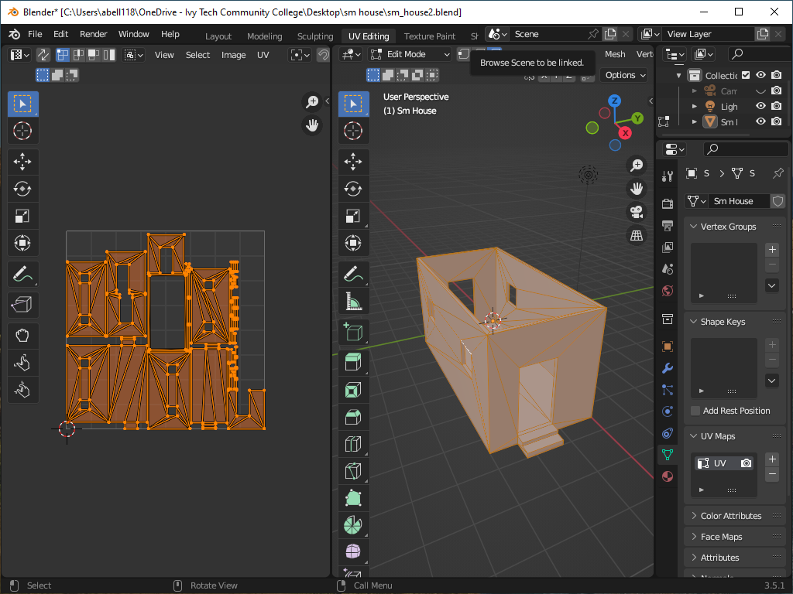
Suppose you want to add material to the outer wall, inner wall, floor, steps, and window and door ledges. To do this you will need to create material for each of these and to begin just create a base for everything an assign a color to it that stands out.
If you just use solid color materials you won’t need to modify the UVMap for island orientation.

Slide 8
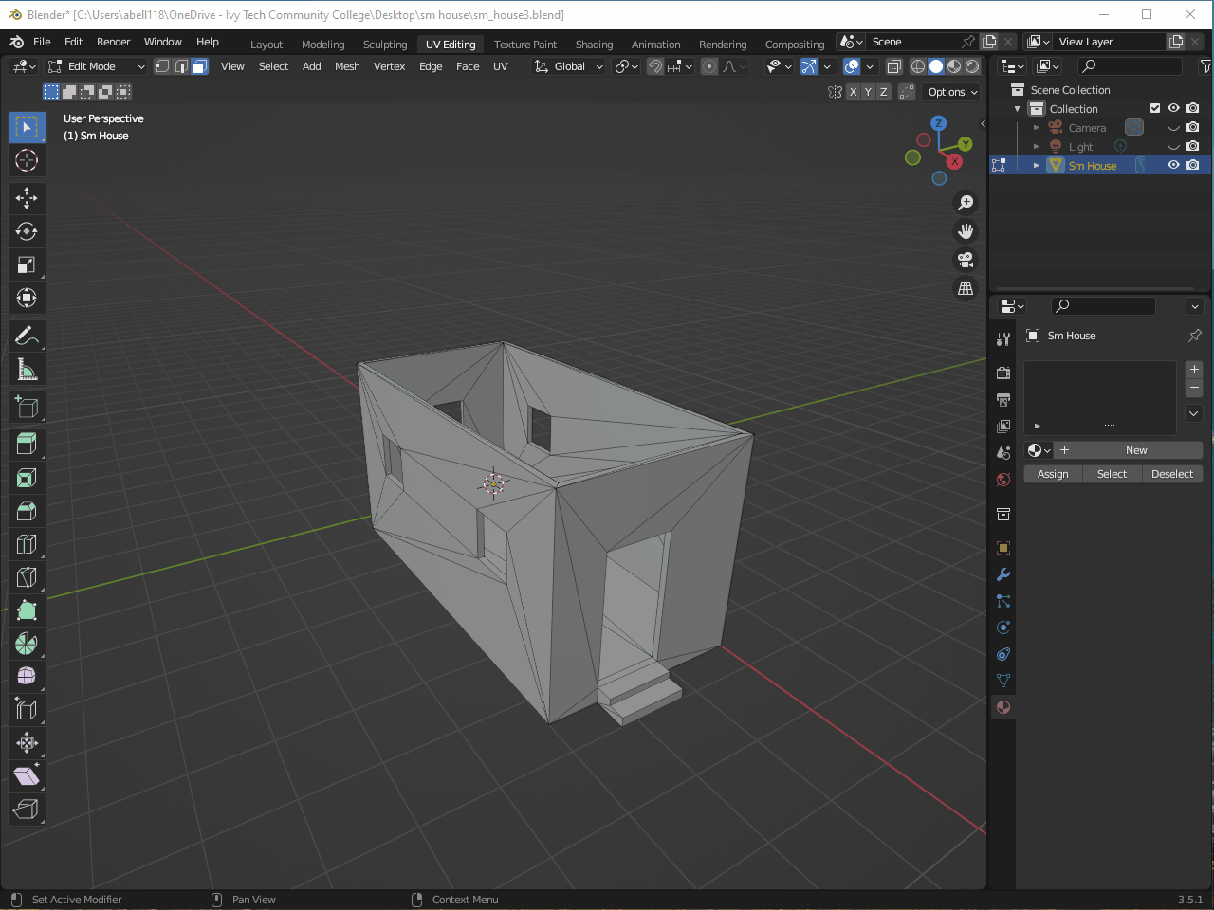

First, create a Base material that will be assigned to all the faces. We already know that we want it to be a particular color but you can make it whatever you want it to be.
To see it you will need to switch to the “Viewport Shading” mode which is to the right of the blue box with the white circle at the top.

Slide 9
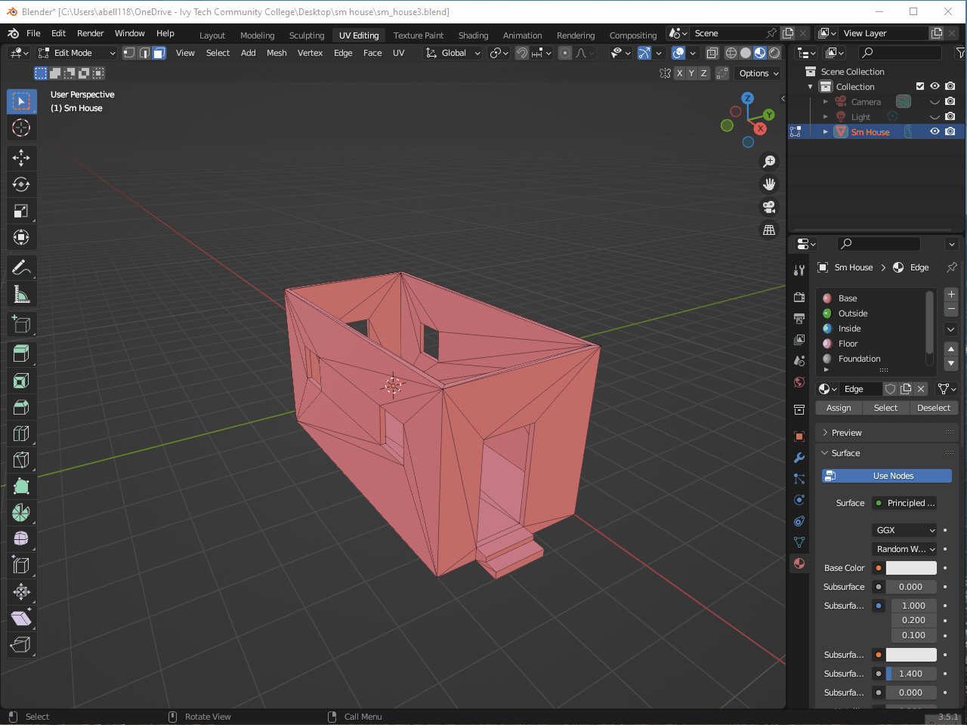
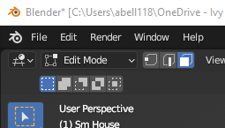
Next, you will need to create all the other materials and assign them a unique color. Then, in face mode, you call select and assign all the faces to a particular material.

Slide 10
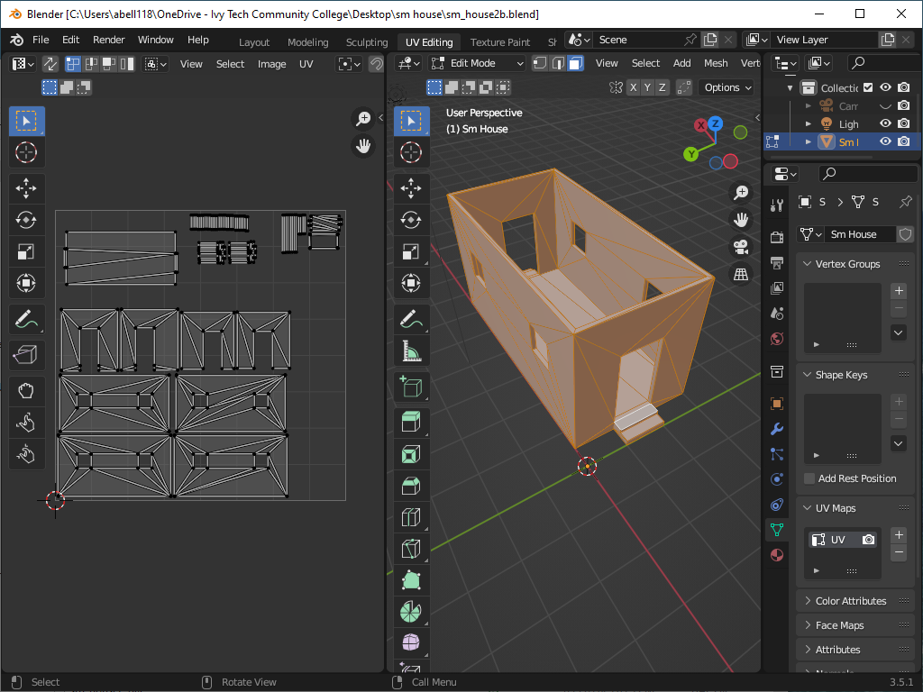
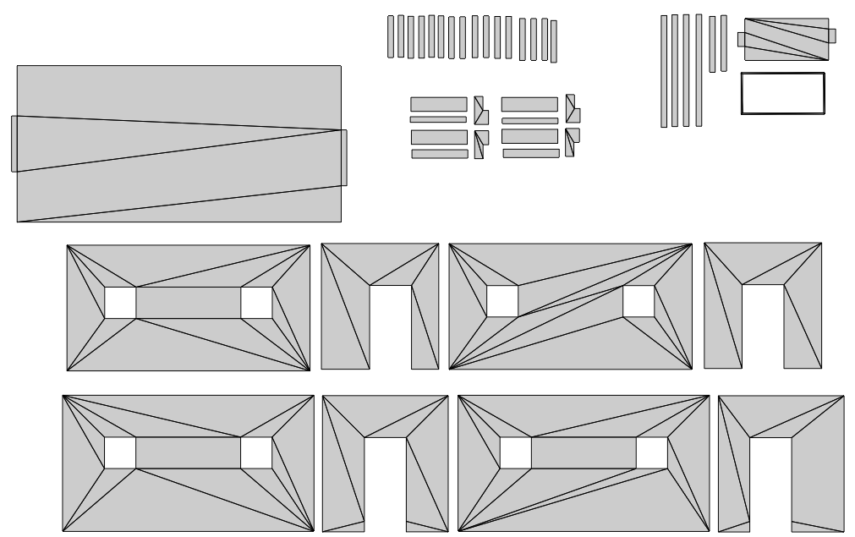
This is not exactly the final version but all the islands have been scaled and rotated. If you don’t rotate the islands to the same orientation and you have a texture that is patterned it might not look right if you apply the pattern to adjacent walls.
Improved Alignment

Slide 11
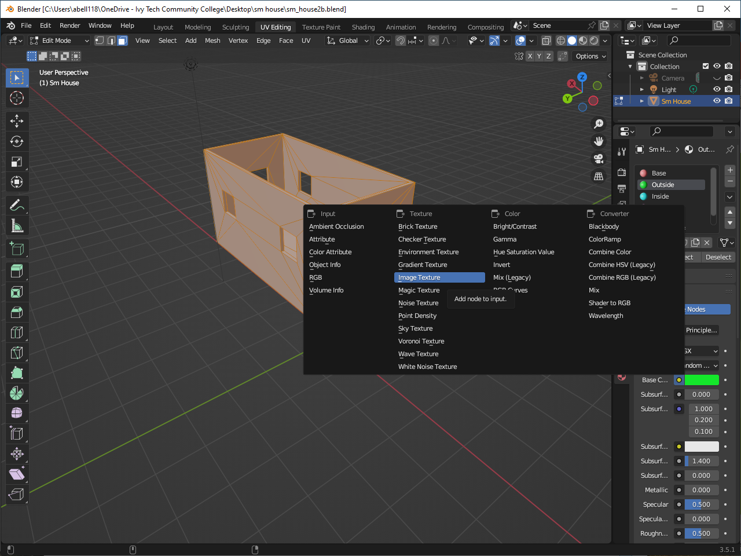
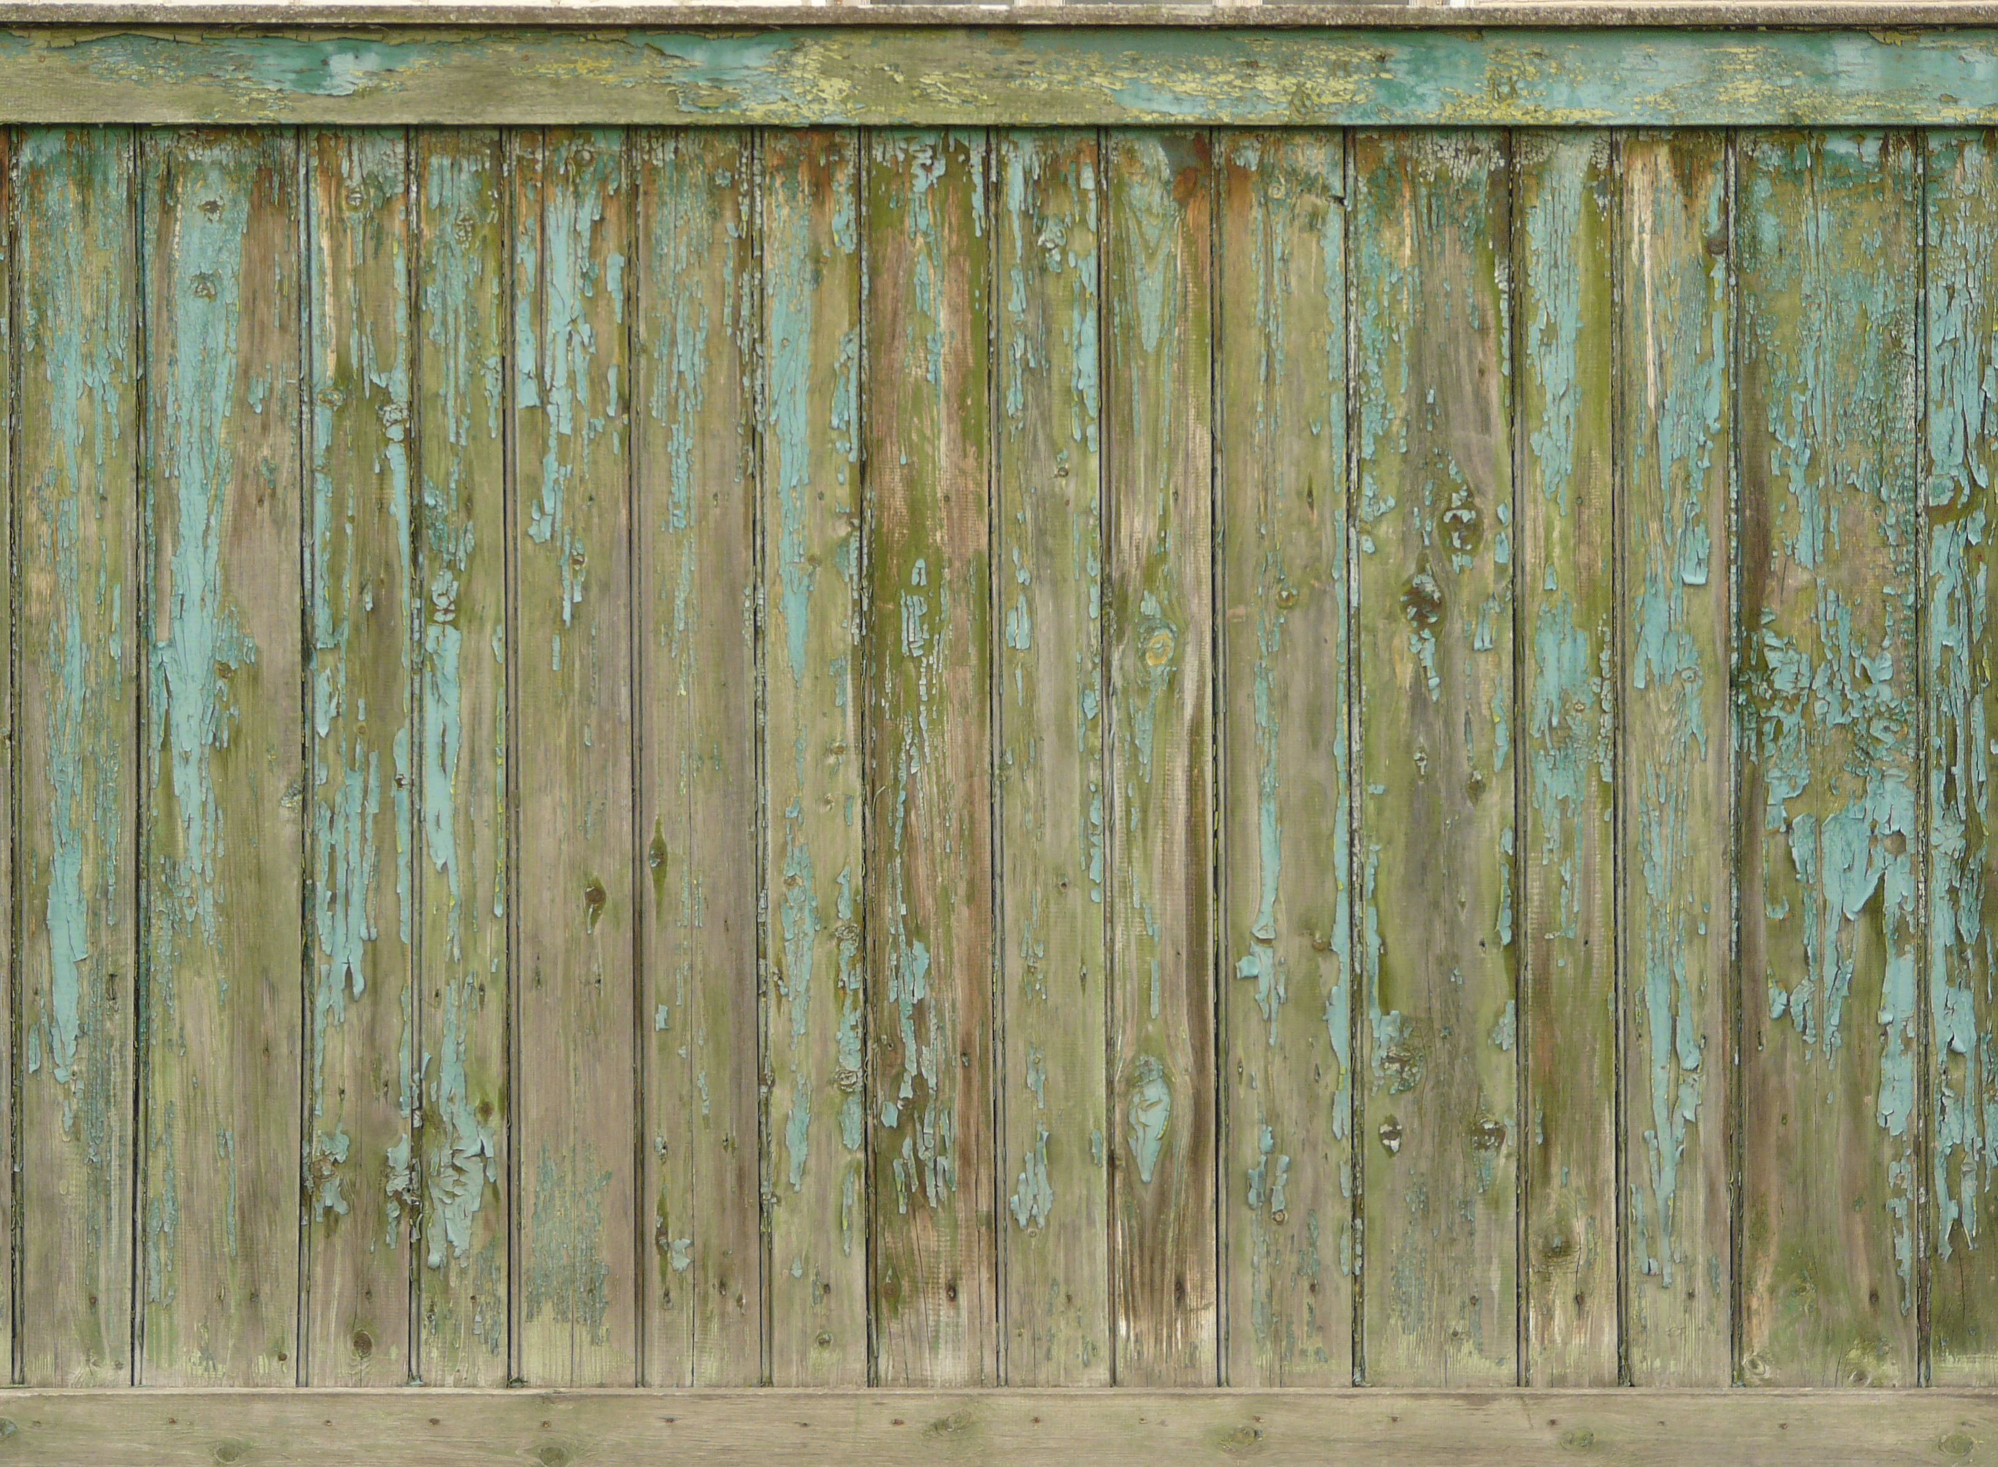
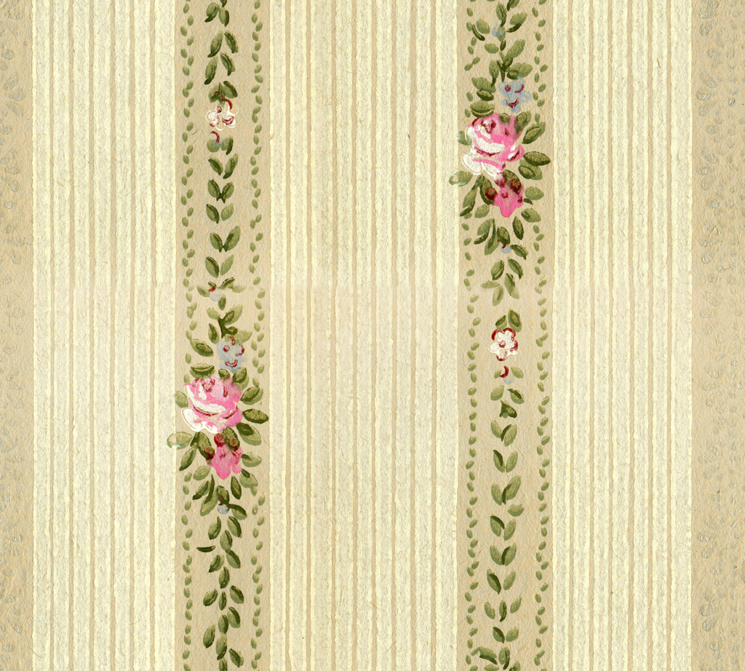
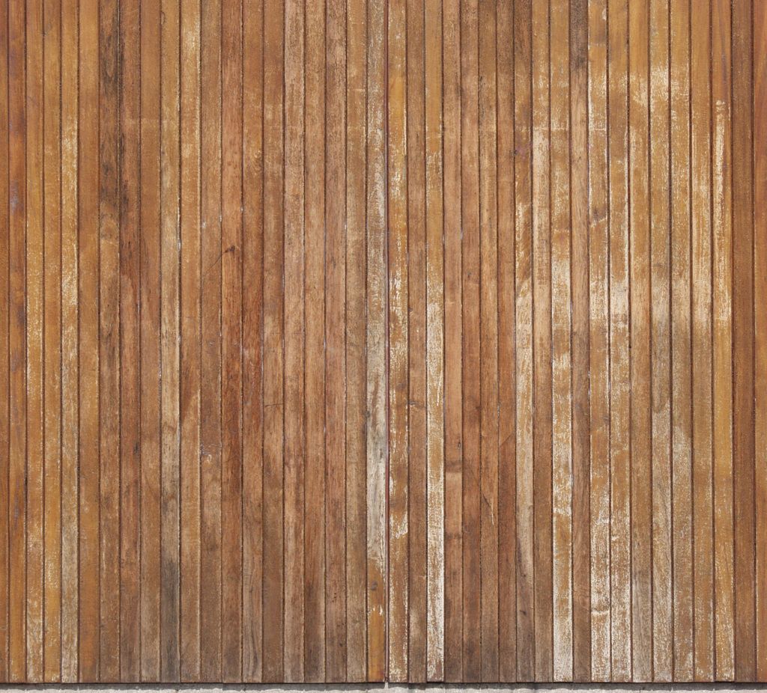
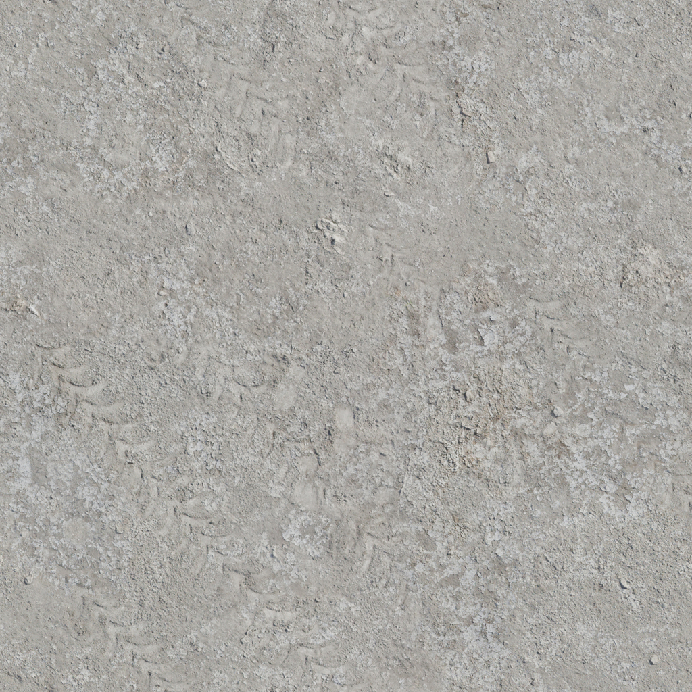
Step one is to change the materials from a color to an image texture and do this for
all the materials except the Base. To find textures (images) you will need to do a little digging on the web.

Slide 12
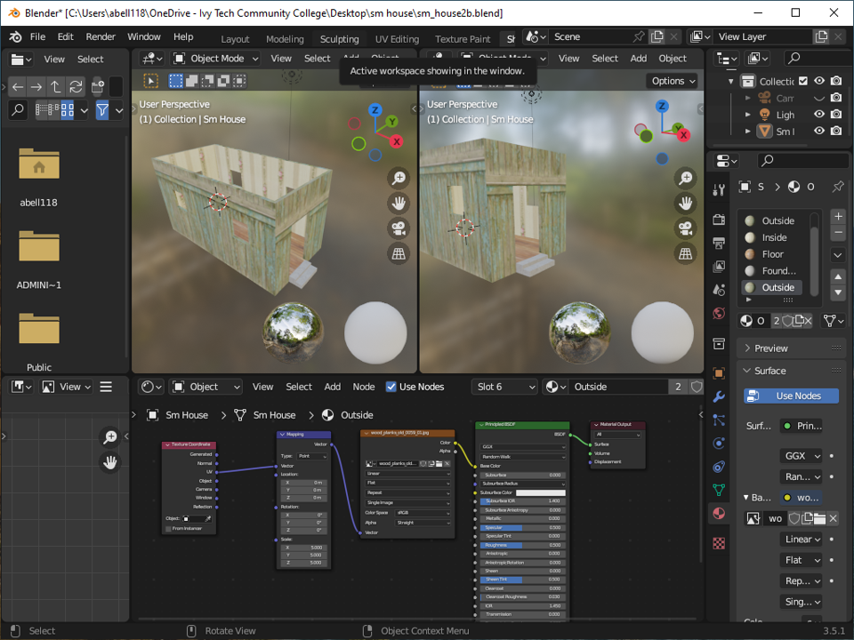
Because the UVMap was not aligned and rotated properly the outside wall and the floor have problems. Also, the inside wall could be improved if the UVMap was aligned better.
Improved UVMap

Slide 13
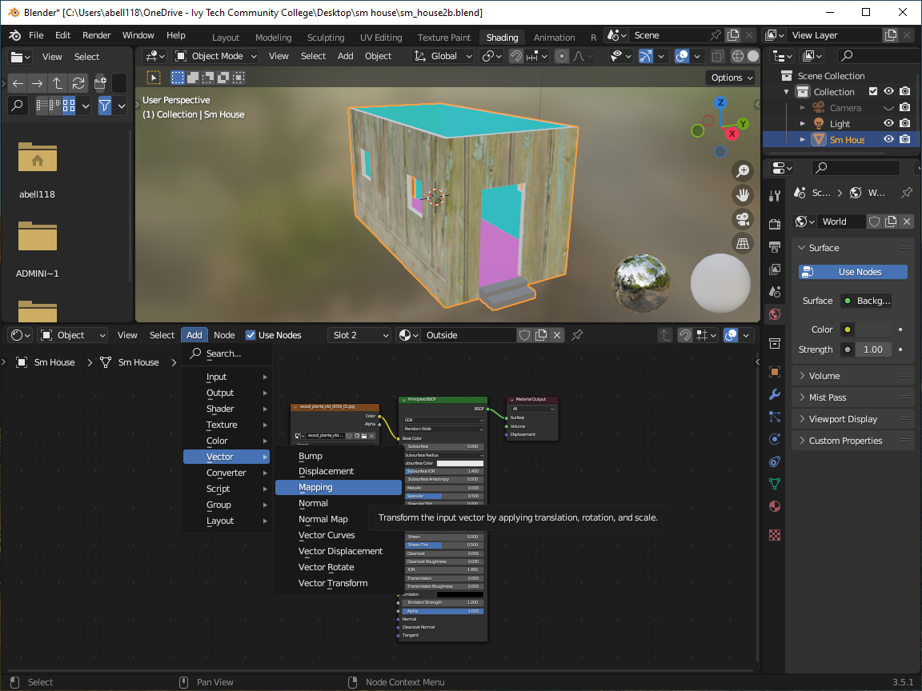
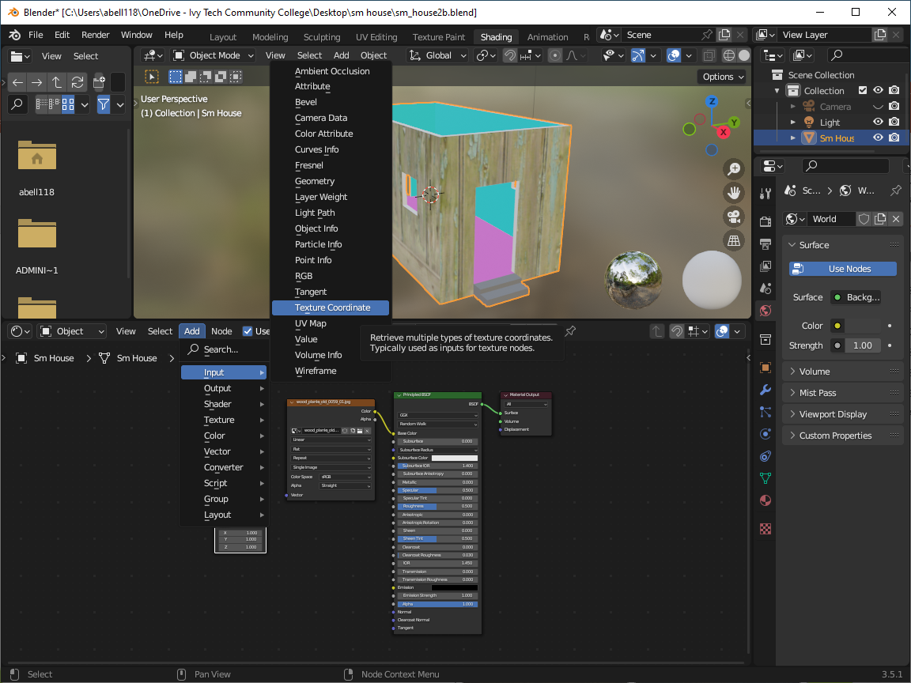
After you get the UVMap updated and all the image textures assigned you can switch to the Shading Editor to scale, rotate, and align the images on the faces of the house. To do this you will need to add two more nodes: a
Vector Mapping Node (Add>Vector>Mapping) and a
Texture Coordinate Node (Add>Input>Texture Coordinate)

Slide 14
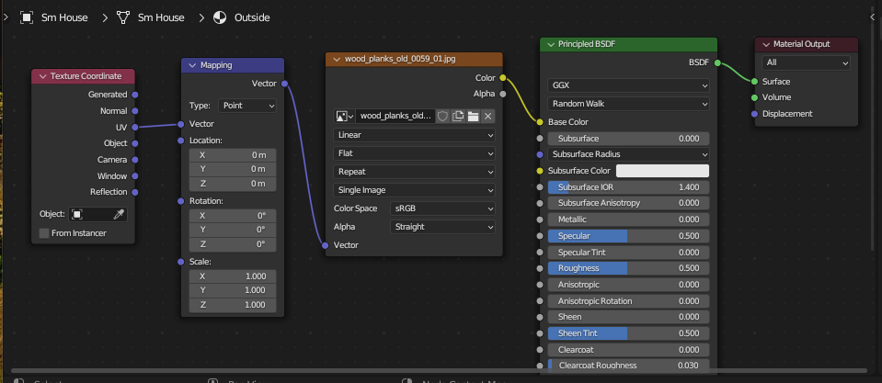
Connect the UV output from the Texture Coordinate Node to the Vector input of the Mapping Node. Then connect the Vector output from the Mapping Node to the Vector input of the Image Texture Node. You can then change the Location, Rotation, and Scale in the Mapping Node to align, rotate and scale your image texture. Once you are happy you can move onto the next texture image for the next surface.
Tiling is accomplished by increasing the Scaling for X, Y, and Z in the Mapping Node.

Slide 15
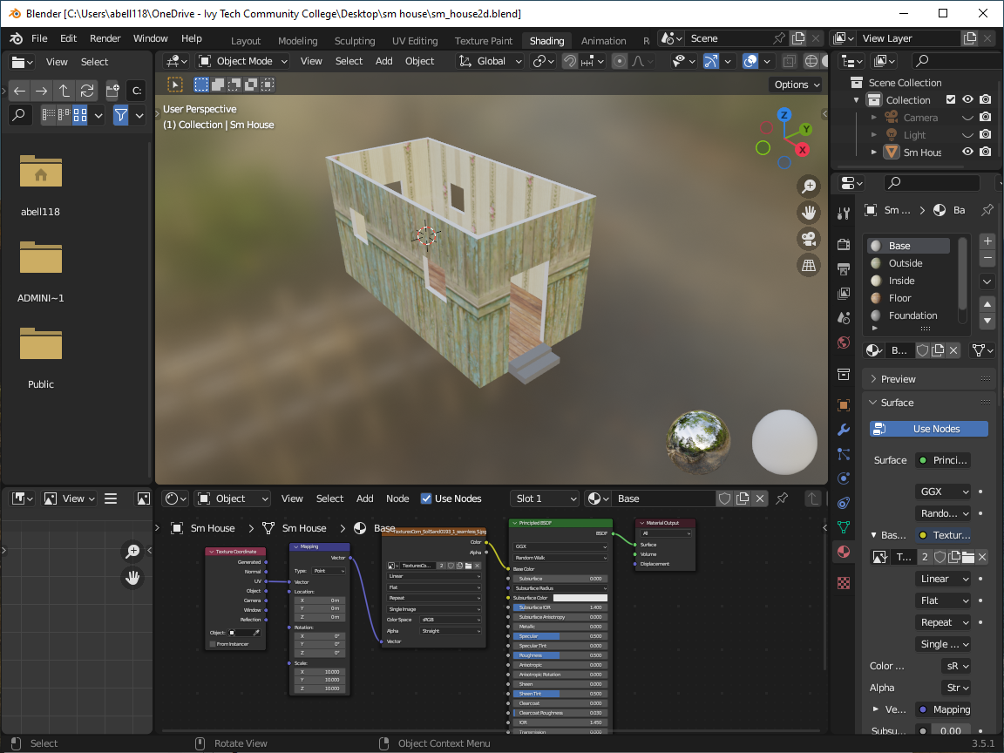
This slide shows a big jump forward in texturing all the surfaces using the Shading Editor. Two new nodes are added to the nodes in the bottom part of the screen for each surface. Each image was individually tailored for the best results.

Slide 16
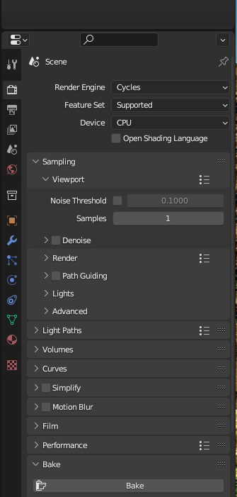
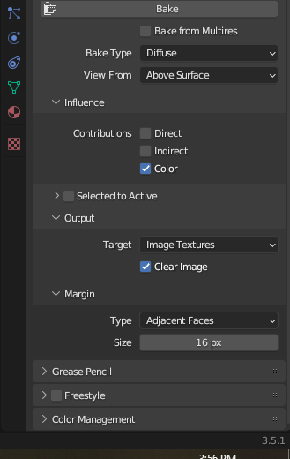
Next, we need to combine all the texture images into a single image texture. In the Shader Editor add an Image Texture which is linked to a common 2K image. Then for each material select each Image Texture node and switch to the Render. Set samples to 1 and prepare to bake. Select Cycles and CPU
Select Bake Type>Diffuse and uncheck Direct and Indirect. In addition, the Margin Type should be changed to Extend.
Option not shown

Slide 17
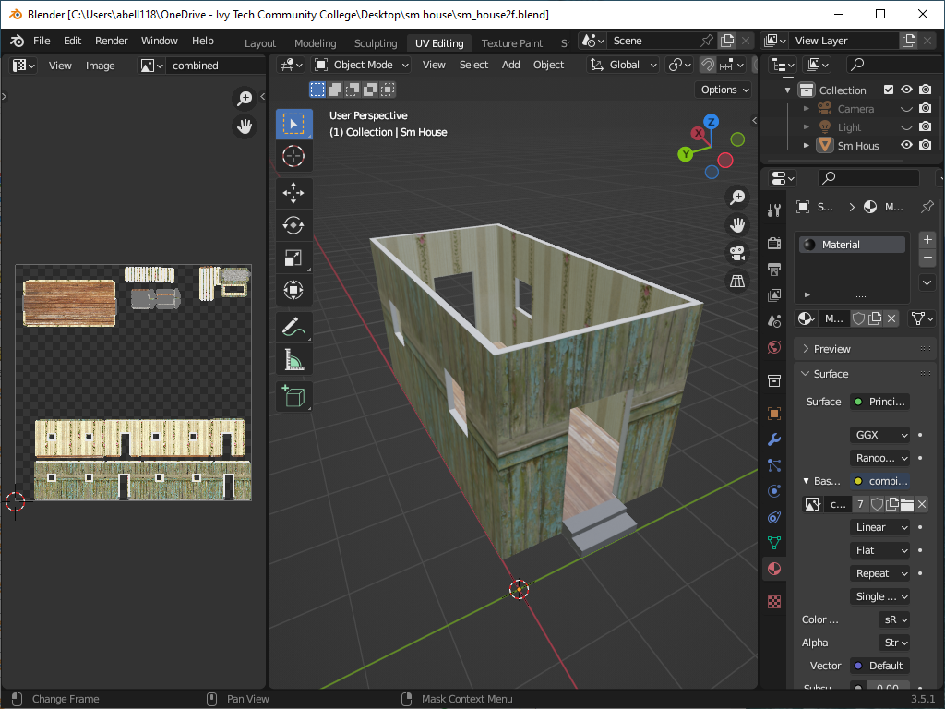
This shows what the new combined Image Texture would look like. The image can be saved and applied to a model that has the same UVMap as a single material (image texture).

Slide 18
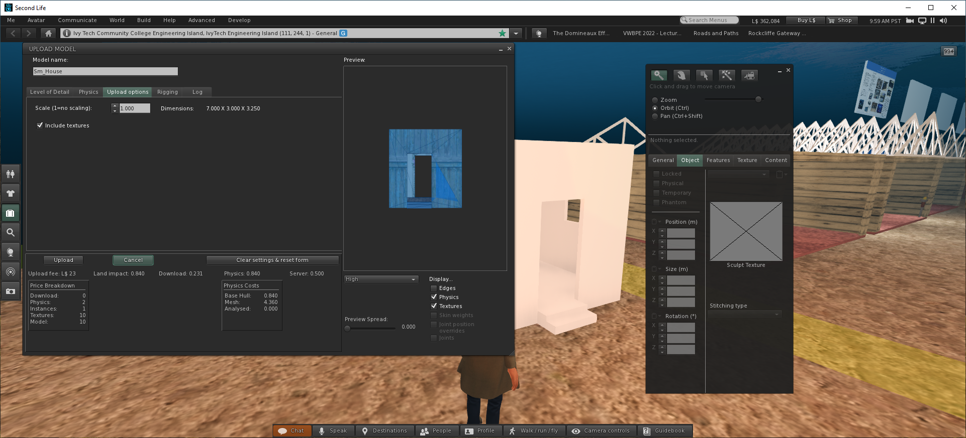
The DAE file with the physics file and the image texture can be uploaded into Second Life. Upload values for Lan Impact, Download, Physics, Server, and cost look very reasonable.

Slide 19
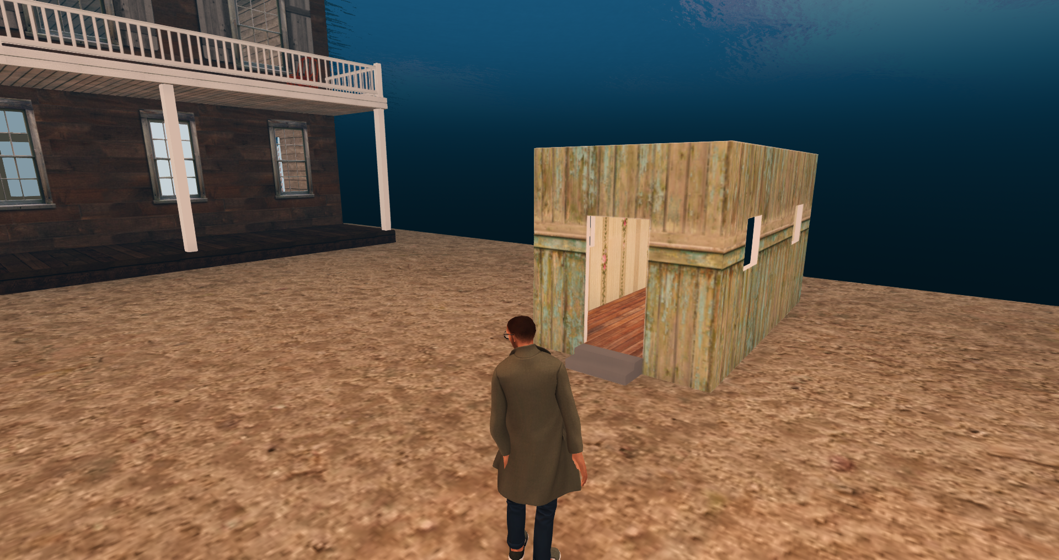
In World, the image looks great. You may need to change Features>Physics Shape Type from Convex Hull to Prim so you can enter the building. There may still be minor issues such as color and alignment

Slide 20
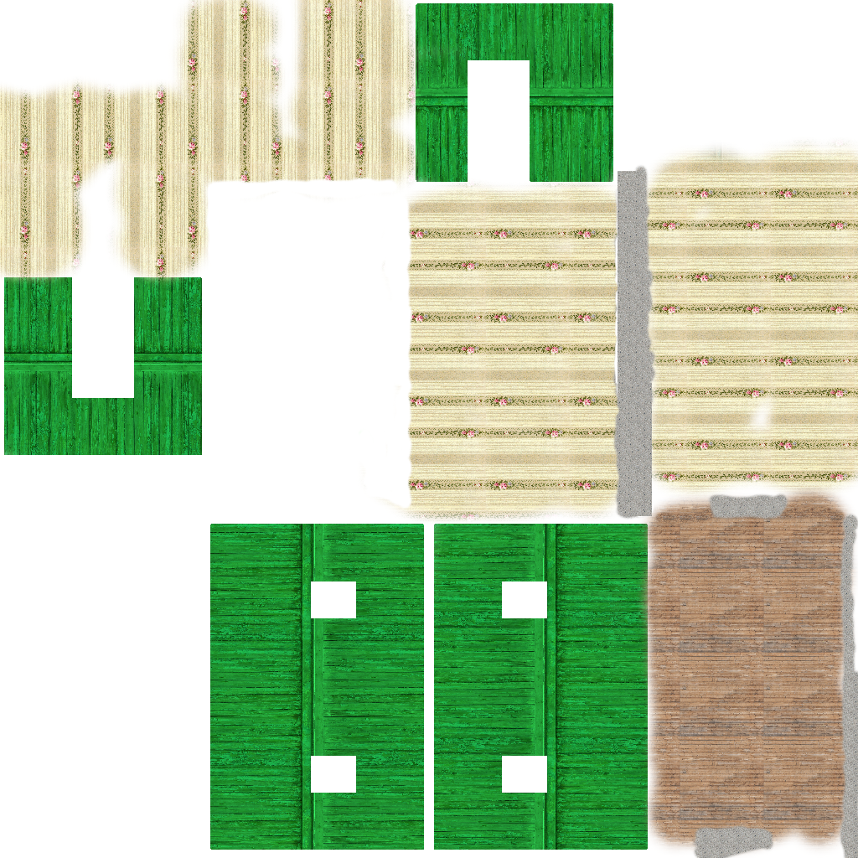
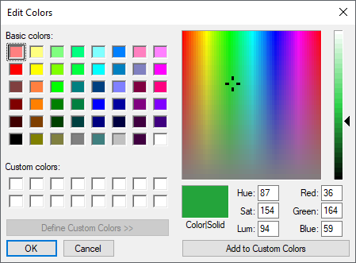
The original image for the outside wall had a “greener” undertone but I could not find the image for the one shown in the image map to the right. The RGB Hex code is approximately 24A43B

Slide 21
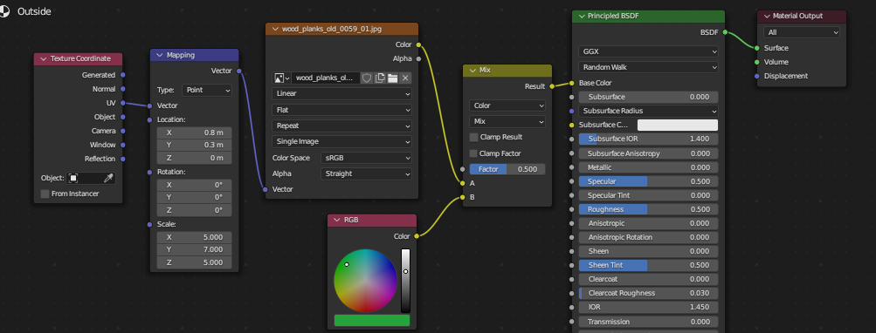
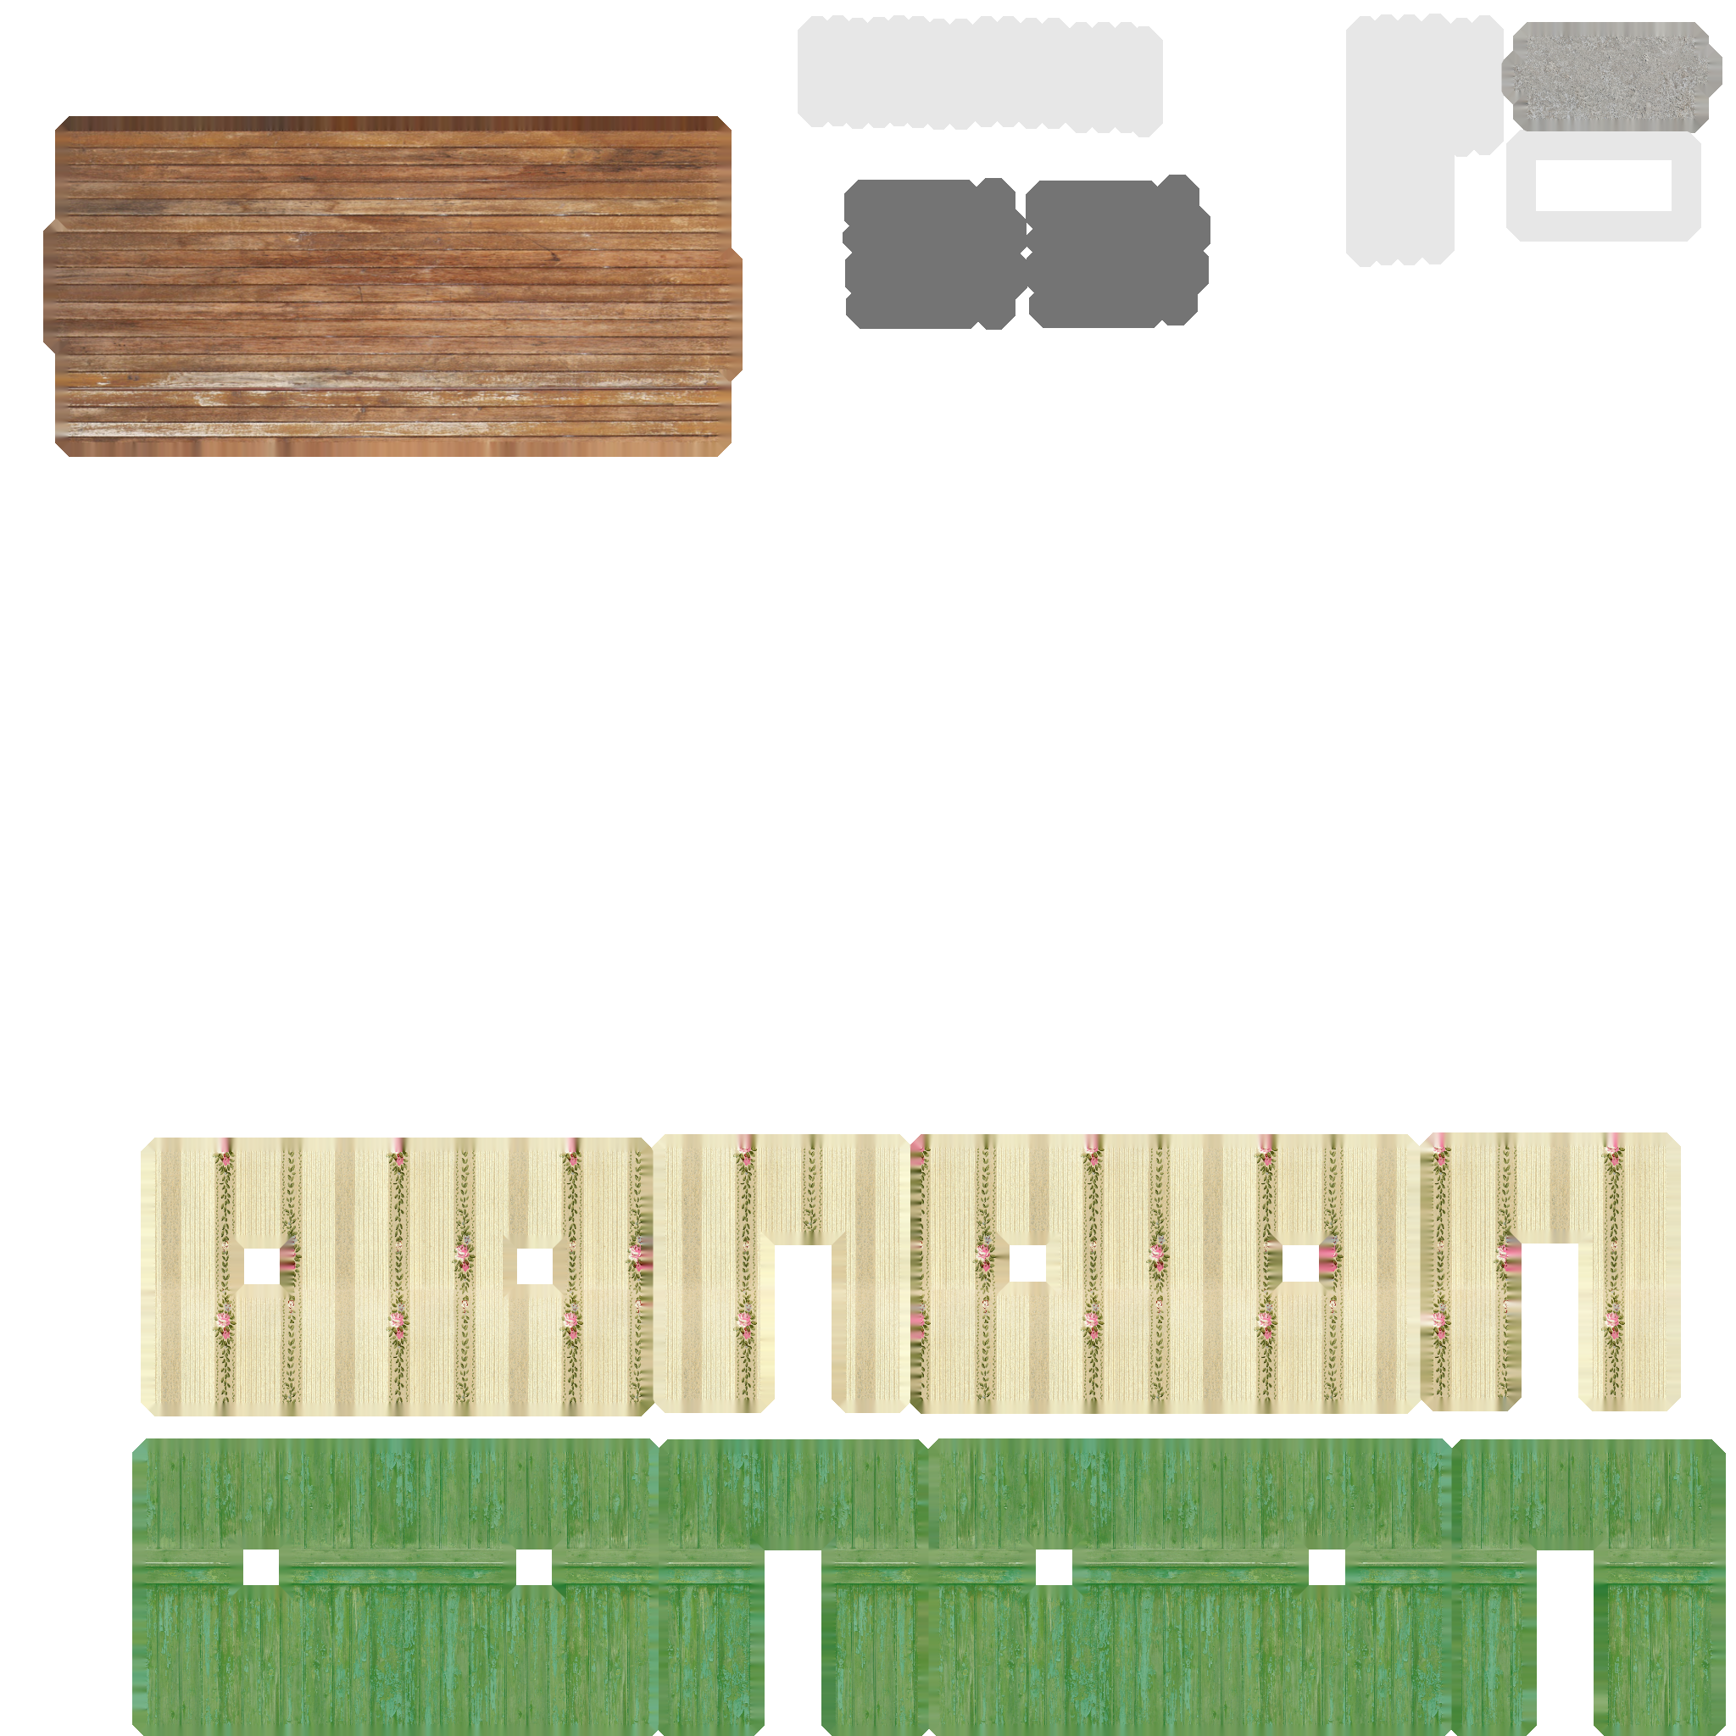
If we go back to the Outside material we could add a few more nodes to mix the RGB value with the outside texture image. When we do this we get the following composite image that can be applied to the sm house model…

Slide 22
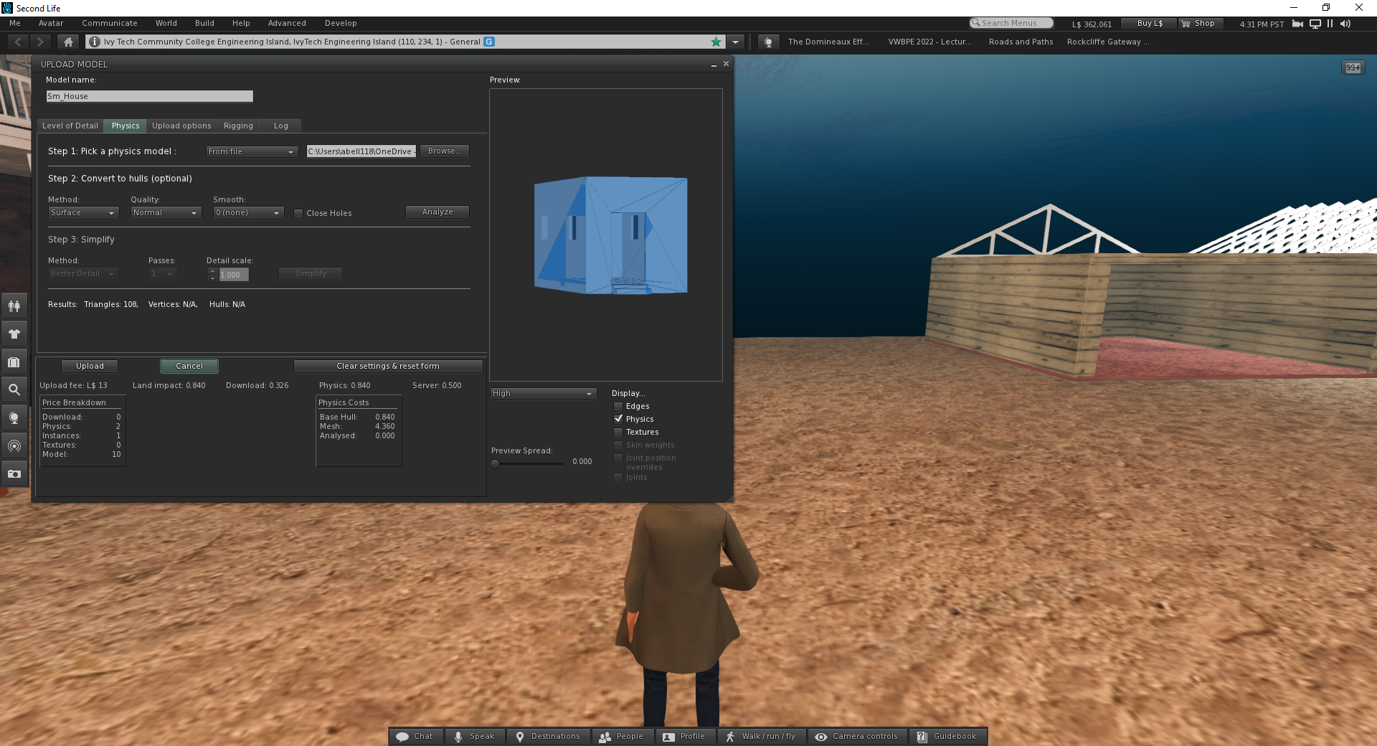

Slide 23
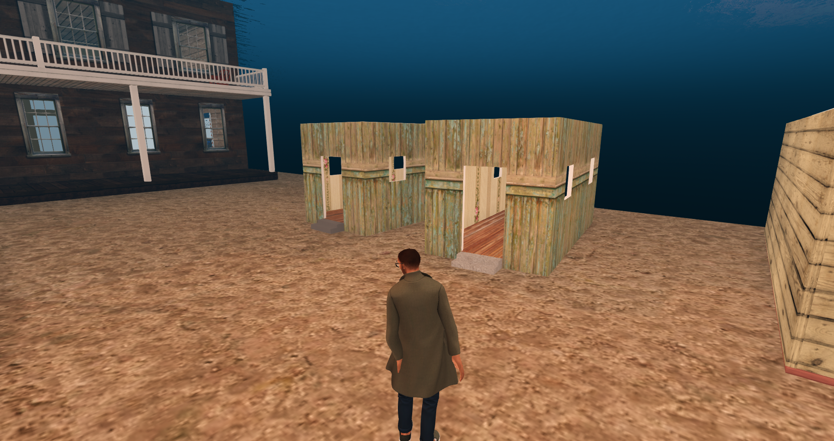
House on left done in Blender while house on right done in Second Life. Tiling may be a little different but SL looks better. It was a little fussy with getting all the surfaces textured, lol. All textures were uploaded to SL for the model on the right.

