Slide 1
Using Oculus Quest II VR Headset in Engineer and Technician Education
AGBell
7/29/2024
1

Slide 2
Developing VR Content for Unreal Engine
This presentation is show how to “develop” VR content for Unreal Engine (UE). This software can be freely downloaded and used to develop models and environments for VR headsets like the Oculus Quest II.
Getting Started
Making a poster
Getting a model
Importing a model
Model building outside Unreal Engine
Model building inside Unreal Engine
2

Slide 3
Developing VR Content for Unreal Engine – Getting Started
There are a number of software packages you will need to install on your computer ro build content for VR using Unreal Engine. To install software your will, need admin right on your computer and the computer will need to be capable of supporting VR (high end graphics).
Hardware –
Quad-core Intel or AMD, 2.5 GHz or faster
8 GB RAM
Windows 10/11
DirectX 11 or 12 compatible graphics card
Also, you will need hard drive space to save your files.
I use the Dell Alienware Aurora R16 computer with 32 GB of RAM and a 4TB external hard drive. You will also need a Meta Quest 2 or 3 headset with a PC Link Cable so your can upload content to the headsets. We also purchased some docking stations for charging the controllers and headset.
3

Slide 4
Developing VR Content for Unreal Engine – Getting Started
There are a few software packages you will need to build content for VR using Unreal Engine. To install software your will, need admin right on your computer and the computer will need to be capable of support VR (high end graphics).
Software –
Epic Games Launcher
Meta Quest Developer Hub
Oculus App
Unreal Engine 5
Visual Studio - Latest Community Version
Android Studio
Oculus Developer Account
Oculus Mobile App - latest version
Blender
Sidequest
Maybe a CAD program like AutoCAD and/or Solidworks
Maybe Maya
4

Slide 5
Developing VR Content for Unreal Engine – Getting Started
Epic Games Installer - latest version
Oculus - latest version
Meta Quest Developer Hub - latest version
Android Studio - Android Studio Flamingo | 2022.2.1 Patch 2 May 24, 2023.
Visual Studio - Latest Community Version
May also need to have the Oculus App on your phone to enable the development mode for each of your headsets.
5

Slide 6
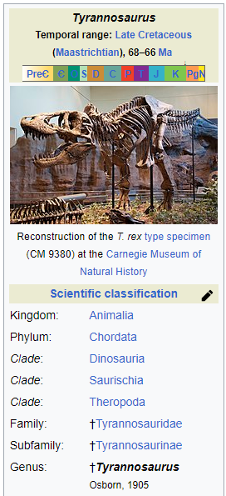
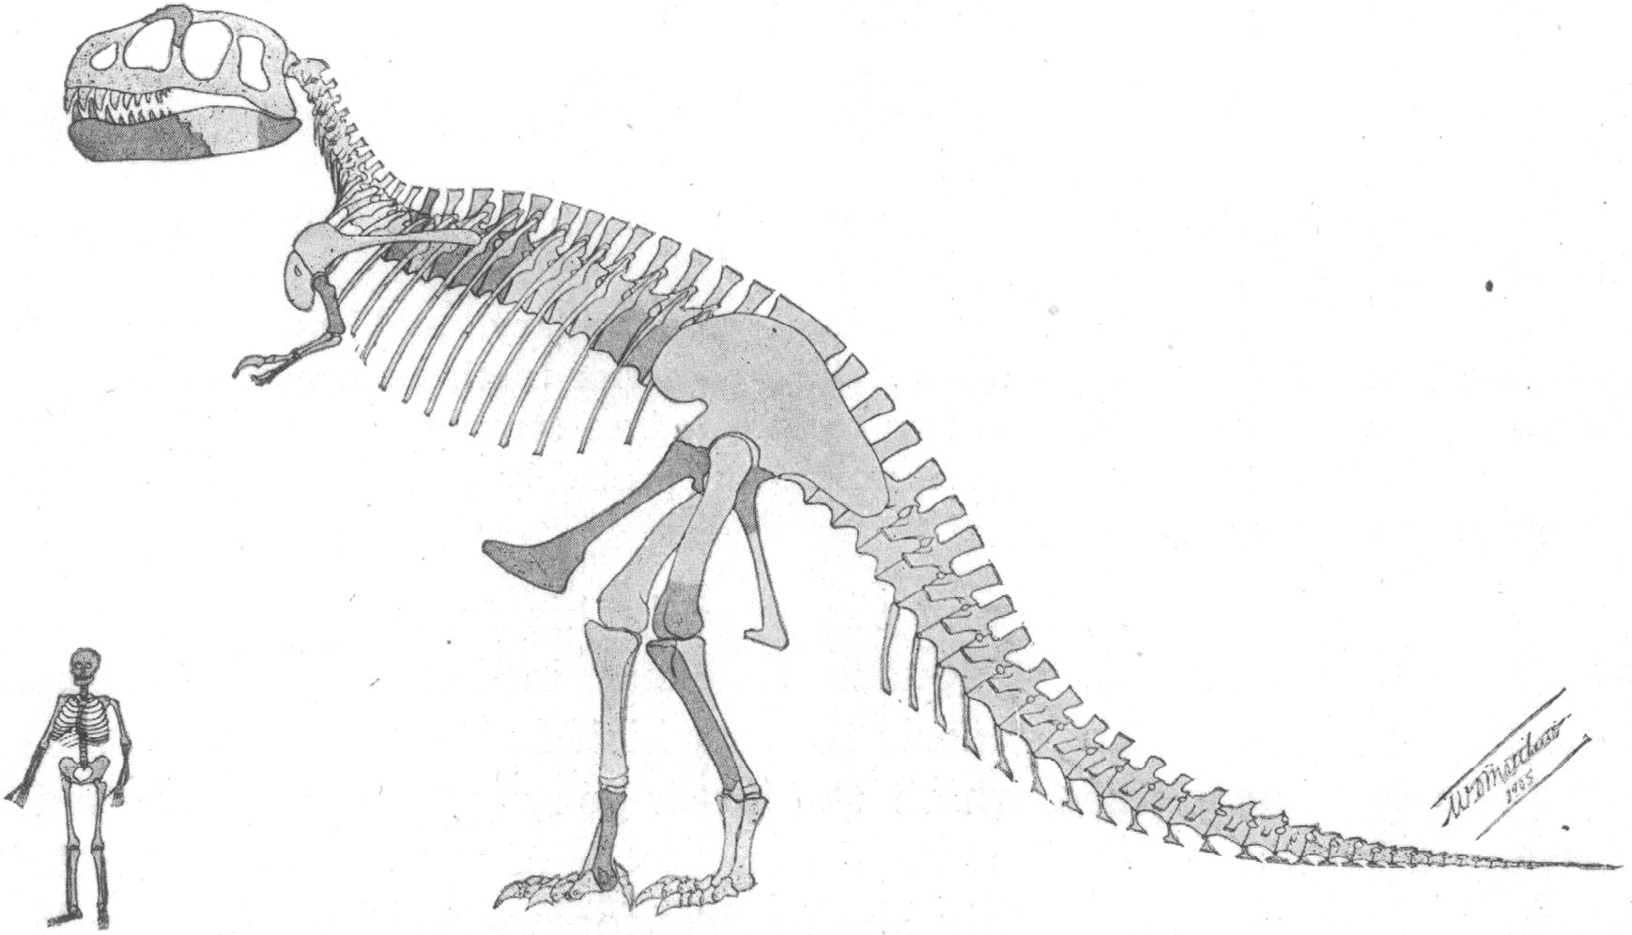
Developing VR Content for Unreal Engine
You must first decide what you want to use in VR. You can develop your own assets (models) using Blender, Maya, Solidworks, AutoCAD or some other tool or you can find 3D models on the web at GrabCAD, Thingiverse, etc.
Info - https://en.wikipedia.org/wiki/Tyrannosaurus
3D Model - https://www.thingiverse.com/thing:308335
6

Slide 7
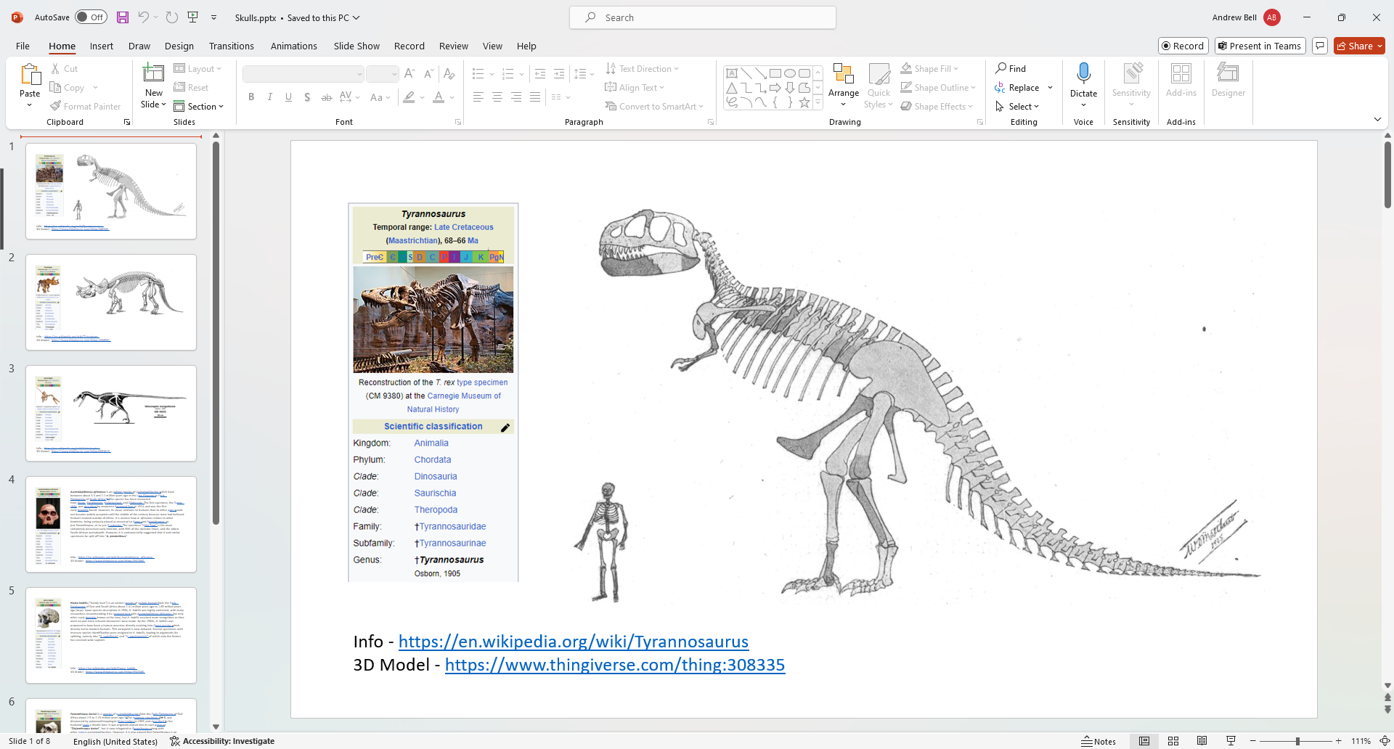
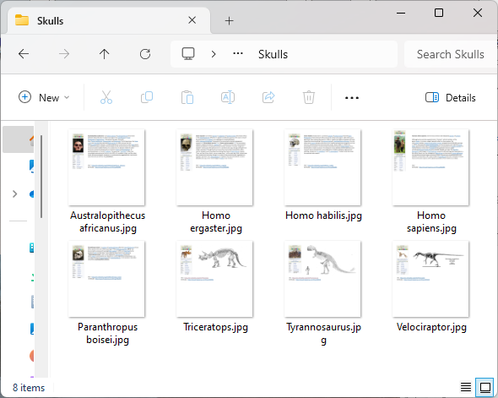

Developing VR Content for Unreal Engine - Making a poster
If you want a poster then an images can be created with the MS Paint, PowerPoint, or other tools. Many Posters are created with PowerPoint and then the slides are saved as images and can be used as materials or textures in Unreal Engine
7

Slide 8
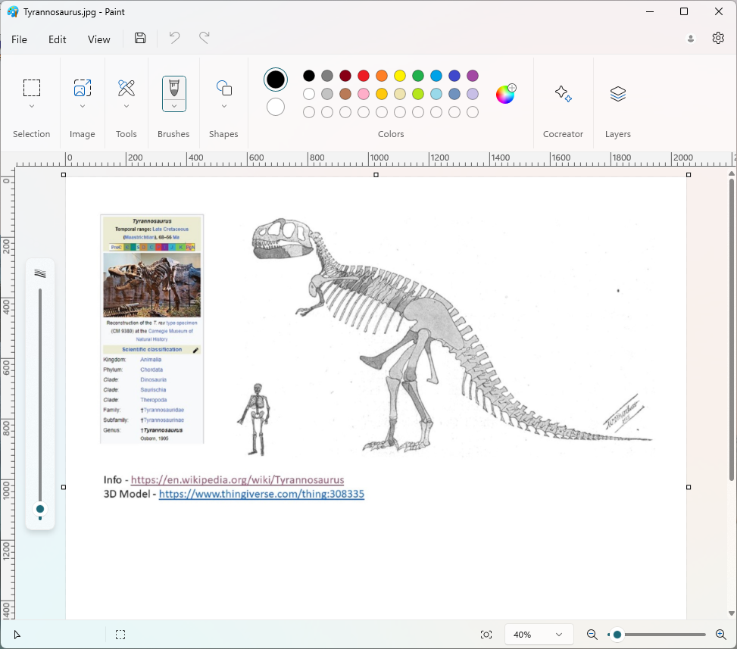
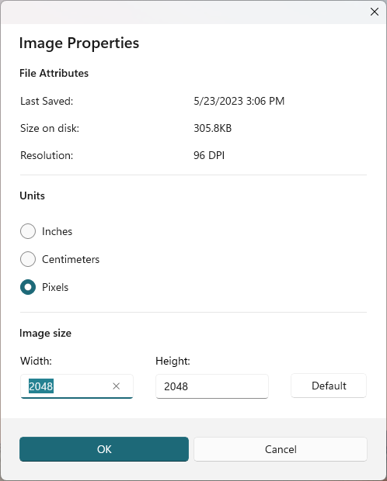
Developing VR Content for Unreal Engine - Making a poster
Posters can be presented in Unreal Engine on actors (assets that are displayed in the level) as a material. The image to be applied can be a square image that is related to a power of 2, i.e., 1024 by 1024, 2048 by 2048.
8

Slide 9
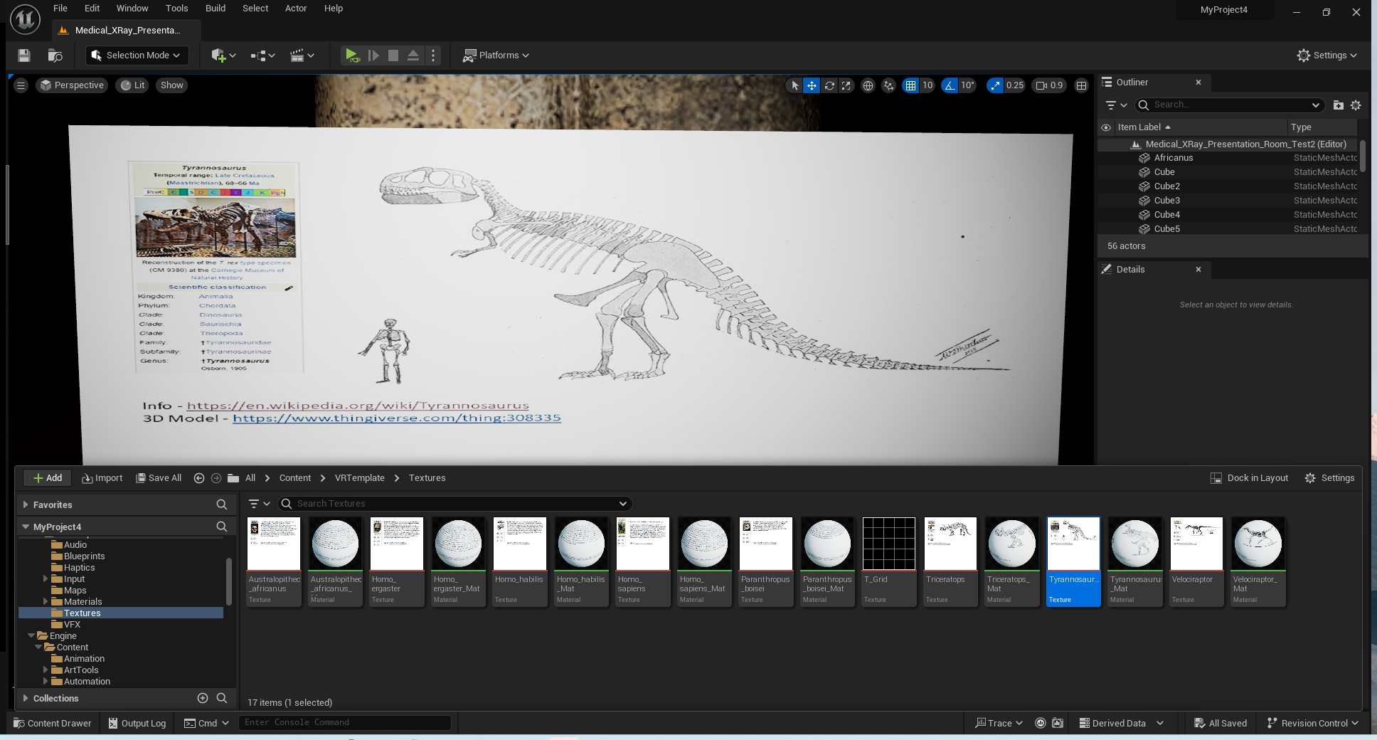
Developing VR Content for Unreal Engine - Making a poster
Open the Content Folder and make a directory for “Textures”. Import the image you want to use as the poster into your project. Then edit the image.
9

Slide 10
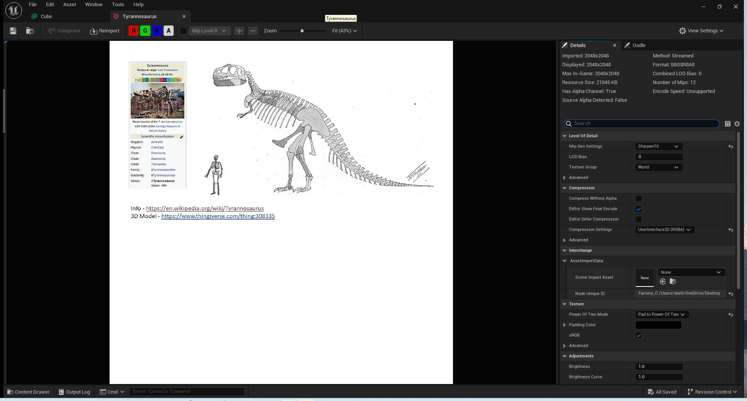
Developing VR Content for Unreal Engine - Making a poster
Make three modifications to the image:
1.) Compression Settings > UserInterface2D (RGBA)
2.) Power of Two Mode > Pad to Power of Two
3.) Mip Gen Setting > Sharpen 10
10

Slide 11
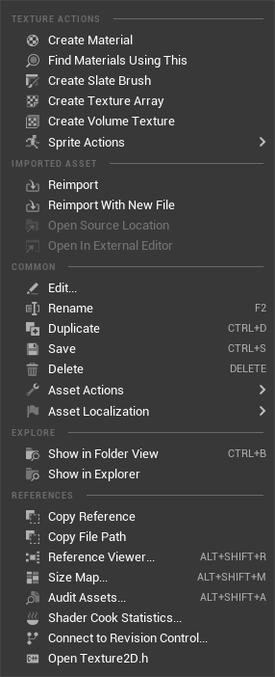
Developing VR Content for Unreal Engine - Making a poster
Next, create a material from the texture. This can then be applied to the poster. You can also create a Materials Folder and move the material file, but I prefer keeping everything together.
11

Slide 12
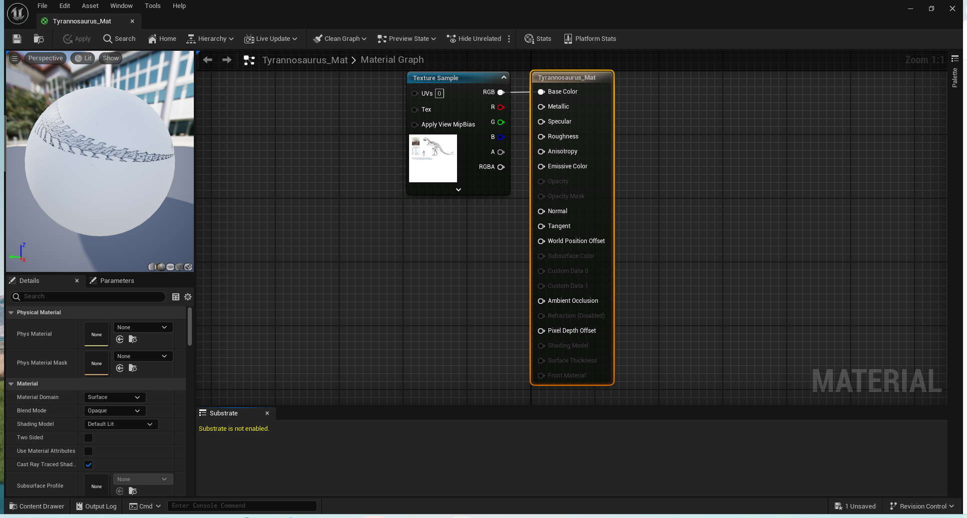
Developing VR Content for Unreal Engine - Making a poster
This is what the material looks like. Also, shown is the blueprint that is used to apply the material to a shape.
12

Slide 13
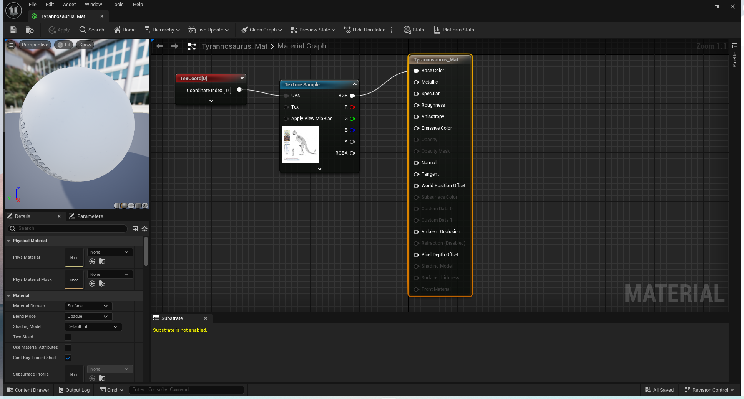
Developing VR Content for Unreal Engine - Making a poster
To align to the material to the shape you will need to add a TextureCoordinate to the UVs input in the Blueprint for the material. This will improve the image that is displayed on the poster.
13

Slide 14
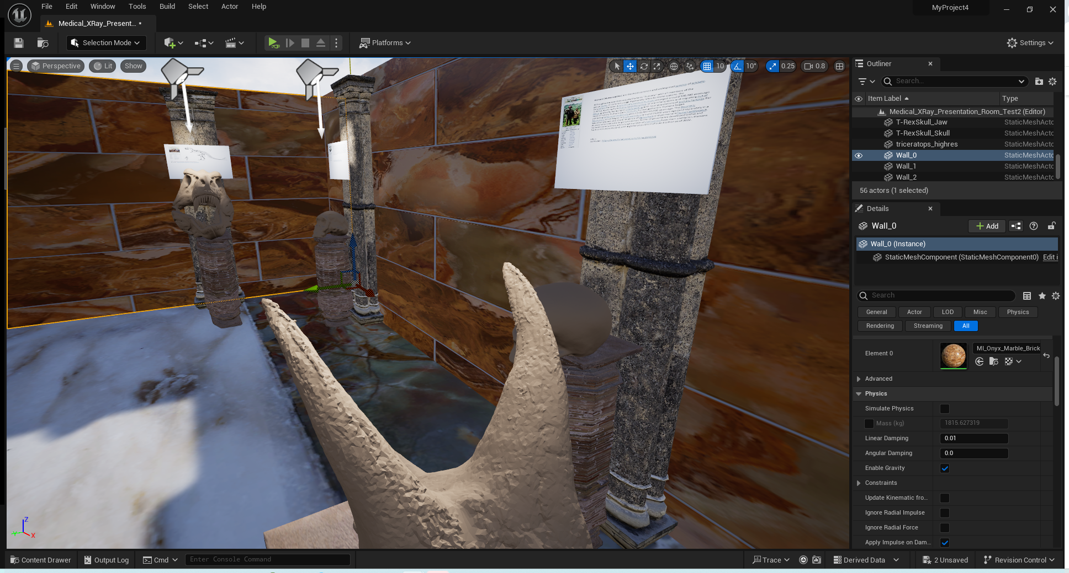
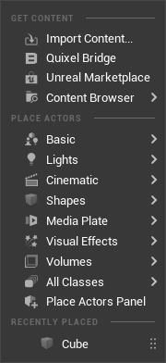
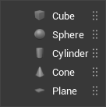
Developing VR Content for Unreal Engine - Making a poster
Create a basic Cube
14

Slide 15
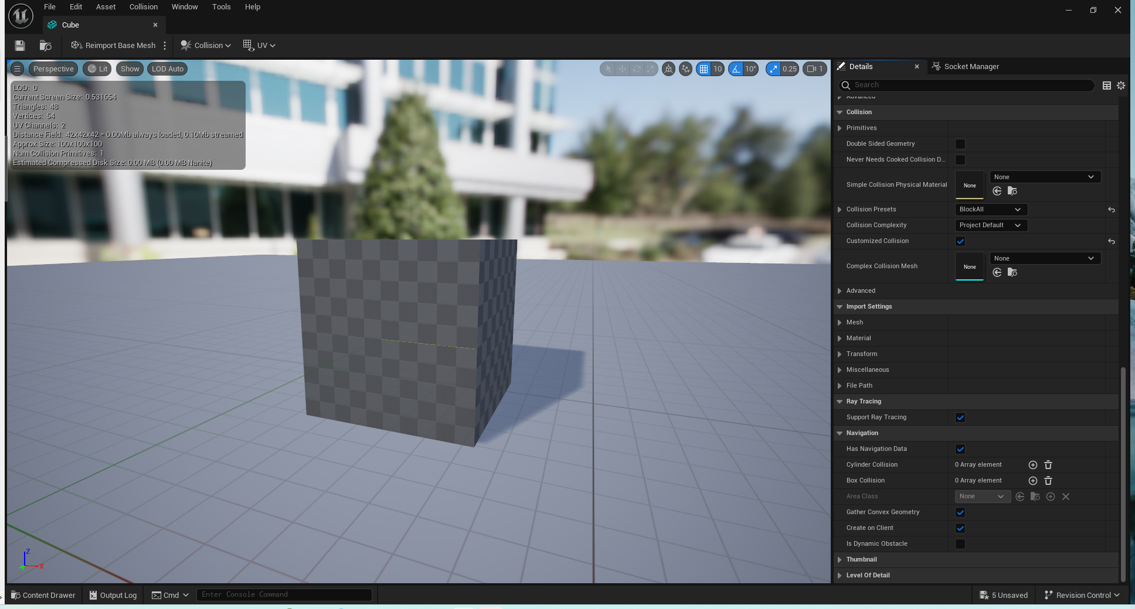
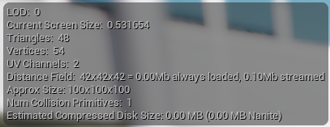
Developing VR Content for Unreal Engine - Making a poster
The cube is actually a 100 cm x 100 cm x 100 cm cube. Why?
15

Slide 16
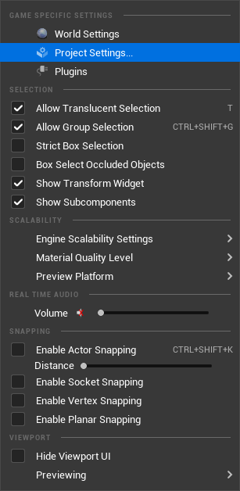
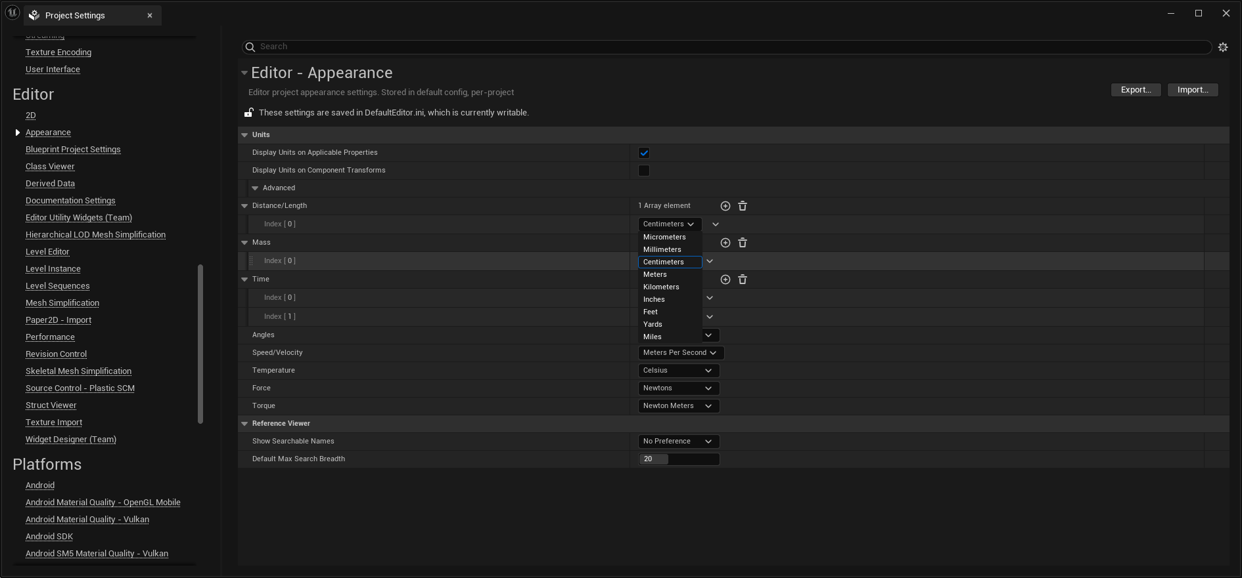
Developing VR Content for Unreal Engine - Making a poster
Ans - It is the default size.
In the Project Settings > Editor > Appearance we see the Distance/Length is in Centimeter. This can be changed if you want imperial or a different metric value. Some programs may use Meters as a default unit.
16

Slide 17
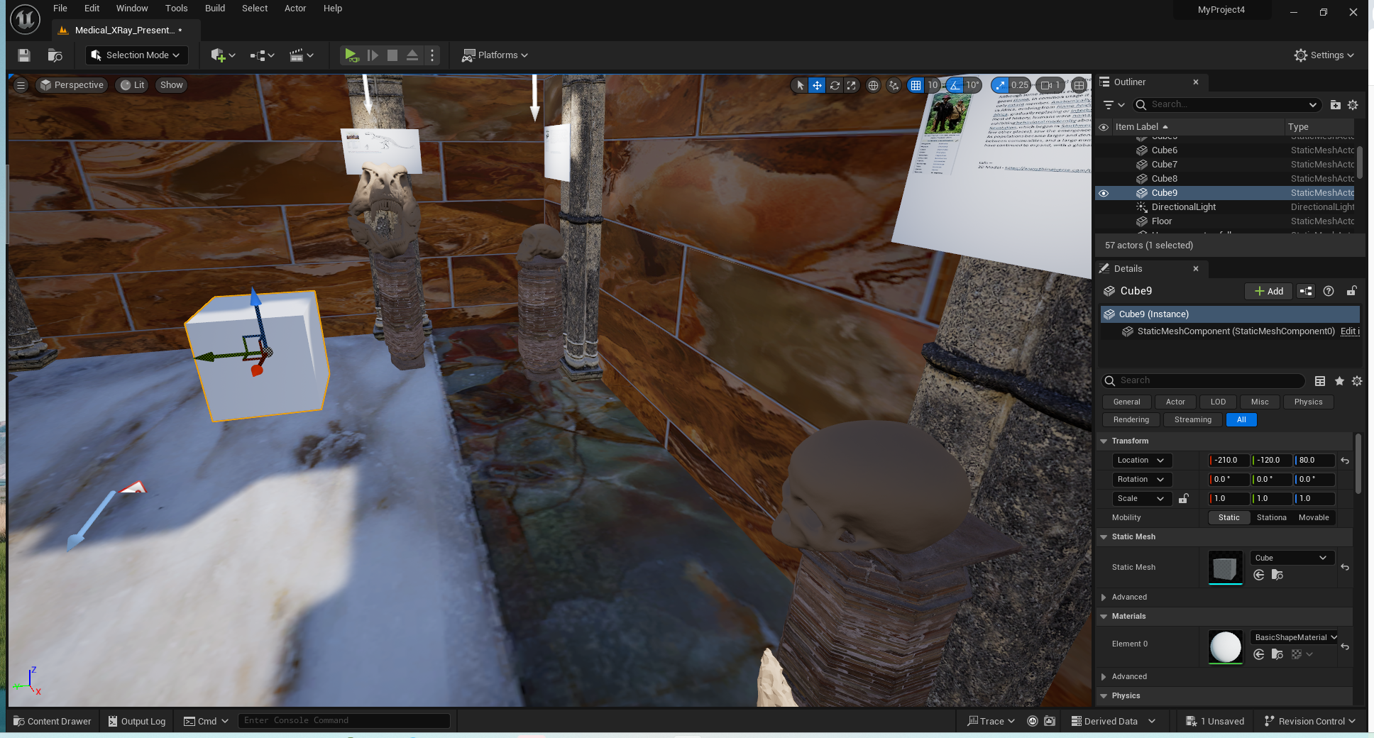
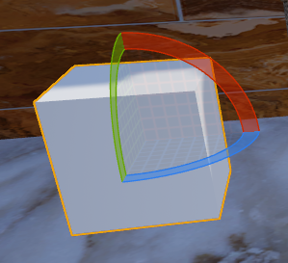
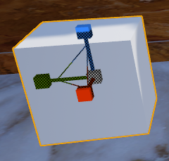
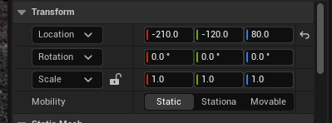
Developing VR Content for Unreal Engine - Making a poster
A shape’s size (scale), location and rotation can all be changed to place the object exactly where you want “in-world”. If you hit the Spacebar you can cycle through the three options to modify the object.
17

Slide 18
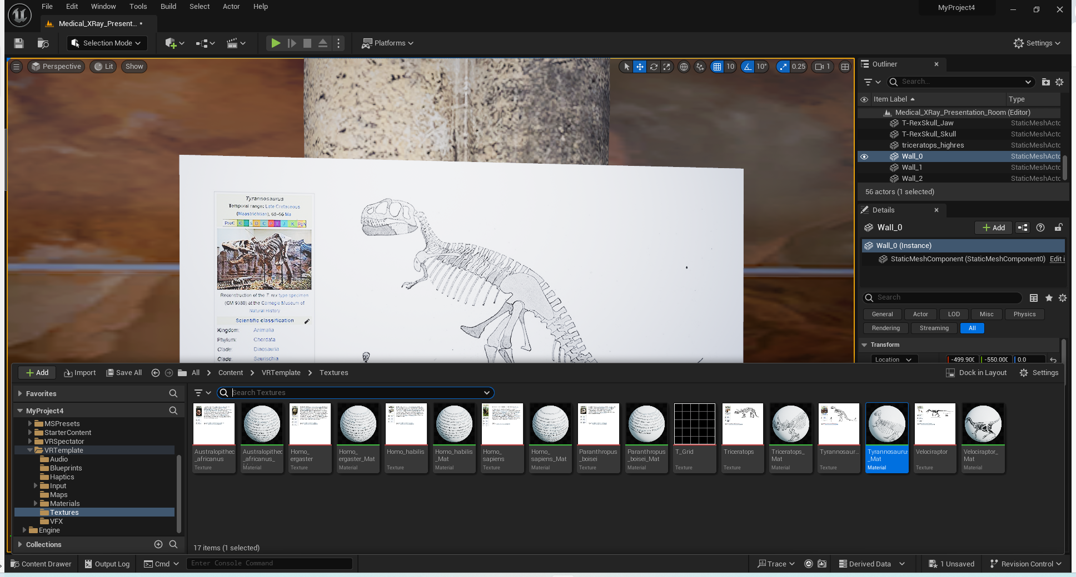
Developing VR Content for Unreal Engine - Making a poster
The poster displayed here is actually 1 meter wide by 0.56264 meters tall with a 0.01 meter thickness (16:9 aspect ratio) . UE is not a modeling tool so you must get use to scaling or building models outside UE.
The desired material can be added to the poster that is sized and placed where we want it.
X
18

Slide 19
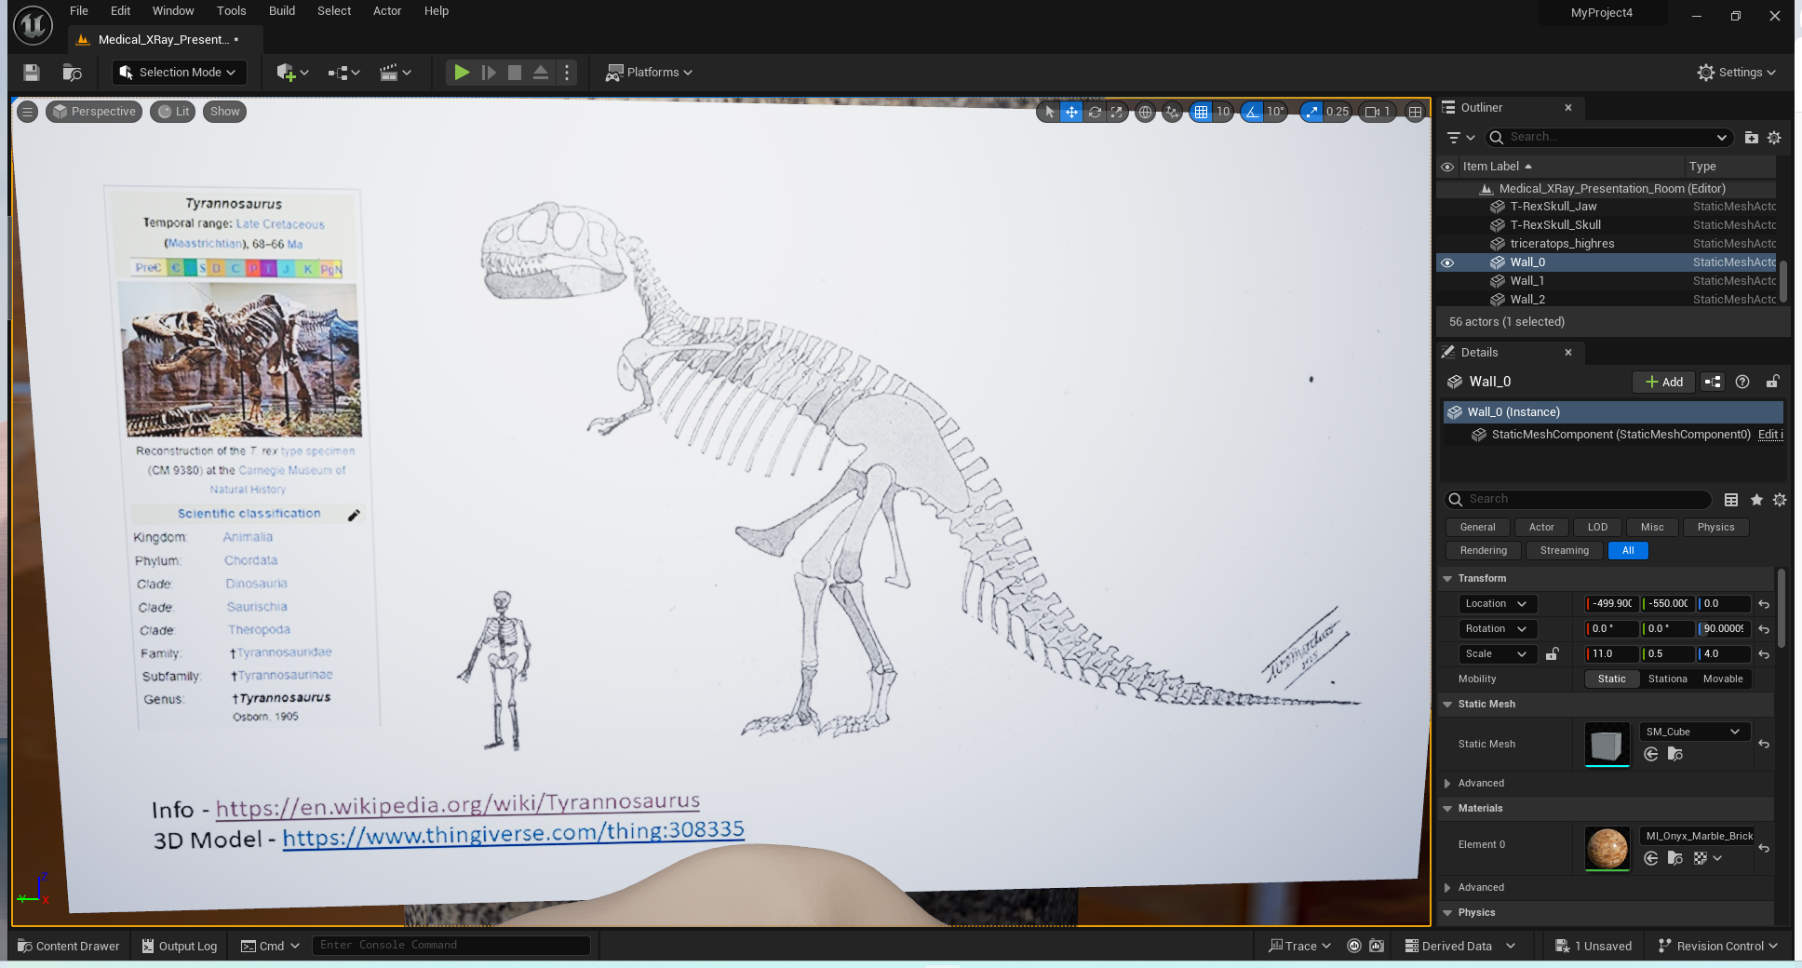
Developing VR Content for Unreal Engine - Making a poster
Finished poster.
19

Slide 20
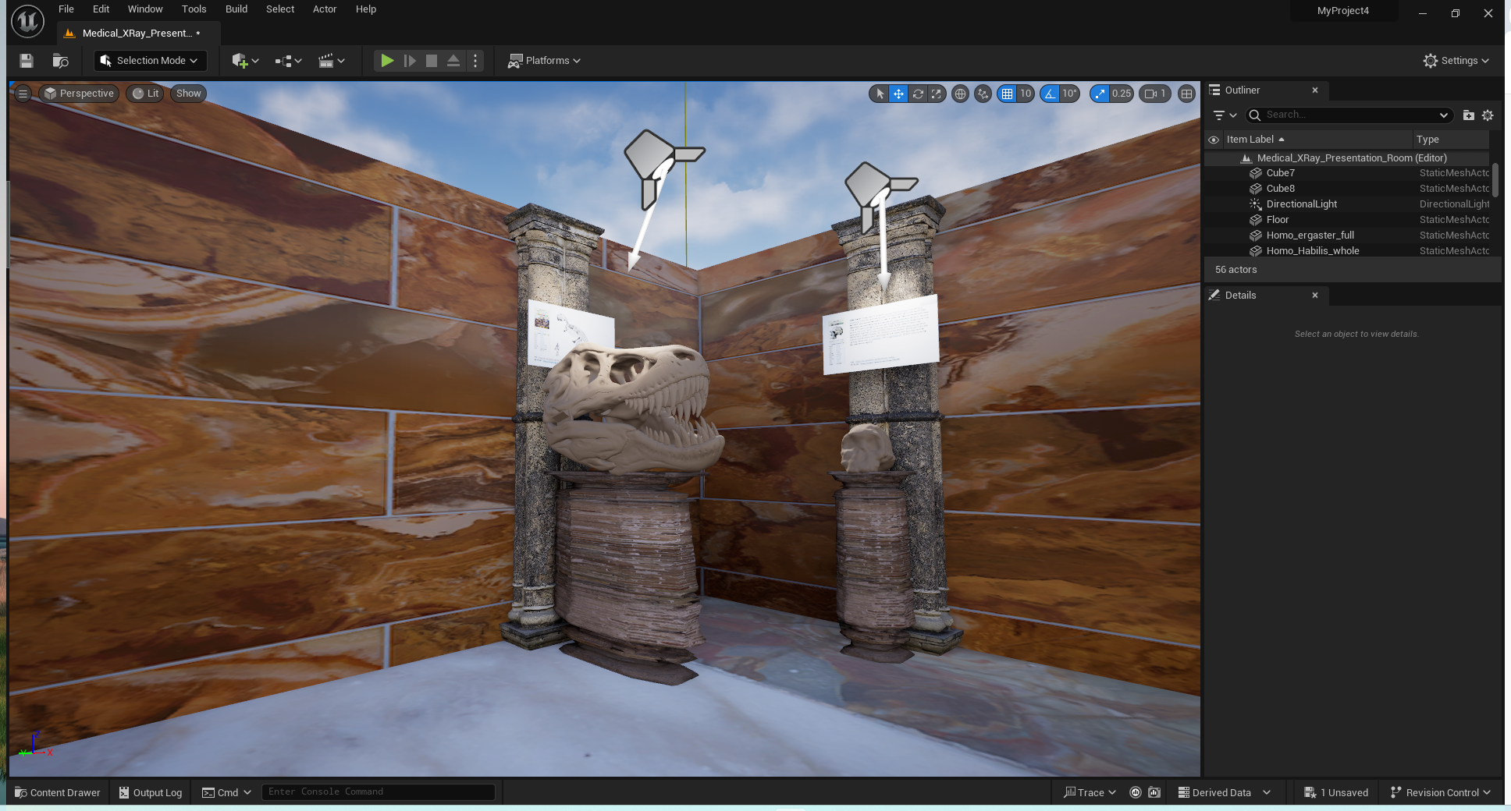
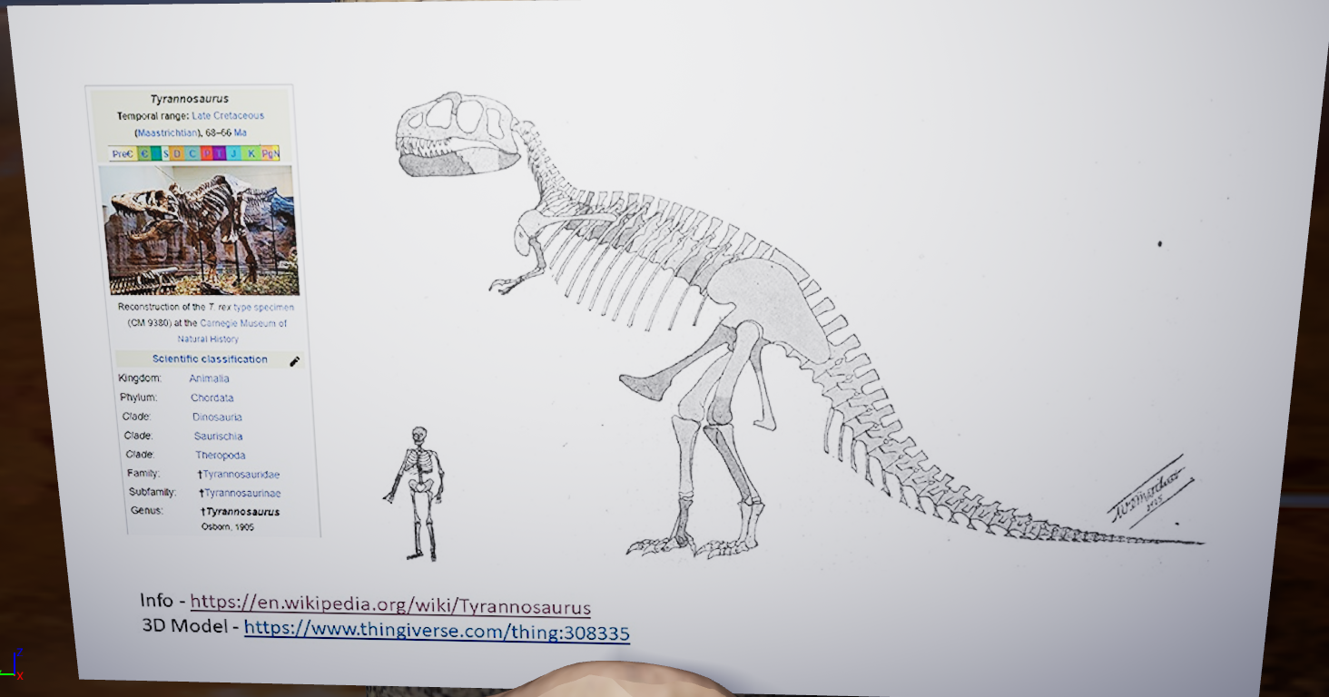
Developing VR Content for Unreal Engine - Making a poster
Posters can be placed in Unreal Engine and provide value information to the student. In world the student can move around to better view the posters. Poster size and location are important so that students can see the posters.
20

Slide 21
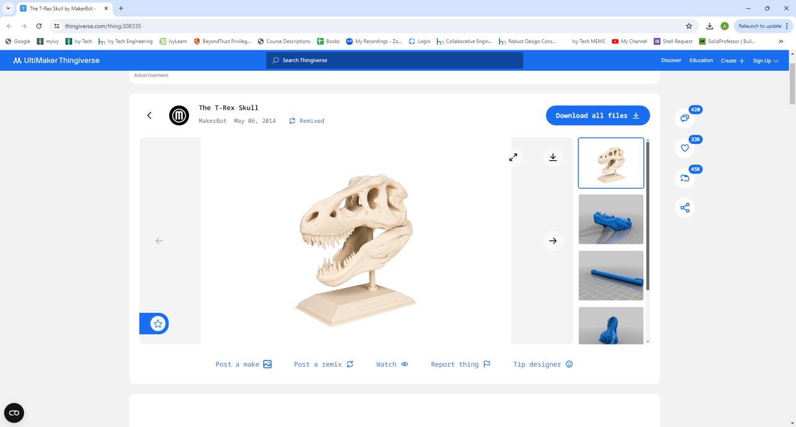
Developing VR Content for Unreal Engine - Getting a model
If you find something on the web you may need to convert it from an STL to a FBX or OBJ file. There are online tools you can use but I prefer to use Blender since you can also evaluate the complexity of the mesh.
21

Slide 22
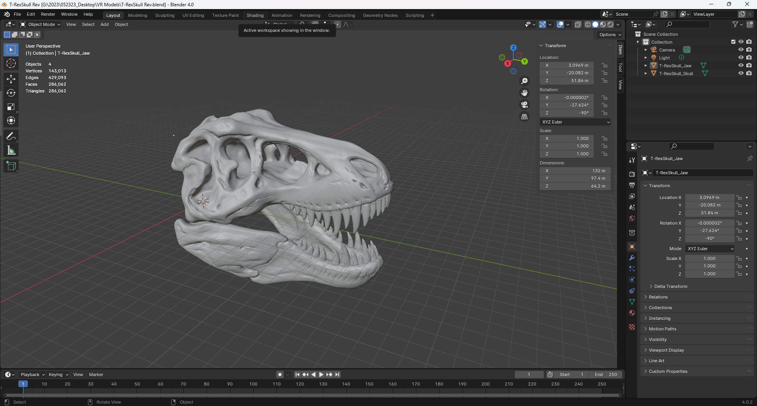
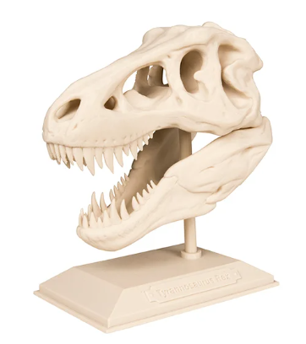
Developing VR Content for Unreal Engine - Getting a model
In Blender this is a very large model (286,062 tris). The physical size is 132 meters and needs to be scaled.
This is two models that were combined into a single model (skull and lower jaw)
22

Slide 23
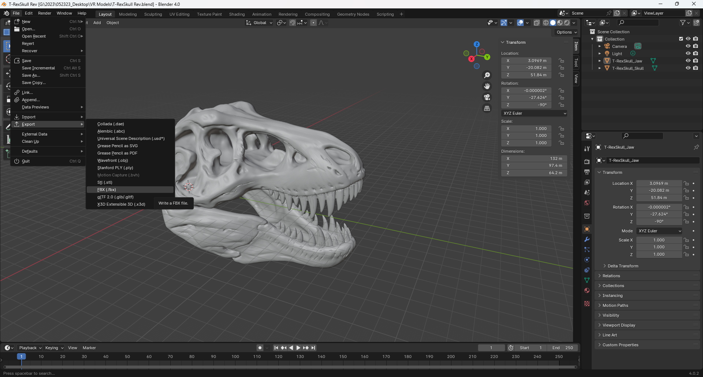
Developing VR Content for Unreal Engine - Getting a model
Model must be converted to be imported into Unreal Engine. We will use the FBX format.
23

Slide 24
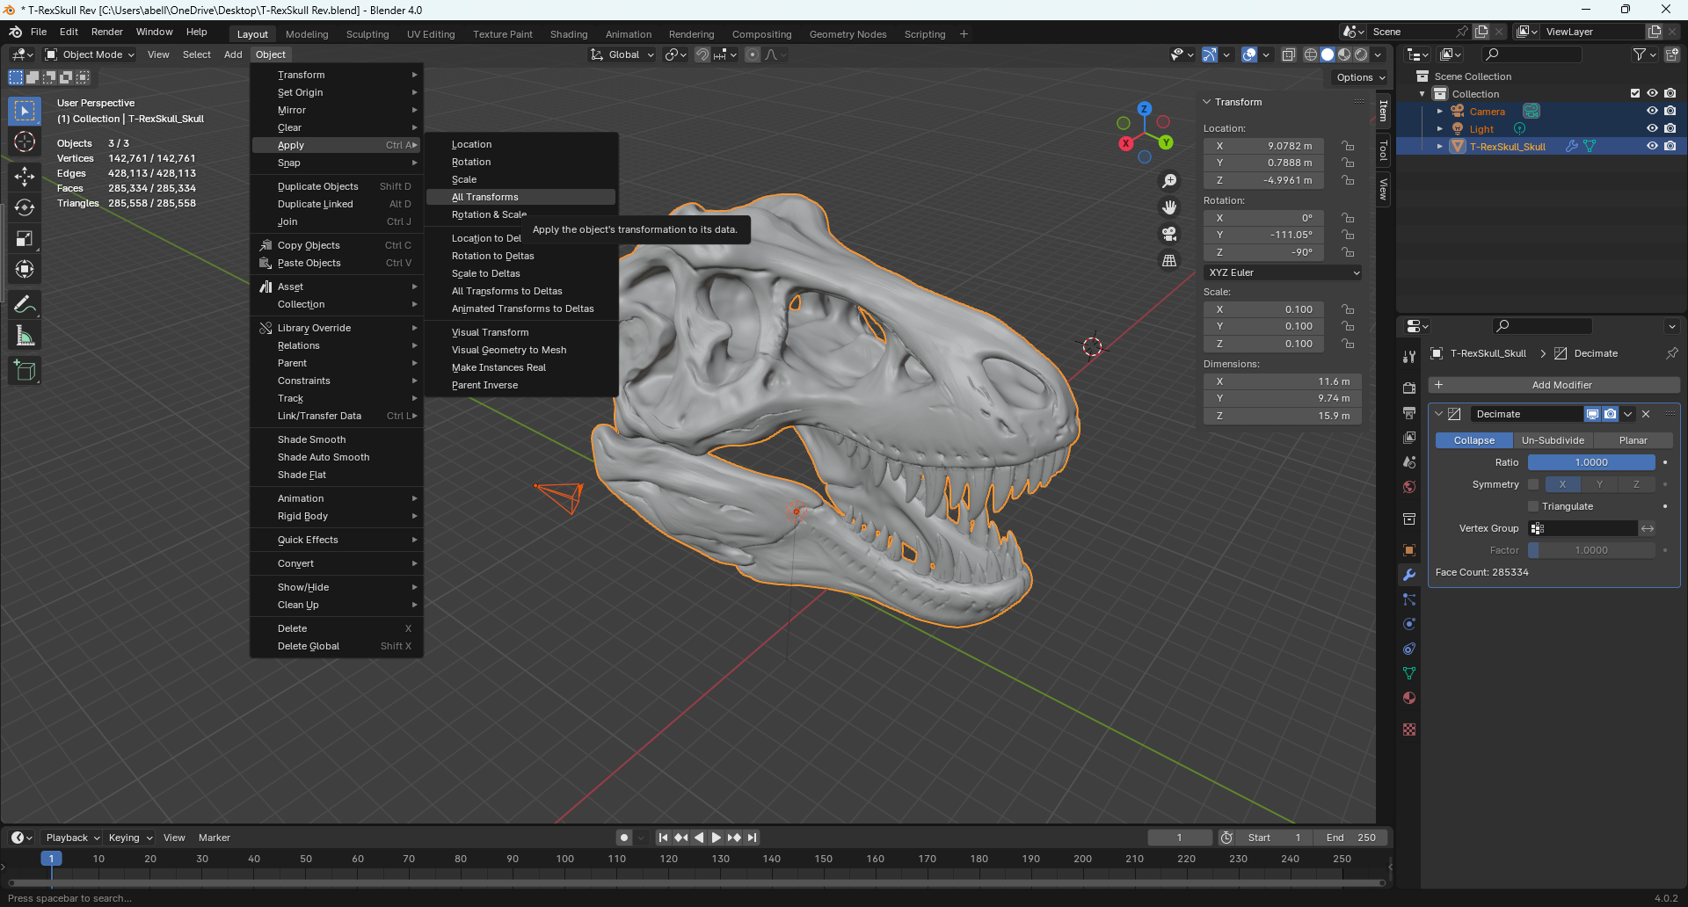
Developing VR Content for Unreal Engine - Getting a model
Prior to export it is a good practice to apply all transforms.
24

Slide 25
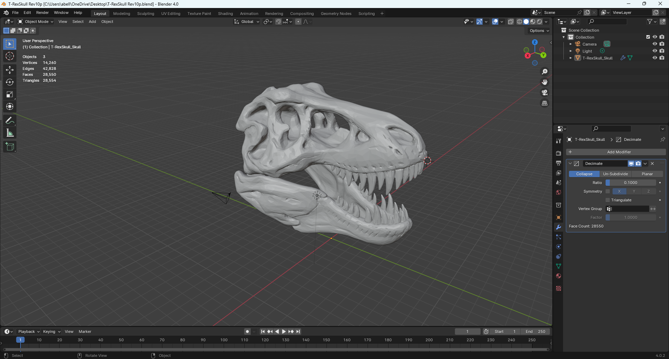
Developing VR Content for Unreal Engine - Getting a model
This is the decimated version of the model which should make it faster to render in Unreal Engine. Decimation can be performed in Blender and the technique used is a simple Collapse to 10% of the original mesh size.
25

Slide 26
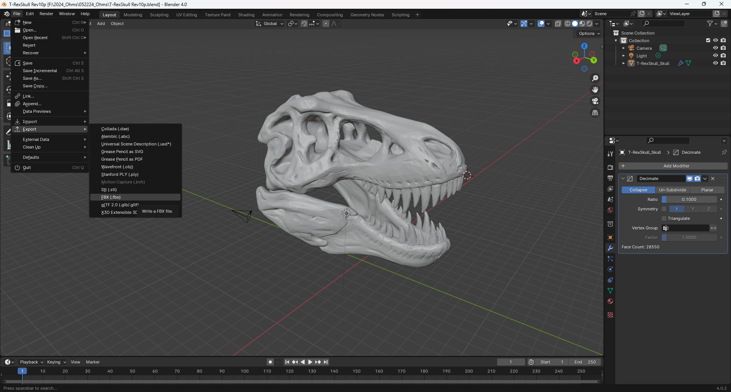
Developing VR Content for Unreal Engine - Getting a model
The model can now be converted into a fbx format and imported into Unreal Engine..
26

Slide 27
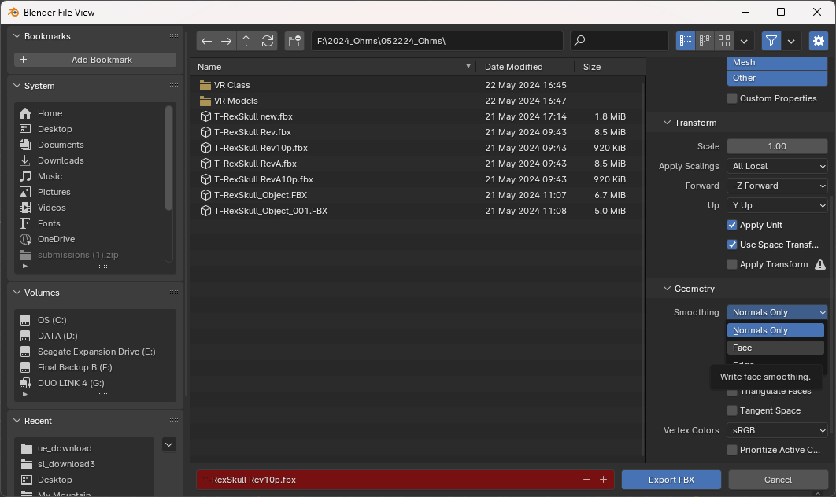
Developing VR Content for Unreal Engine - Getting a model
Unreal engine may complain about the model so you can also apply “face smoothing” to the fbx model and then export it.
27

Slide 28
Developing VR Content for Unreal Engine - Building a model
You can also build your own models using Solidworks, AutoCAD and/or Blender. Since we use Solidworks in our AS degrees this is how you would build models for Unreal Engine.
Step 1 – Design and build your model.
Step 2 – Export model as an STL file from Solidworks.
Should maintain dimensional integrity.
STL files can also be used for 3D printing.
Step 3 – Import STL file into Blender.
Model can be scaled and decimated to reduce the size of the mesh model.
Lower poly models should be your goal, but model complexity should be
balanced against how the model looks in VR.
Step 4 – Export STL file from Blender as an FBX.
Blender can support the model but may want to add face smoothing.
Always save your Blend file.
Step 5 – Import FBX file into Unreal Engine.
There are more details that could be shared regarding UV Maps, textures and materials using Blender. I would strongly encourage that you learn and use Blender to support developing VR content.
28

Slide 29
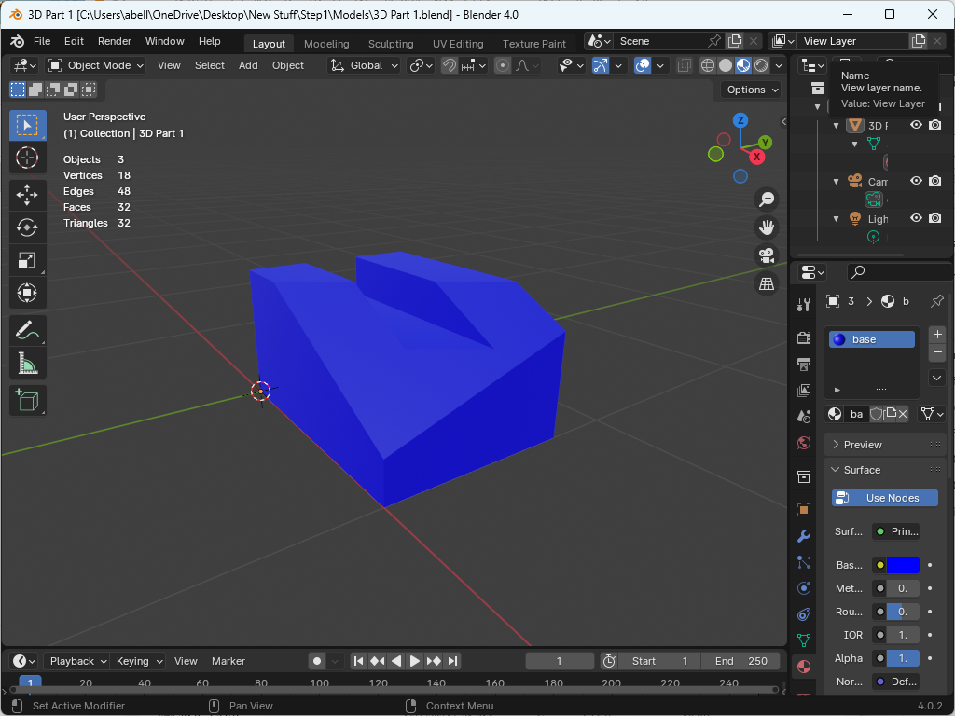
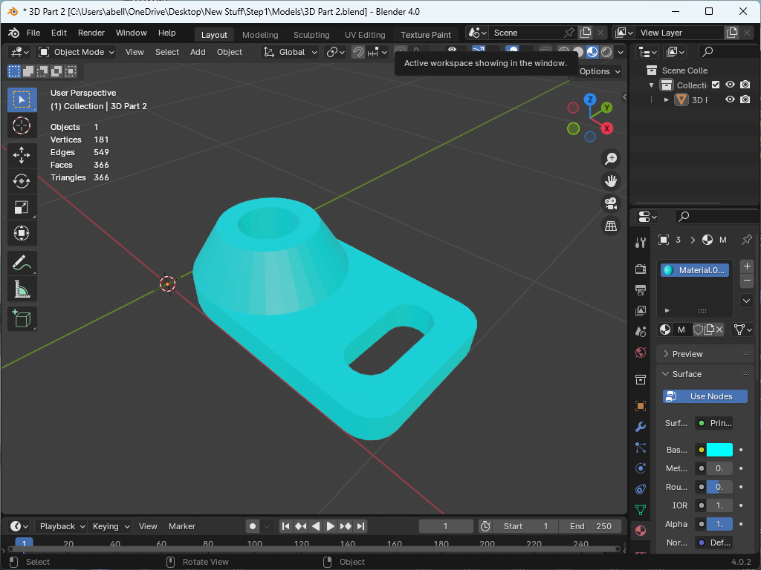
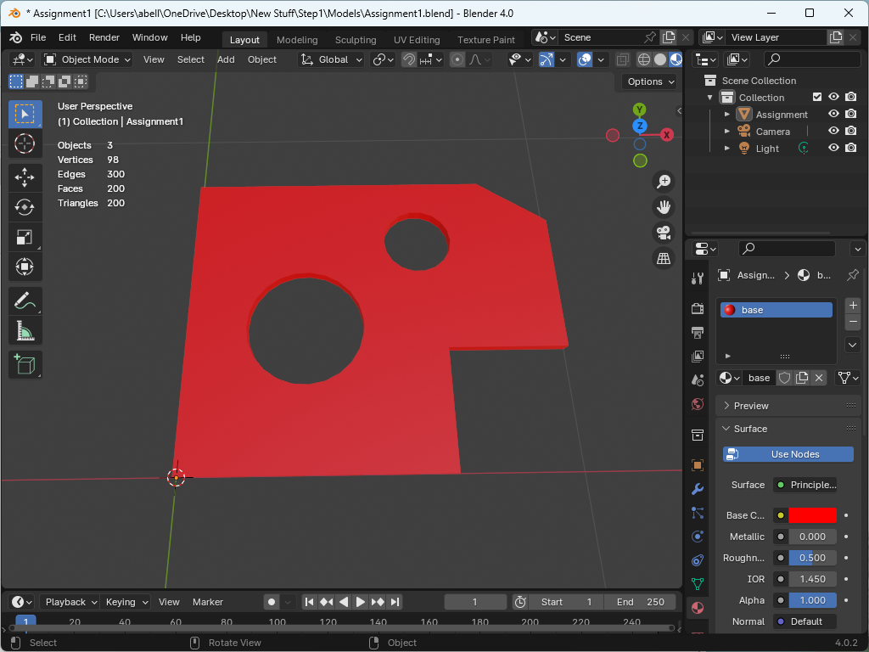
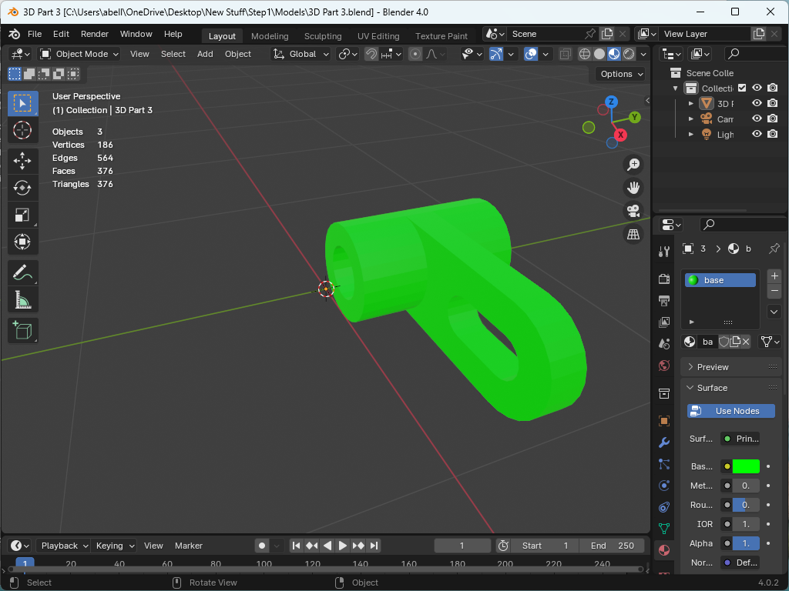
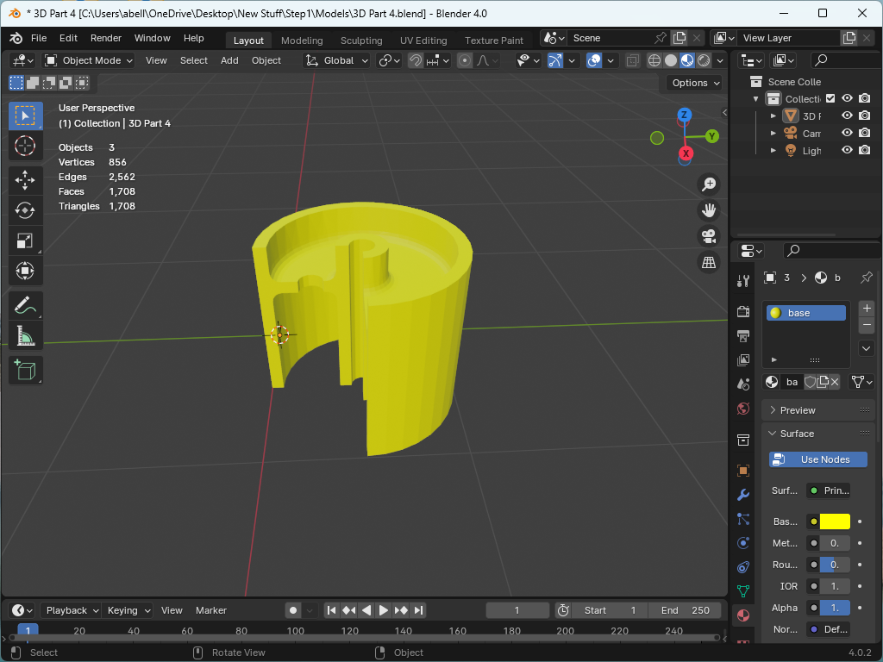
Developing VR Content for Unreal Engine - Building a model
Here are examples of 5 CAD models built with AutoCAD and Solidworks. These models were exported as STL files and then converted to FBX files for Unreal Engine. (Note the number of the “Triangles” is relatively low so these would be low poly models.
29

Slide 30
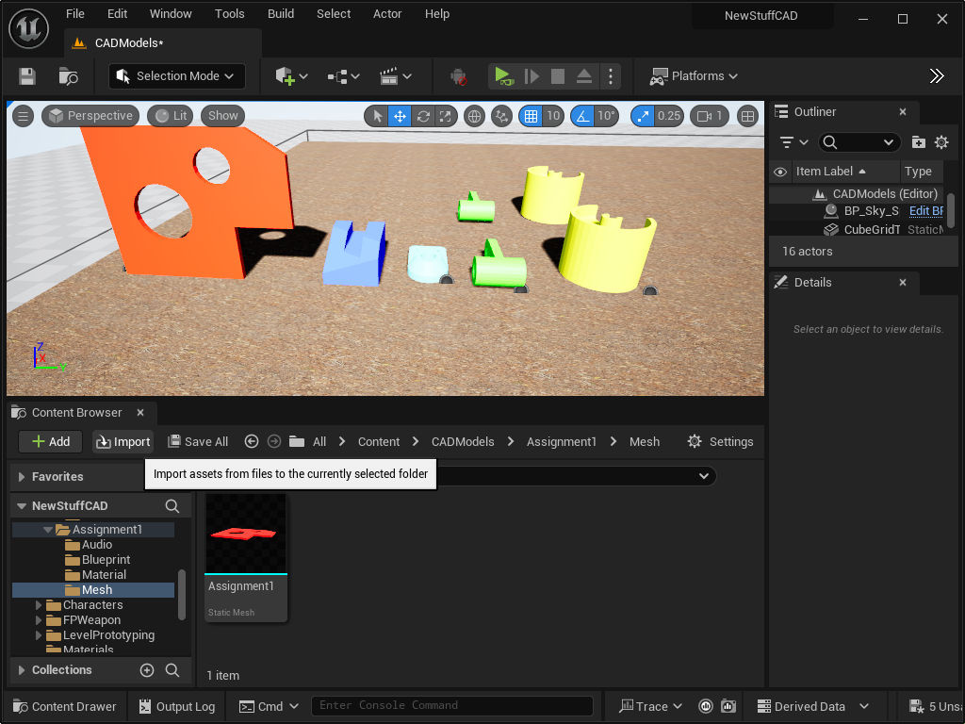
Developing VR Content for Unreal Engine - Building a model
Within Unreal Engine you should create a folder for each model and import the mesh (FBX file) into the folder you create called “Mesh”. You can also import the material (texture) of the model as well or add the texture within Unreal Engine.
All five models were imported into a folder call CAD Models and then placed within a scenario to view and interact with.
30

Slide 31
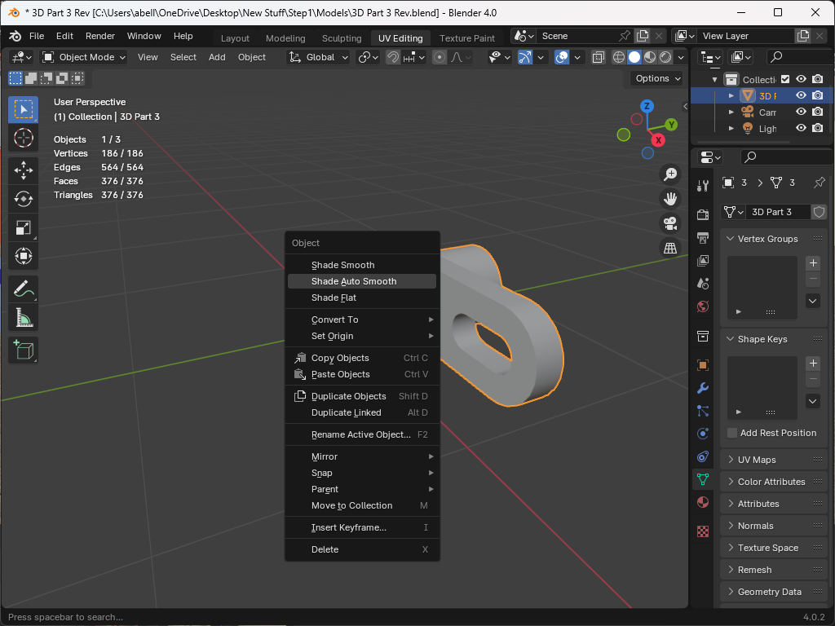
Developing VR Content for Unreal Engine - Building a model
For the more complicated models that include circular faces I did a Shade Auto Smooth in Blender. This greatly improved the quality of the model in VR.
Mesh density and lighting will continue to be an issue as you use more complicated models. To get it “right” will take some research and experimentation.
31

Slide 32
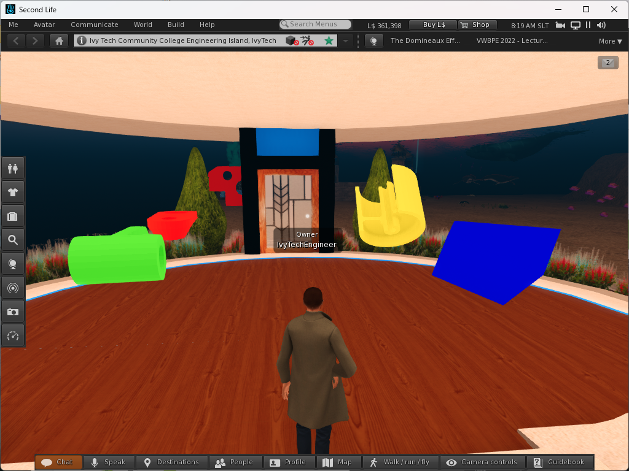
Developing VR Content for Unreal Engine - Building a model
These are the five CAD models that were uploaded to Second Life. A script was also added (shown below) to the models so they would freely spin. These models are DAE files but were produced using the same Solidworks (STL) models with Blender.
default
{
state_entry()
{
llTargetOmega(<1.0,1.0,1.0>*llGetRot(),0.1,0.01);
}
}
32

Slide 33
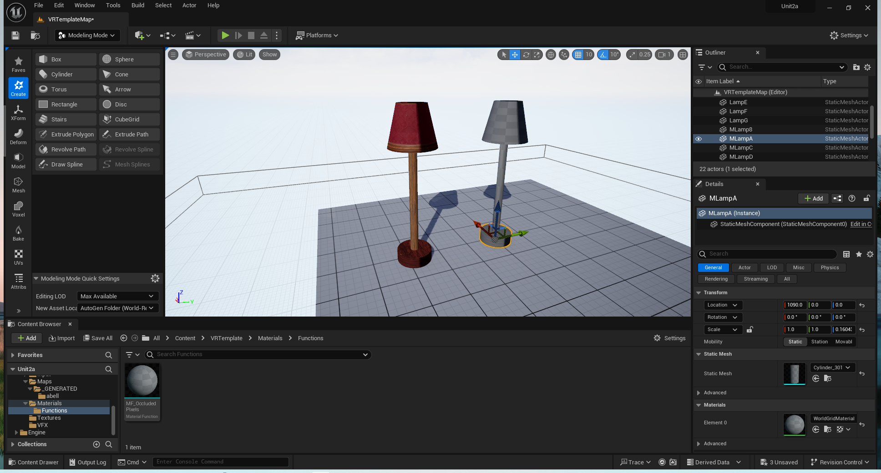
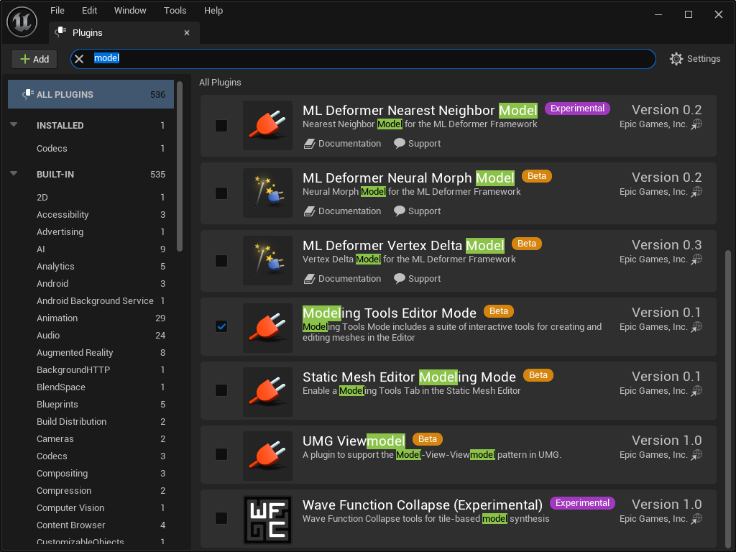
Developing VR Content for Unreal Engine - Building a model inside Unreal Engine
To build a model using Unreal Engine requires multiple steps. The first step is to add the “Modeling Tool Editor” plugin. This plugin will help you create models that can be used in VR.
33

Slide 34
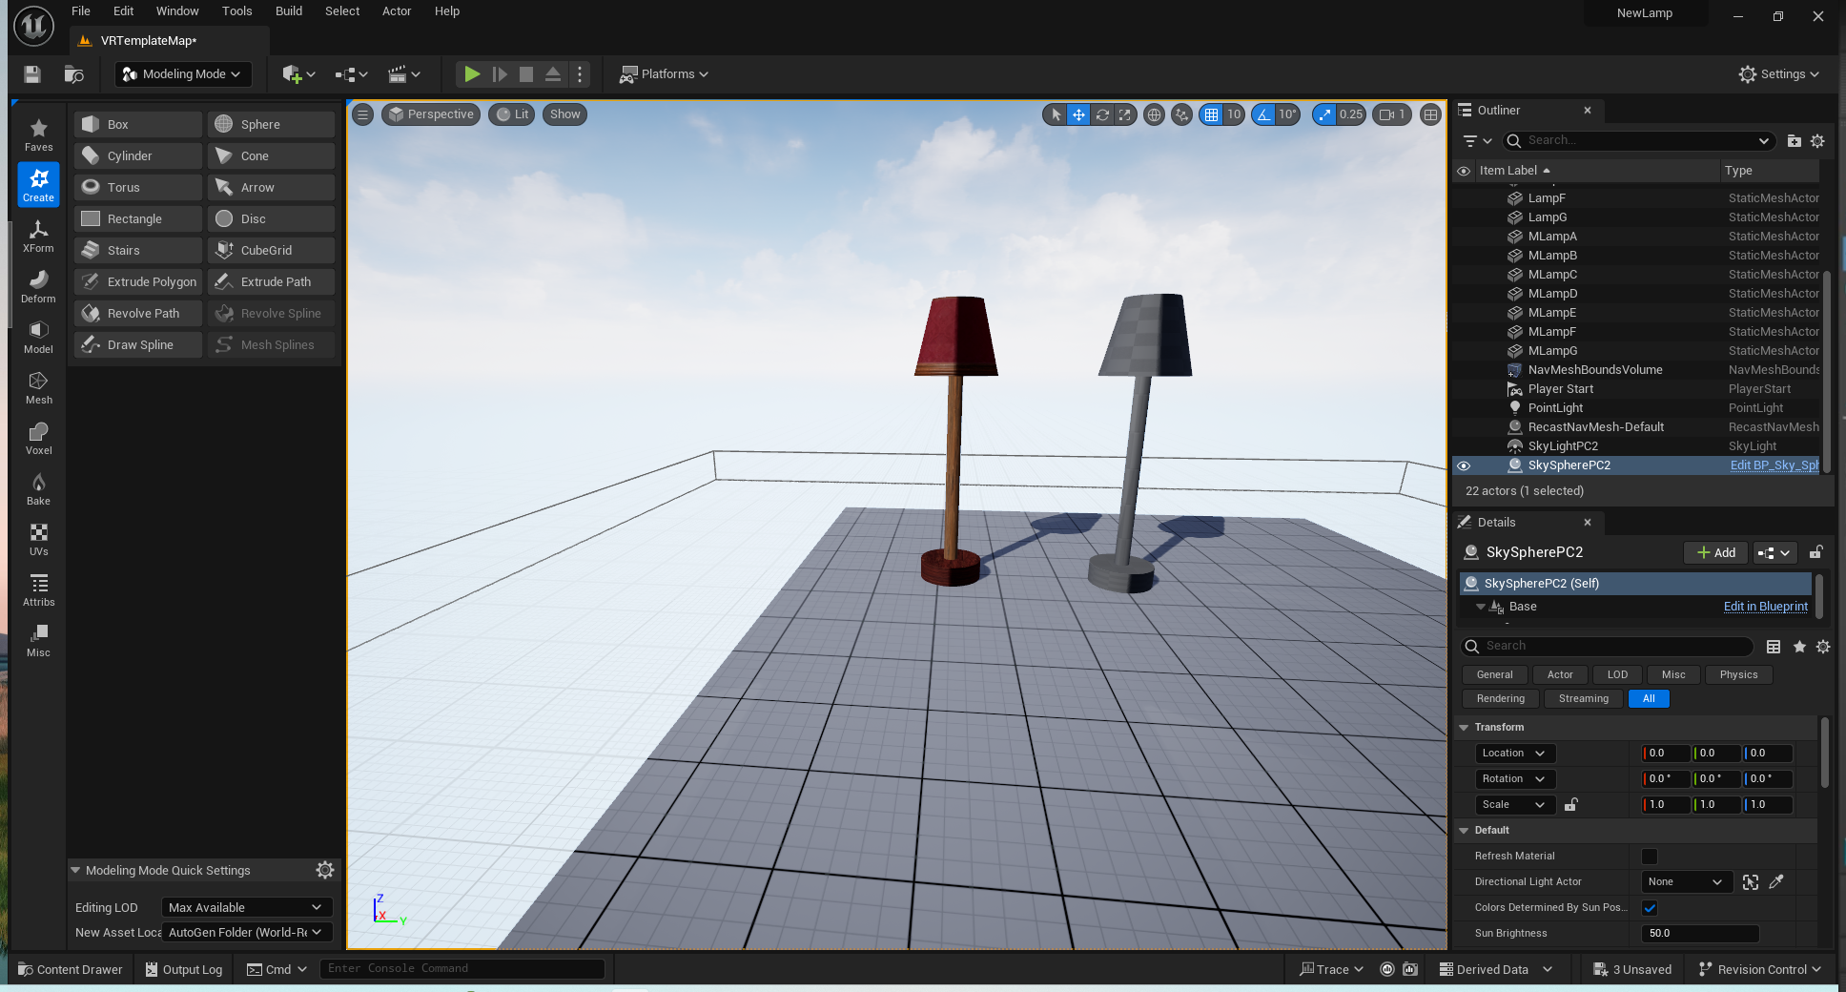
Developing VR Content for Unreal Engine - Building a model inside Unreal Engine
Using the Box, Cylinder and Sphere you can create this lamp(s) in Unreal Engine.
34

Slide 35
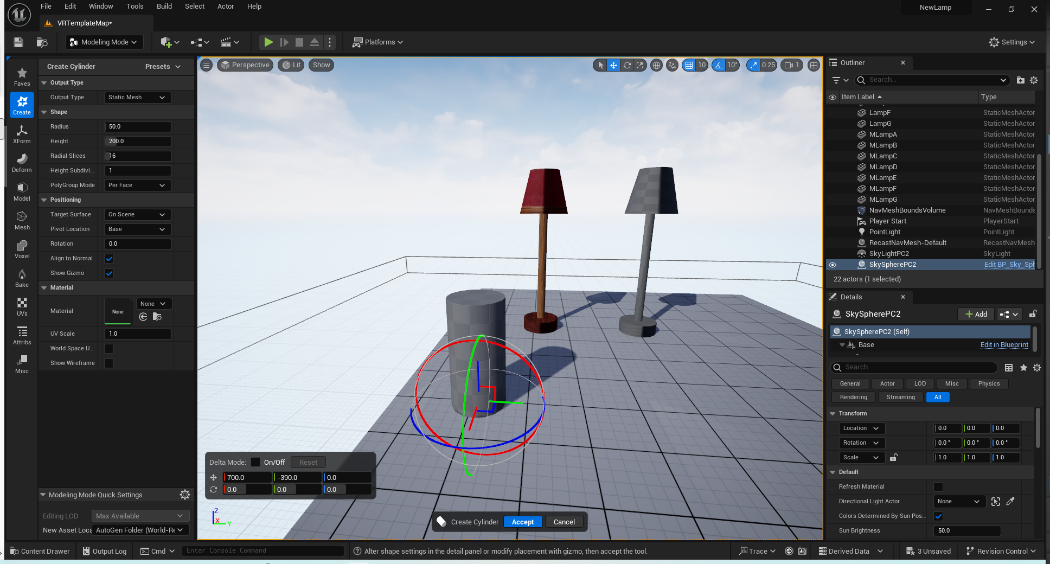
Developing VR Content for Unreal Engine - Building a model inside Unreal Engine
The default cylinder has a radius of 50 and height of 200. The user can create the model and then scale the “asset” or the “actor”.
The “asset” is the based model that everyone would use while the “actor” is the version that is used in the scene.
35

Slide 36
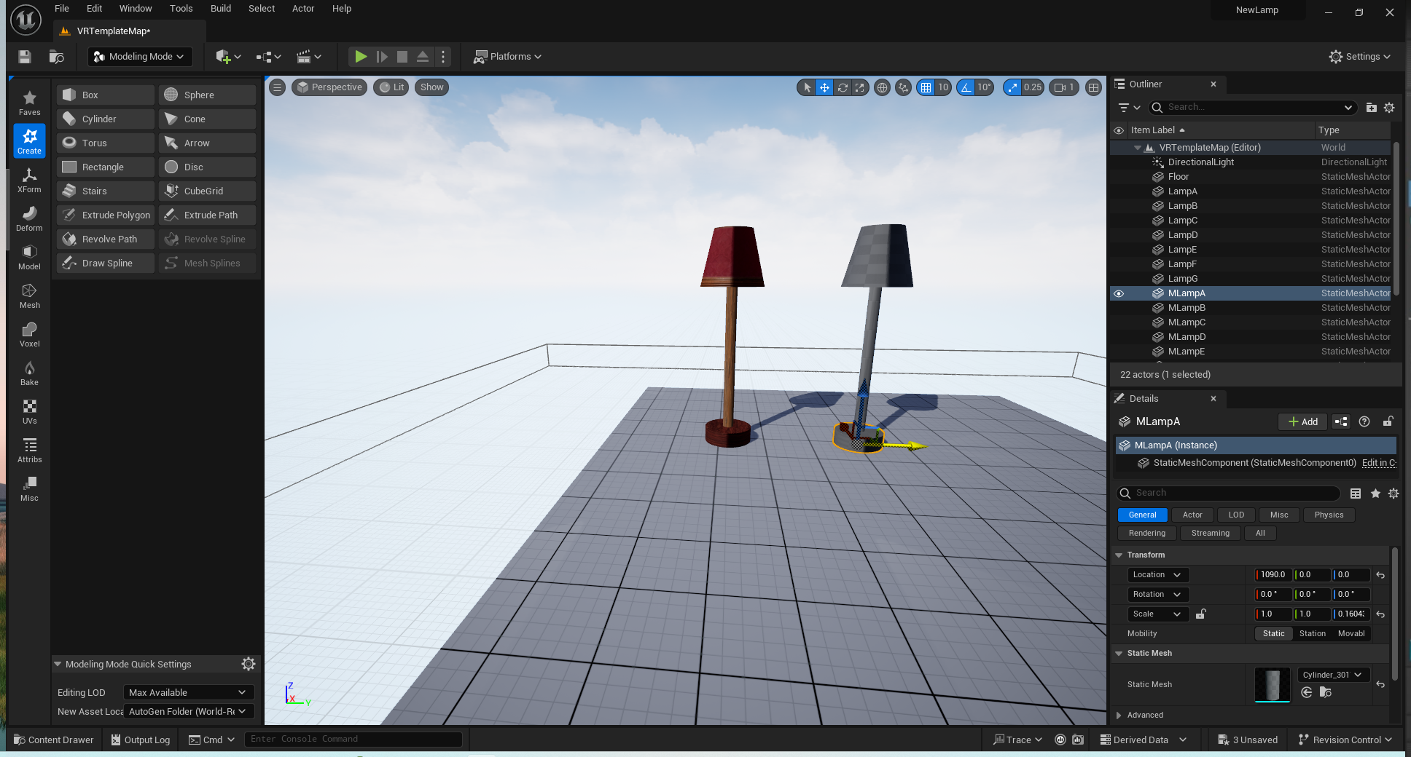
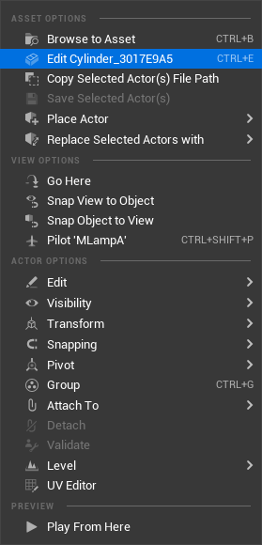
Developing VR Content for Unreal Engine - Building a model inside Unreal Engine
If we edit the cylinder used for the base of the lamp …
36

Slide 37
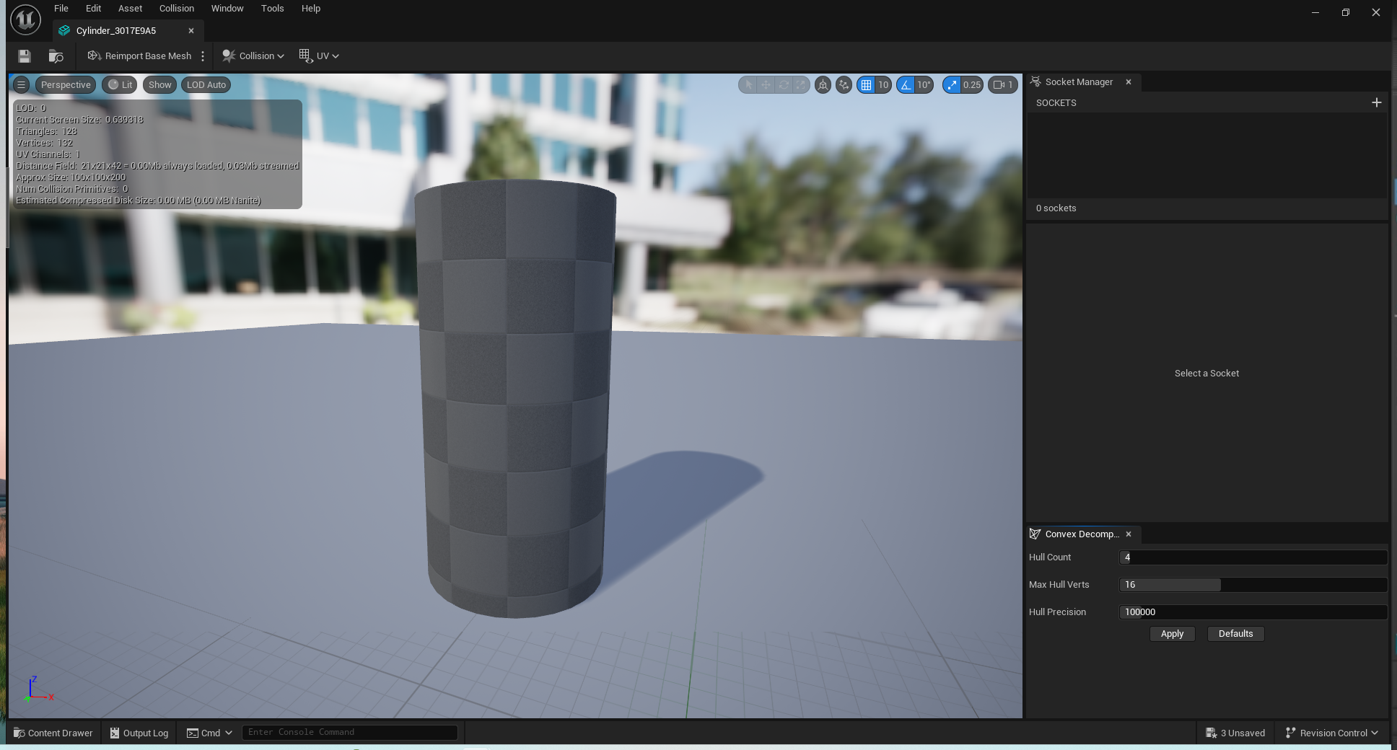
Developing VR Content for Unreal Engine - Building a model inside Unreal Engine
… we can see that this model was not modified, i.e. it maintained the original dimensions and the “actor” was scaled.
37

Slide 38
Developing VR Content for Unreal Engine - Building a model inside Unreal Engine
The z value of the base is scaled to 0.160439 which would translate into a height of 0.160439*200 = 32.0878.
Ideal when making a model the “asset” should have the correct dimension vs the “actor”.
38

Slide 39
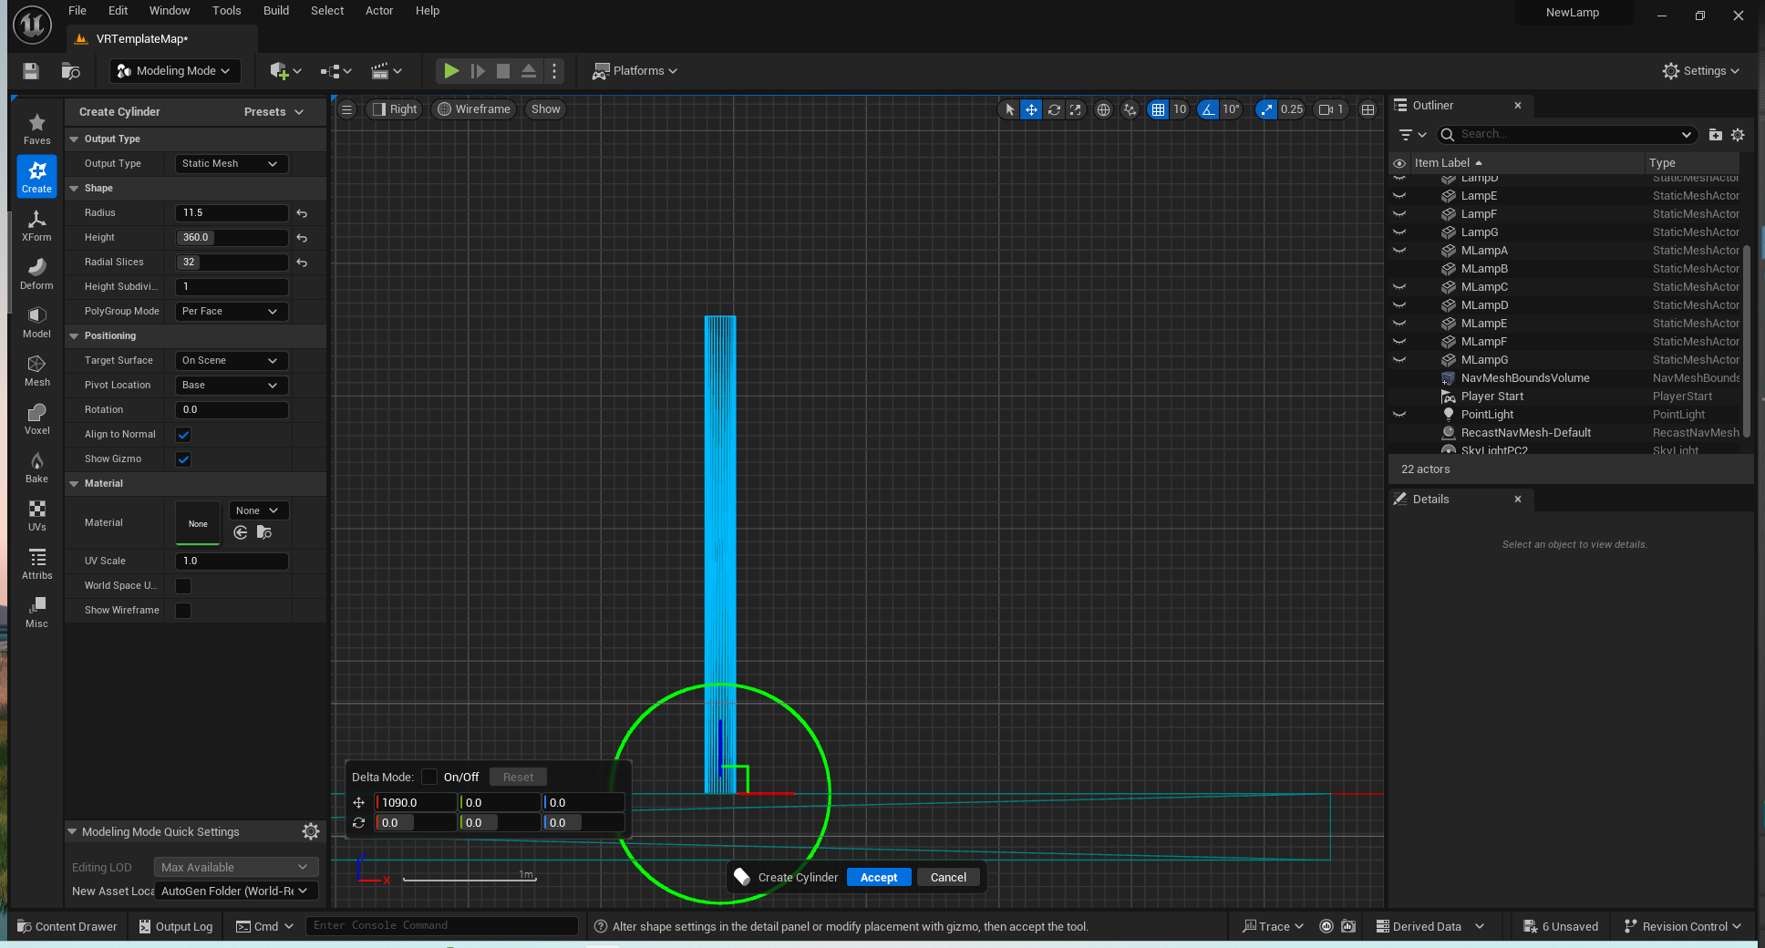
Developing VR Content for Unreal Engine - Building a model inside Unreal Engine
The pole for the lamp has a radius of 11.5 and length of 360. This
39

Slide 40


Developing VR Content for Unreal Engine - Building a model inside Unreal Engine
The pole for the lamp has a radius of 11.5 and length of 360. The measurements sort of match if your edit the pole for the lamp.
40

Slide 41

Developing VR Content for Unreal Engine - Building a model inside Unreal Engine
Two versions were created. One without a texture and one with a texture(s). Also, it should be noted that the lamp shade was created using a Boolean operation which subtracts a smaller diameter cylinder from a larger one.

Slide 42

Developing VR Content for Unreal Engine - Building a model inside Unreal Engine
There are still some issues to clean up with these models. After you “Build” the level you may have issues like overlapping UVs.
42

Slide 43

Developing VR Content for Unreal Engine - Building a model inside Unreal Engine
In Modeling Mode, we can switch to the UVs and look at the UVs for the Lamp Shade as an example using the UVEditor mode.
43

Slide 44

Developing VR Content for Unreal Engine - Building a model inside Unreal Engine
There are still some issues to clean up with these models. After you “Build” the level you may have issues like overlapping UVs.
A model UV is how the model mesh is unwrapped and in Unreal Engine it uses two types of UVs, The UV for the mesh and the UV for lighting. In this case the UV has overlaps which should be resolved.
44

Slide 45

Developing VR Content for Unreal Engine - Building a model inside Unreal Engine
This was done by just selection the layout option. Once corrected the overlapping UVs will be eliminated.
45

Slide 46

Developing VR Content for Unreal Engine - Building a model inside Unreal Engine
Initially my plan was to show you how to export a textured model, but it is not that easy because the UVmaps for the various parts of the lamp are sort of needed to provide the level of detail shown. However, a non-textured version can be created and used and the textures for each section can be downloaded and used to build the model.
46

Slide 47

Developing VR Content for Unreal Engine - Building a model inside Unreal Engine
To combine all the pieces together select all the “actors” you want to combine and convert them into a single mesh model.
47

Slide 48

Developing VR Content for Unreal Engine - Building a model inside Unreal Engine
Then the model can be exported as an FBX model. Textures can be in Blender if you wish.
48

Slide 49

Developing VR Content for Unreal Engine - Building a model inside Unreal Engine
In Blender, the model is recreated with the textures which were also downloaded from Unreal Engine.
It should be noted that the UVmap shows multiple UVs with overlaps. This may be a problem in Unreal Engine.
49

Slide 50

Developing VR Content for Unreal Engine - Building a model inside Unreal Engine
Blender can greatly help in the modification of the model and the UV Map: Scaling, Rotation, unlinking islands or stitching can be used to improve the UV maps that were created in Unreal Engine
50

Slide 51

Developing VR Content for Unreal Engine - Building a model inside Unreal Engine
As can be seen the UV Map is better than the one was created in Unreal Engine. OBTW, the model was also improved by reducing the number of vertices. Tris were reduced by 20 but the geometry was improved with the elimination of poor geometry.
51

Slide 52

Developing VR Content for Unreal Engine
There are many other aspects to using Unreal Engine for the creation of apps and models for your Oculus Quest VR headsets.
Lighting, lightmaps, textures, materials and blueprints are all significant topics to consider and use to build VR apps.
It is also important that you learn some of the VR vocabulary so that you can ask questions to others. YouTube is a great resource and your can search for Discord Servers and ask question in the Unreal Engine Forum. I would also suggest that you learn Blender and maybe a CAD tool like Solidworks.
Finally, the IT support you get will make your life easier when developing and supporting the use of VR headsets. If you can get admin rights on your development PC this will make it easier for you to build VR Content.
52

Slide 53
Developing VR Content for Unreal Engine
References
1.) This website contains many of the models and apps presented at the workshop.
https://www.ivytech-mems.org/VR_Models.html
2.) My faculty webpage contains links to some previous presentation on VR.
https://www.ivytechengineering.com/abell118/
3.) Many STL models can be downloaded from the web and used in Unreal Engine
https://www.thingiverse.com/
4.) This another 3D model website that I use
https://grabcad.com/library
5.) Get the latest version of Blender for free (Lots of help on YouTube for it)
https://www.blender.org/
6.) You may find help with the Unreal Engine Forum
https://forums.unrealengine.com/categories?tag=unreal-engine
7.) Epic Games Installer https://www.unrealengine.com/en-US/download
8.) Oculus - https://www.meta.com/quest/setup/
9.) Meta Quest Developer Hub - https://developer.oculus.com/downloads/package/oculus-developer-hub-win/
10.) Android Studio - https://developer.android.com/studio/archive
11.) Visual Studio (Community Version) - https://visualstudio.microsoft.com/vs/community/
53

Slide 54


Questions
Andy Bell
Department Chair – Engineering
Ivy Tech Community College – Northeast
Phone: 260-481-2288 : Fax: 260-480-2052
abell118@ivytech.edu
SDKB Technology Center, Room TC1240R,
3800 N. Anthony Blvd.,
Fort Wayne, IN 46805
SL avatar = ivytechengineer
54

