Slide 1
Making a Mountain using Second Life from Terrain.Raw file (part 1)
AGBell
4/23/2022

Slide 2
I wanted to understand the terrain.raw file used in Second Life to create a mesh model of a mountain I want to move so I could use the terrain to build on. To do this I researched the web and asked people in the Second Life Forum for help and advice.
The following is excerpts from the Forum and what I discovered after search for help of terrain.raw files I found a 2018 question on “terrain import/export – issues”
My Question - Feb 23, 2022 - Sorry, I am late to the post but is there a Blender addon for editing the SL terrain.raw file? I am using Blender 2.82
Response from ChinRey Feb 23, 2022 - No there isn't as far as I know. If there is, I'd love to know about it too. (Chin suggested checking out L3DT).

Slide 3
Photoshop was not really needed for this effort and sort of got in the way. I was able to create a some of the terrains that were talked about in the YouTube video:
Editing RAW Terrain Files for Open Sim in Photoshop CC
https://www.youtube.com/watch?v=sr_3B75j3Y4
But it turned out to be a wild goose chase because the video actually
I posted to the YouTube channel
“Hello, I know this is an older video but I am confused by the values used for the RGB channels. You set them to all be equal? When I attempt to follow this I get an extremely tall ziggurat. Shouldn't the G & B channels be the same for each level and not equal to the R channel?”
To date there has been not response or update to the YouTube video.

Slide 4
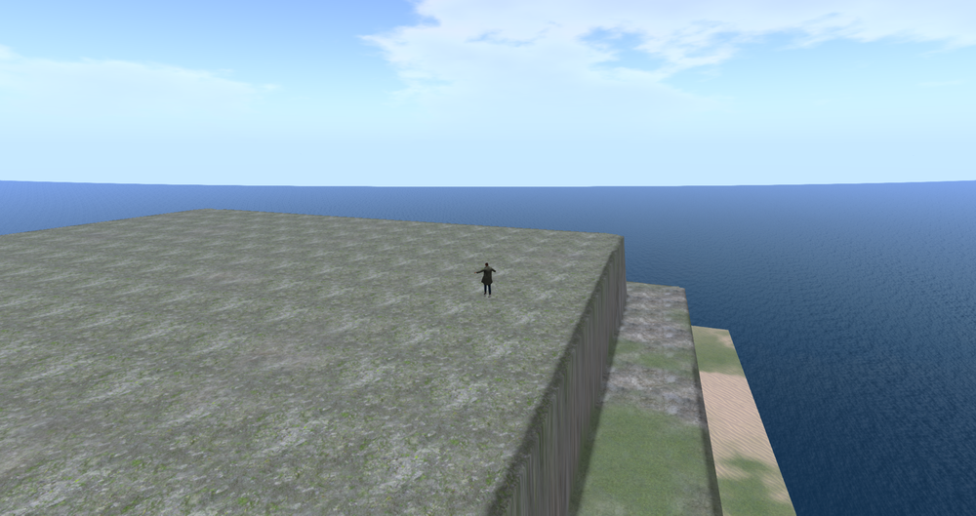
Posted to the Forum 7 March 2022
I think I have figured out the terrain puzzle. Say you want terrain that is 60 meters above the ocean with two other levels that are at 40 meters and 20 meters. Then one solution could be
R = 240, 160, 80 with a G = 32. The G channel is set to 32 where 240*(32/128) = 60. This would lead to a gain of 0.25 or 240*0.25 = 60.
Here are some files that might help you based on the flatgreen.raw file that is talked about in the YouTube video above ...
https://www.ivytechengineering.com/SecondLife/files/60m_flatgreen.raw
https://www.ivytechengineering.com/SecondLife/files/terrainheight.xlsx

Slide 5
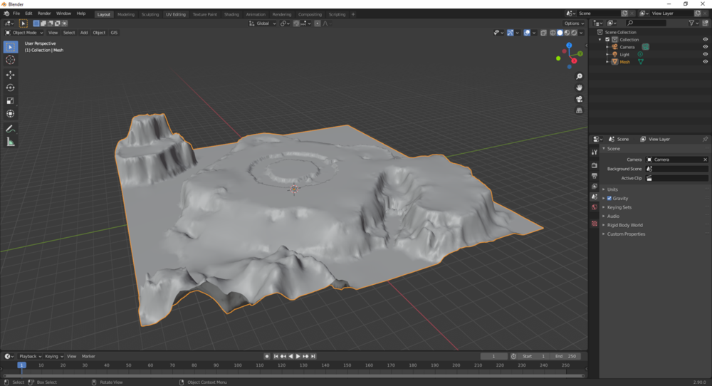
Posted to the Forum 8 March 2022
I was reading an old post in on Bundysoft (L3DT) and a guy wrote a script that might help convert the terrain.raw file.
http://www.bundysoft.com/wiki/doku.php?id=scripts:import_opensim_raw_file
http://www.bundysoft.com/phpBB2/viewtopic.php?f=4&t=2718
These are pretty old posts,
maybe 2013
The script worked but I did not capture the number of tris, quads, etc in the picture for the mesh model. My focus would no shift on the mountain and making a mesh model of it.

Slide 6
Workflow
Software Needed
Download the terrain.raw file from Second Life
You need the Second Life Viewer installed on your computer
Optional - You need the FireStorm Viewer installed on your computer
Optional - can review by uploading terrain.raw into OpenSim
You need OpenSim installed on your computer
You need the FireStorm Viewer for OpenSim installed on your computer
Convert the raw file to a dae file using import_opensim_raw.zs
You access to the import_opensim_raw.zs script
You need Blender installed on your computer
Mesh model can now be uploaded and edited in Blender
Optional - You need L3DT installed on your computer

