Slide 1
Developing VR Content For Unreal Engine
AGBell
5/16/2024

Slide 2
Developing VR Content for Unreal Engine
This presentation is show how to “develop” VR content for Unreal Engine (UE). This software can be freely downloaded and used to develop models and environments for VR headsets like the Oculus Quest II.
Getting Started
Making a poster
Getting a model
Importing a model
Model building outside Unreal Engine
Model building inside Unreal Engine

Slide 3
Developing VR Content for Unreal Engine – Getting Started
There are a number of software packages you will need to install on your computer ro build content for VR using Unreal Engine. To install software your will, need admin right on your computer and the computer will need to be capable of supporting VR (high end graphics).
Hardware –
Quad-core Intel or AMD, 2.5 GHz or faster
8 GB RAM
Windows 10/11
DirectX 11 or 12 compatible graphics card
Also, you will need hard drive space to save your files.
I use the Dell Alienware Aurora R16 computer with 32 GB of RAM and a 4TB external hard drive. You will also need a Meta Quest 2 or 3 headset with a PC Link Cable so your can upload content to the headsets. We also purchased some docking stations for charging the controllers and headset.

Slide 4
Developing VR Content for Unreal Engine – Getting Started
There are a few software packages you will need to build content for VR using Unreal Engine. To install software your will, need admin right on your computer and the computer will need to be capable of support VR (high end graphics).
Software –
Epic Games Launcher
Meta Quest Developer Hub
Oculus App
Unreal Engine 5
Visual Studio - Latest Community Version
Android Studio
Oculus Developer Account
Oculus Mobile App - latest version
Blender
Sidequest
Maybe a CAD program like AutoCAD and/or Solidworks
Maybe Maya

Slide 5
Developing VR Content for Unreal Engine – Getting Started
Epic Games Installer - latest version
Oculus - latest version
Meta Quest Developer Hub - latest version
Android Studio - Android Studio Flamingo | 2022.2.1 Patch 2 May 24, 2023.
Visual Studio - Latest Community Version
May also need to have the Oculus App on your phone to enable the development mode for each of your headsets.

Slide 6
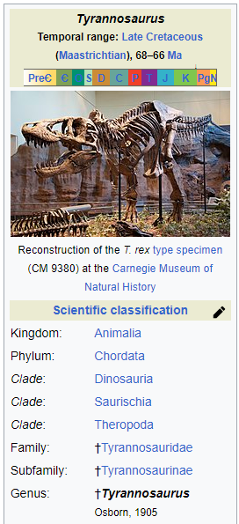
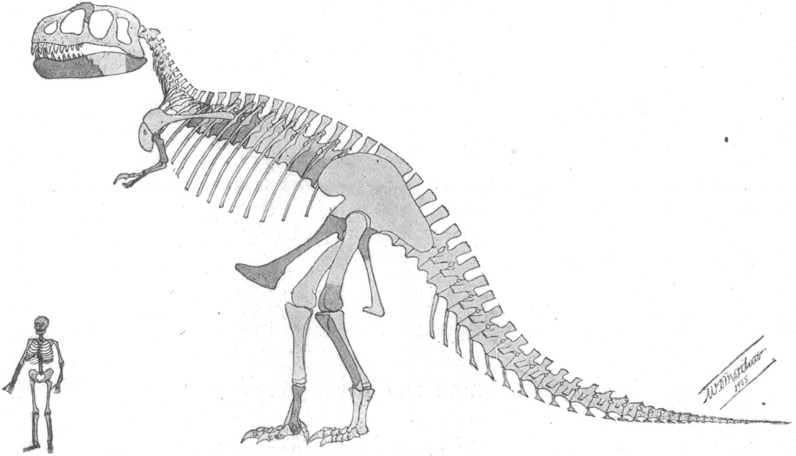
Developing VR Content for Unreal Engine
You must first decide what you want to use in VR. You can develop your own assets (models) using Blender, Maya, Solidworks, AutoCAD or some other tool or you can find 3D models on the web at GrabCAD, Thingiverse, etc.
Info - https://en.wikipedia.org/wiki/Tyrannosaurus
3D Model - https://www.thingiverse.com/thing:308335

Slide 7
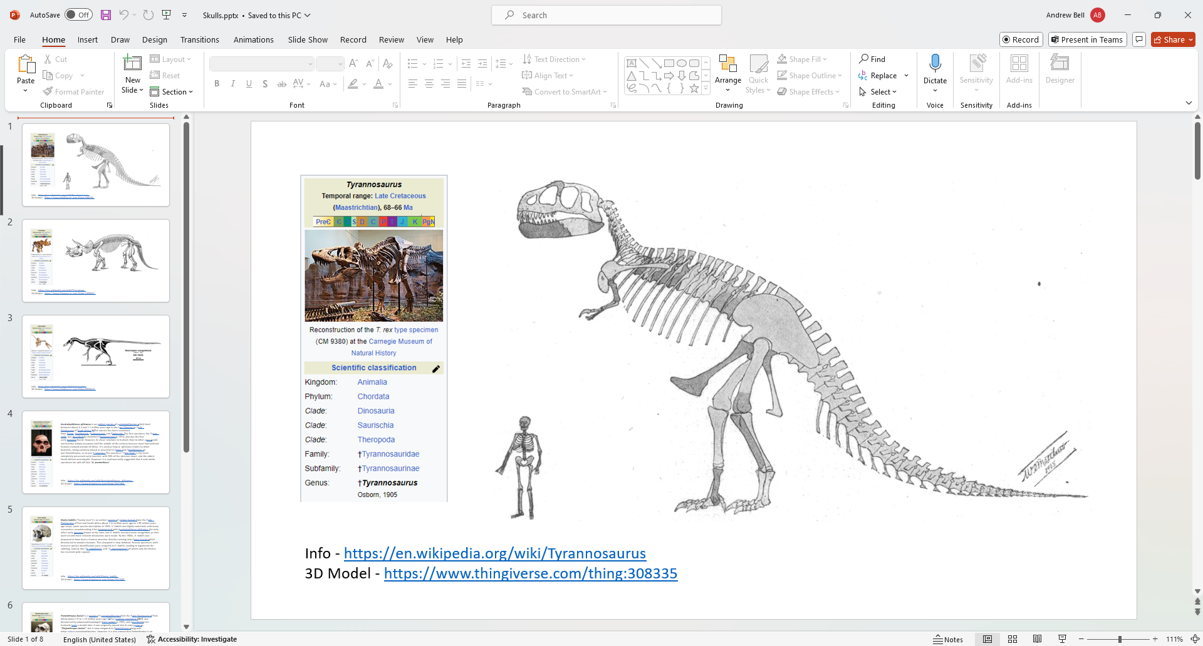
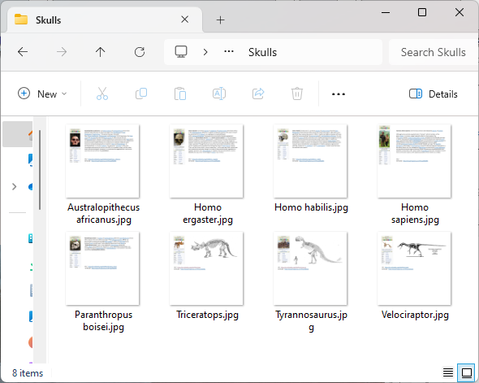

Developing VR Content for Unreal Engine - Making a poster
If you want a poster then an images can be created with the MS Paint, PowerPoint, or other tools. Many Posters are created with PowerPoint and then the slides are saved as images and can be used as materials or textures in Unreal Engine

Slide 8
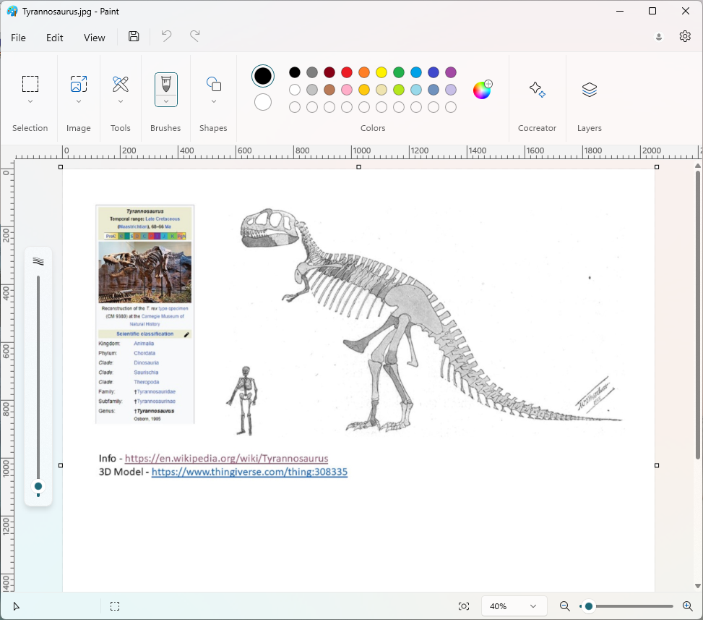
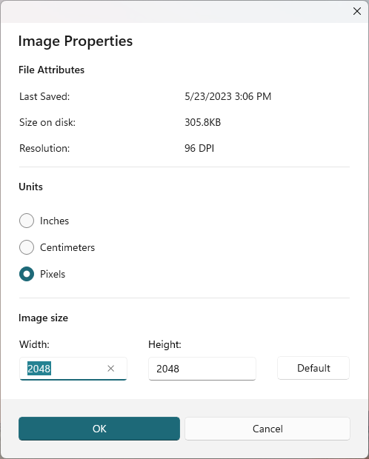
Developing VR Content for Unreal Engine - Making a poster
Posters can be presented in Unreal Engine on actors (assets that are displayed in the level) as a material. The image to be applied can be a square image that is related to a power of 2, i.e., 1024 by 1024, 2048 by 2048.

Slide 9
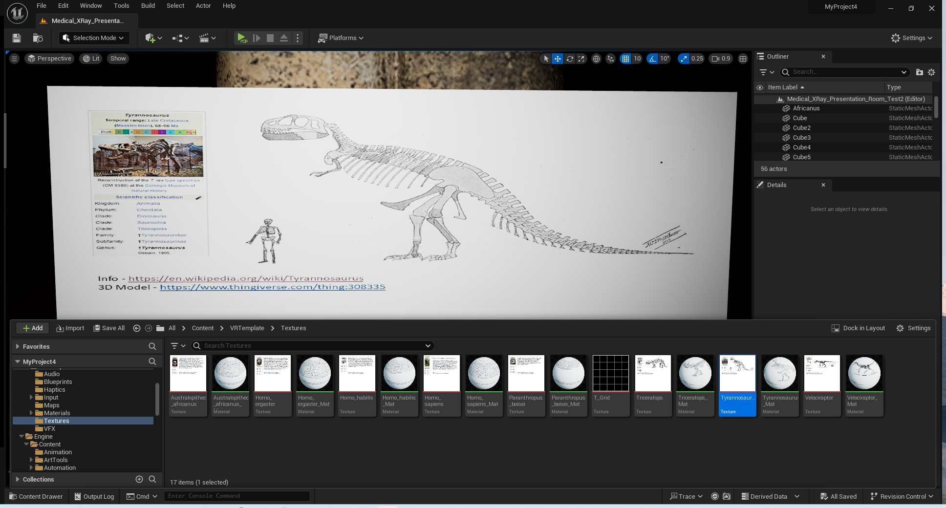
Developing VR Content for Unreal Engine - Making a poster
Open the Content Folder and make a directory for “Textures”. Import the image you want to use as the poster into your project. Then edit the image.

Slide 10
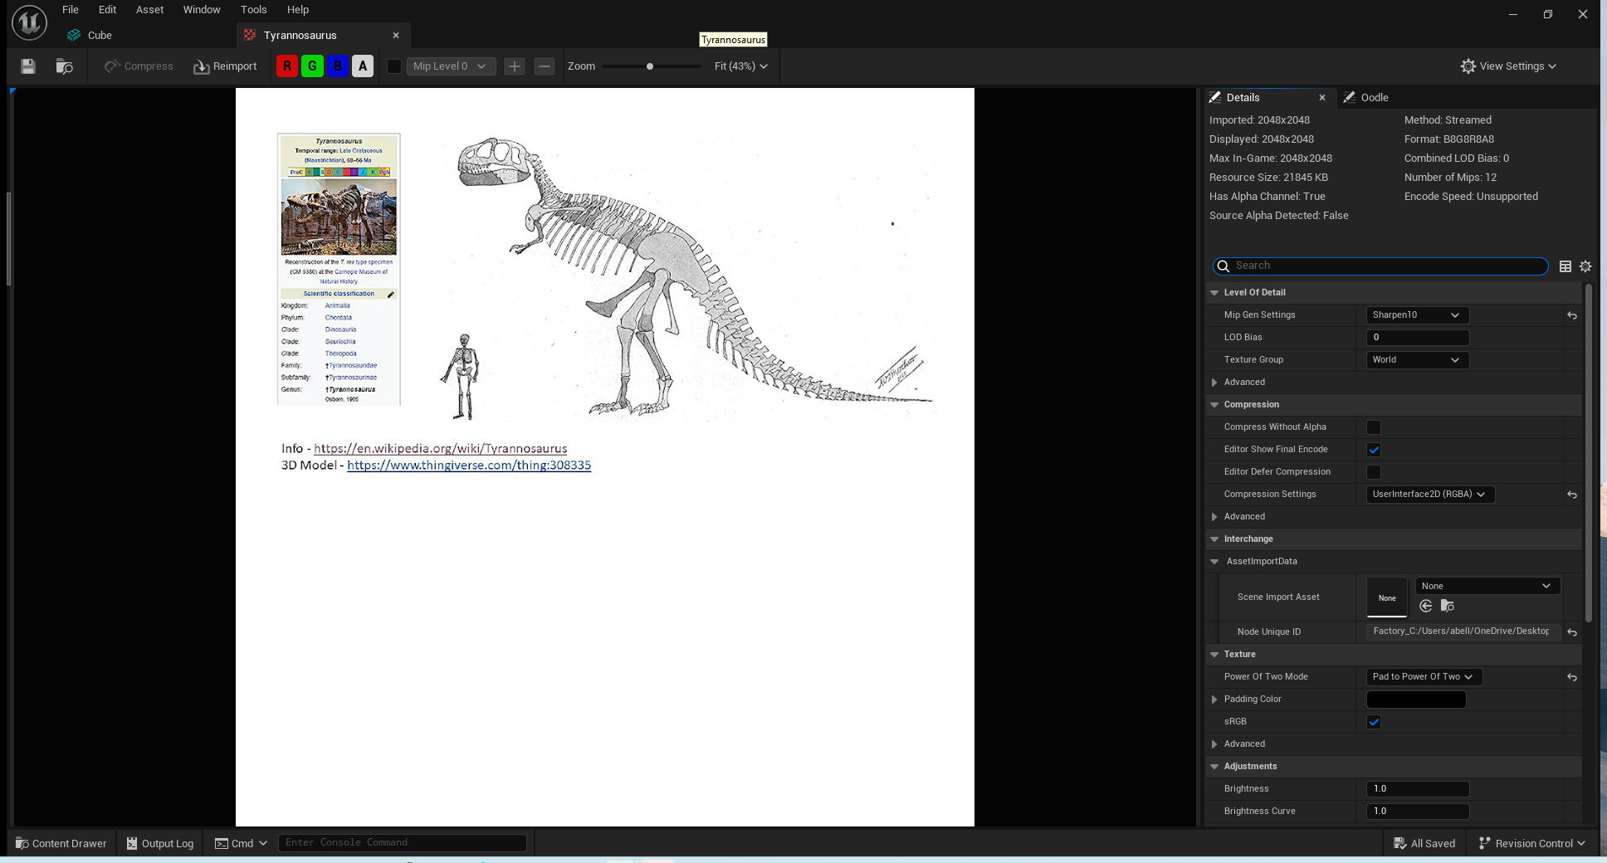
Developing VR Content for Unreal Engine - Making a poster
Make three modifications to the image:
1.) Compression Settings > UserInterface2D (RGBA)
2.) Power of Two Mode > Pad to Power of Two
3.) Mip Gen Setting > Sharpen 10

Slide 11
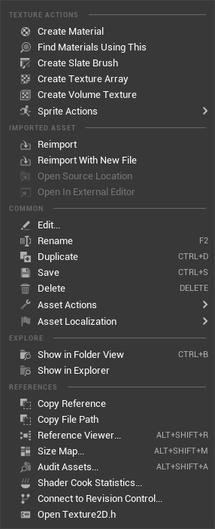
Developing VR Content for Unreal Engine - Making a poster
Next, create a material from the texture. This can then be applied to the poster. You can also create a Materials Folder and move the material file, but I prefer keeping everything together.

Slide 12
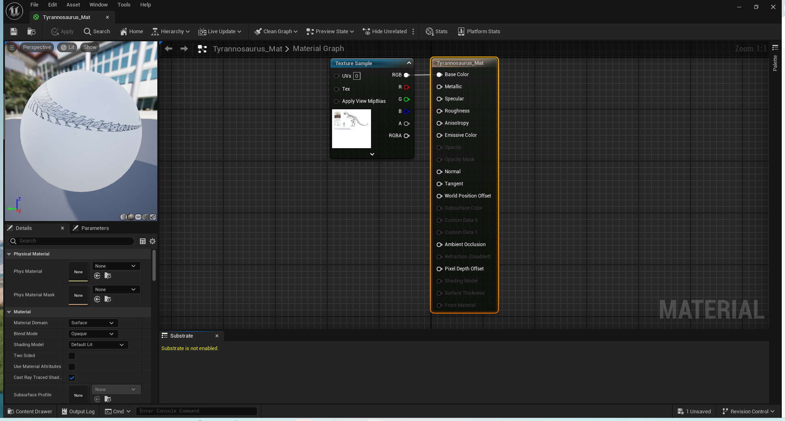
Developing VR Content for Unreal Engine - Making a poster
This is what the material looks like. Also, shown is the blueprint that is used to apply the material to a shape.

Slide 13
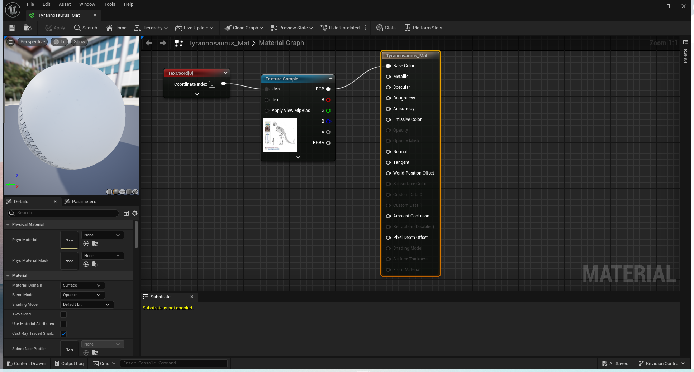
Developing VR Content for Unreal Engine - Making a poster
To align to the material to the shape you will need to add a TextureCoordinate to the UVs input in the Blueprint for the material. This will improve the image that is displayed on the poster.

Slide 14
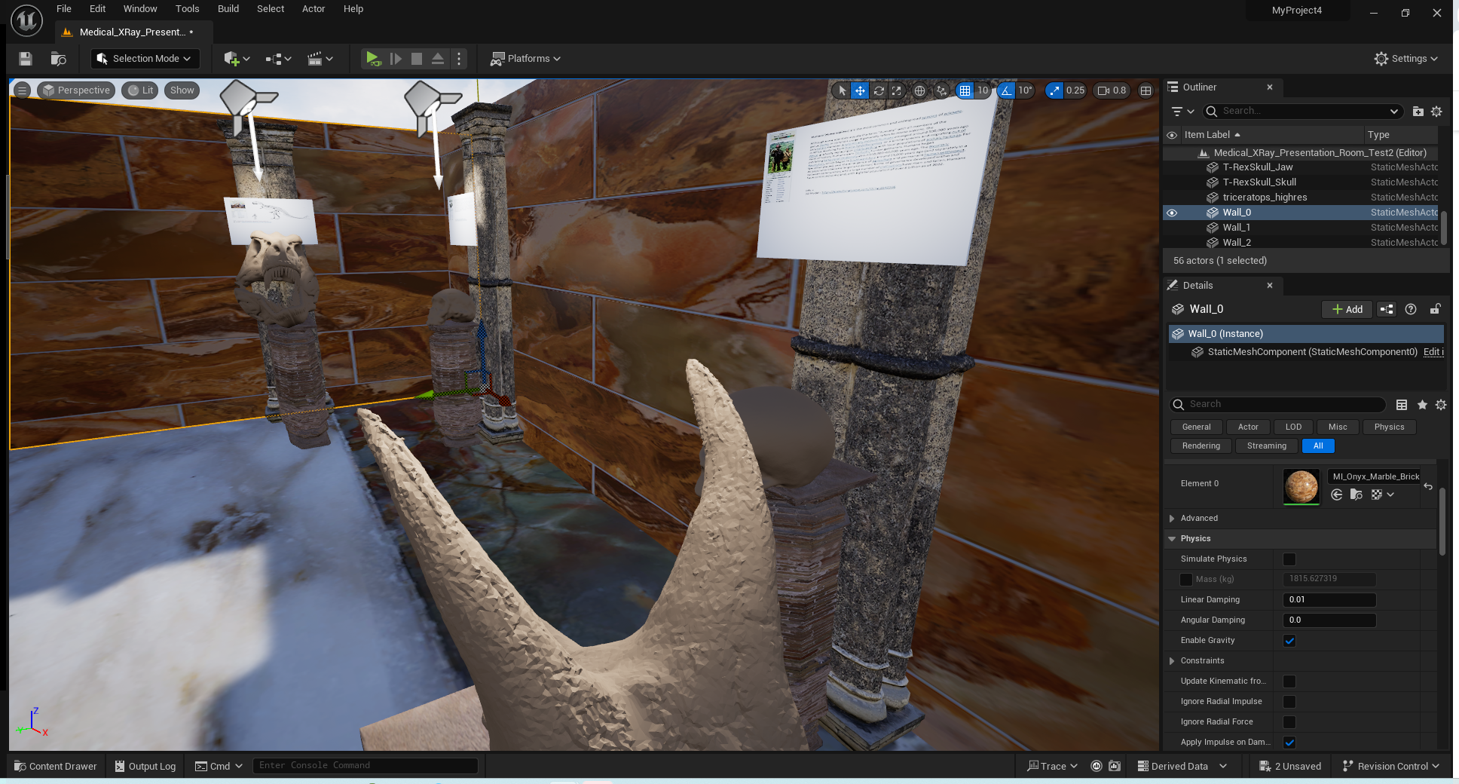
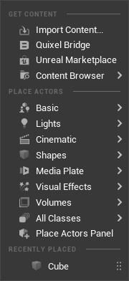
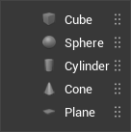
Developing VR Content for Unreal Engine - Making a poster
Create a basic Cube

Slide 15
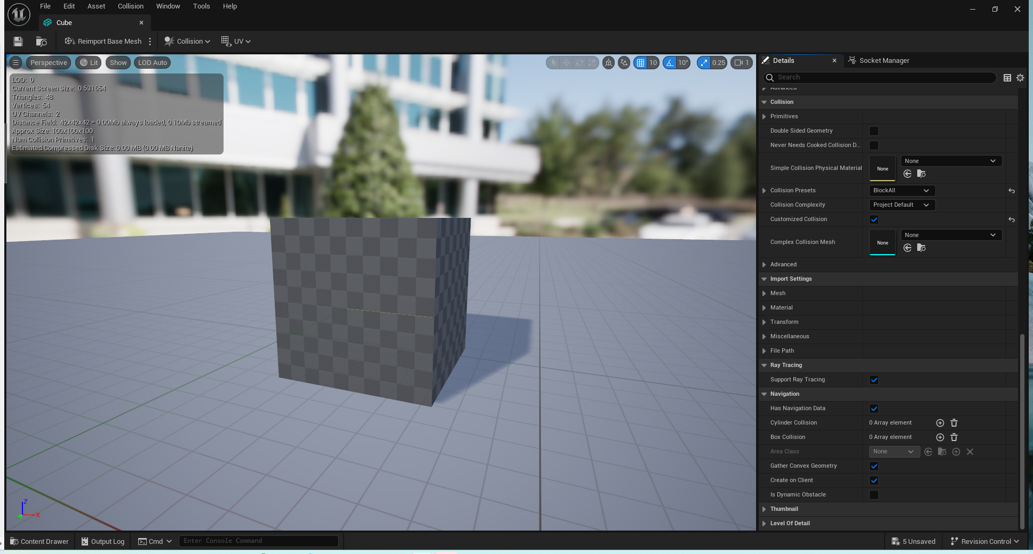
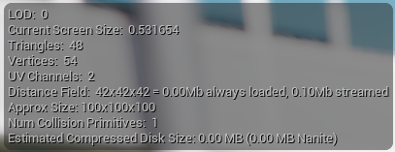
Developing VR Content for Unreal Engine - Making a poster
The cube is actually a 100 cm x 100 cm x 100 cm cube. Why?

Slide 16
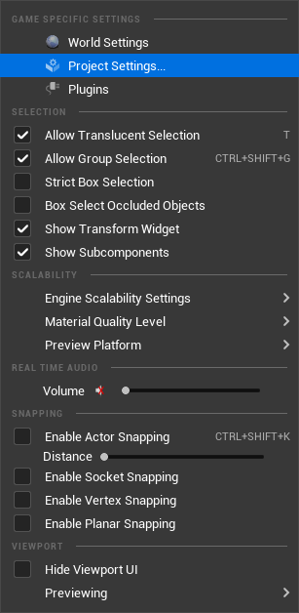
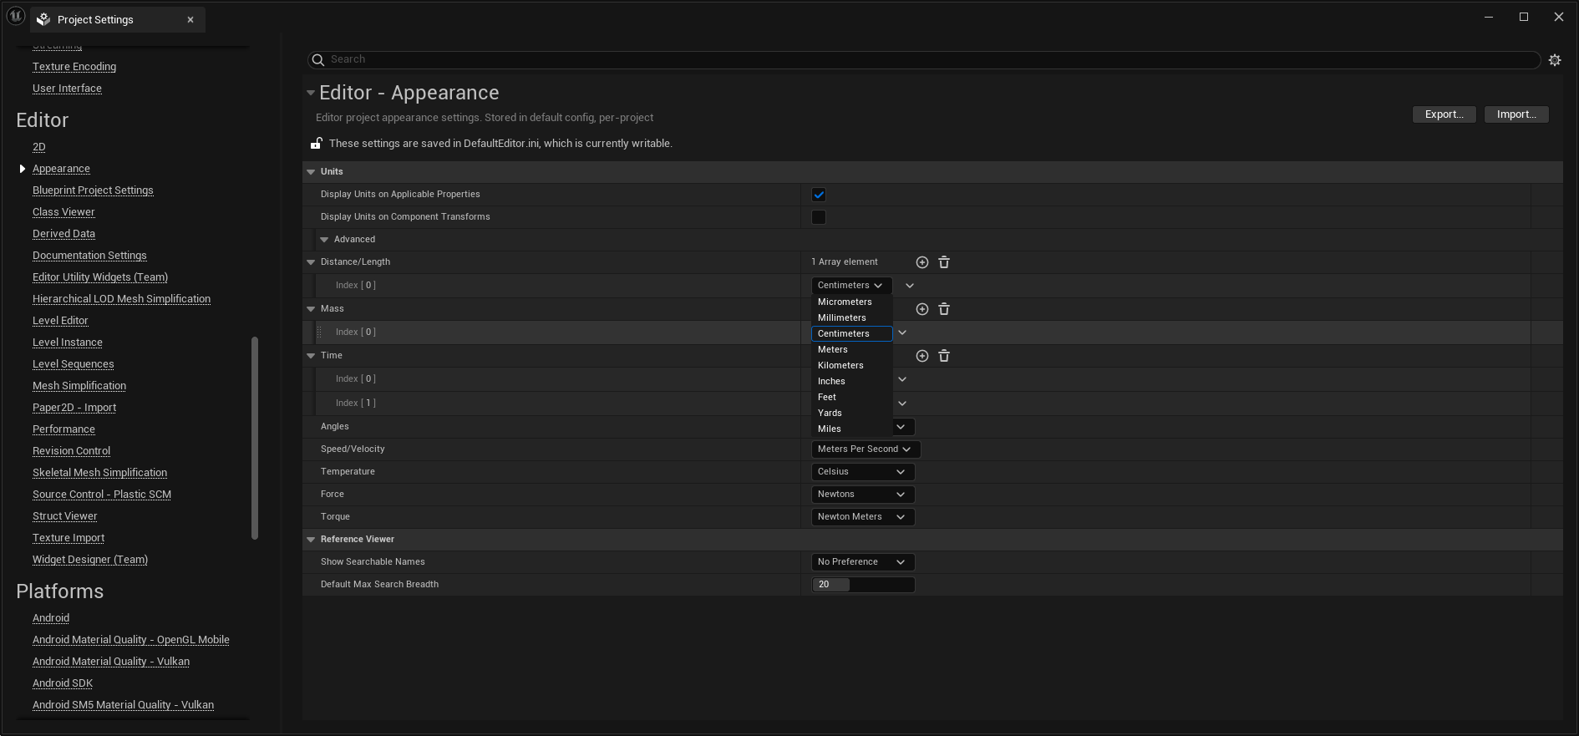
Developing VR Content for Unreal Engine - Making a poster
Ans - It is the default size.
In the Project Settings > Editor > Appearance we see the Distance/Length is in Centimeter. This can be changed if you want imperial or a different metric value. Some programs may use Meters as a default unit.

Slide 17
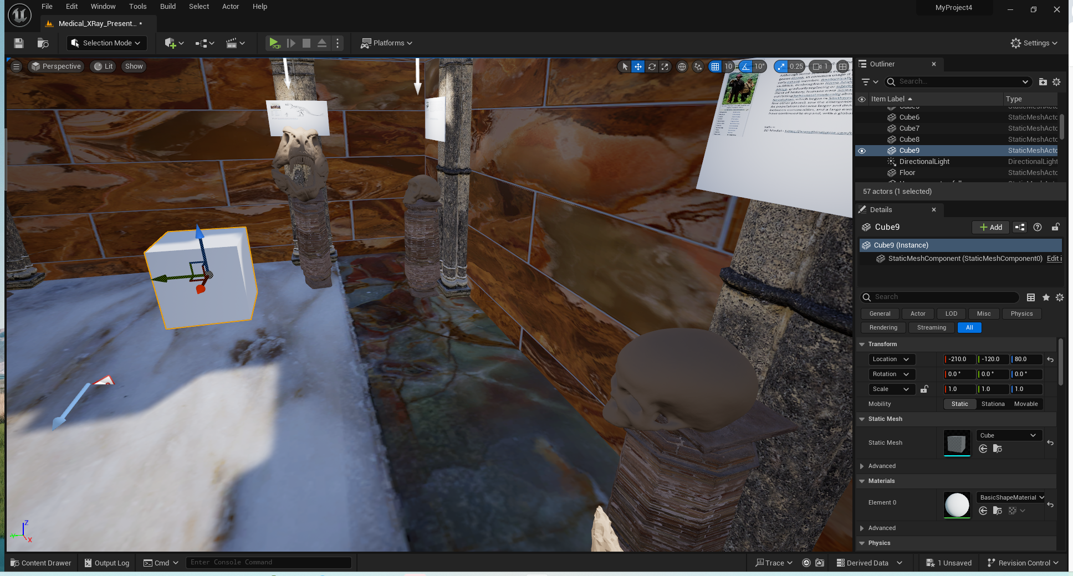
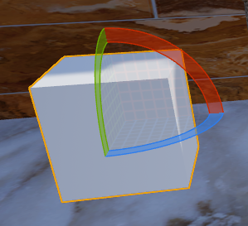
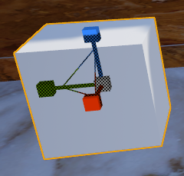
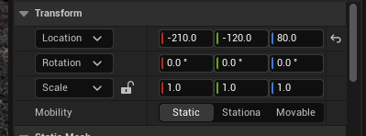
Developing VR Content for Unreal Engine - Making a poster
A shape’s size (scale), location and rotation can all be changed to place the object exactly where you want “in-world”. If you hit the Spacebar you can cycle through the three options to modify the object.

Slide 18
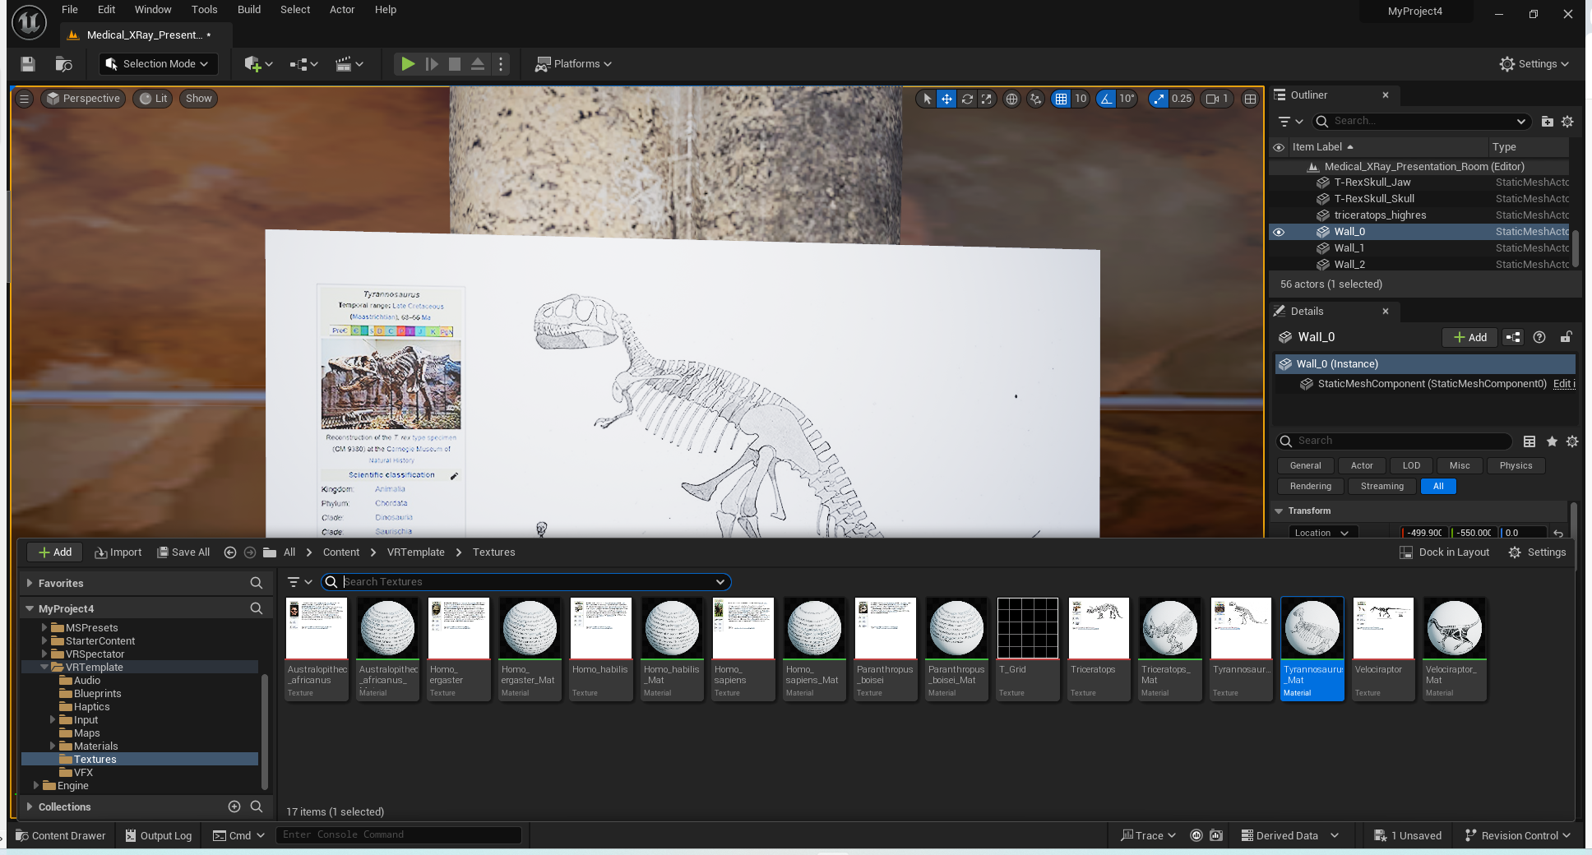
Developing VR Content for Unreal Engine - Making a poster
The poster displayed here is actually 1 meter wide by 0.56264 meters tall with a 0.01 meter thickness (16:9 aspect ratio) . UE is not a modeling tool so you must get use to scaling or building models outside UE.
The desired material can be added to the poster that is sized and placed where we want it.
X

Slide 19
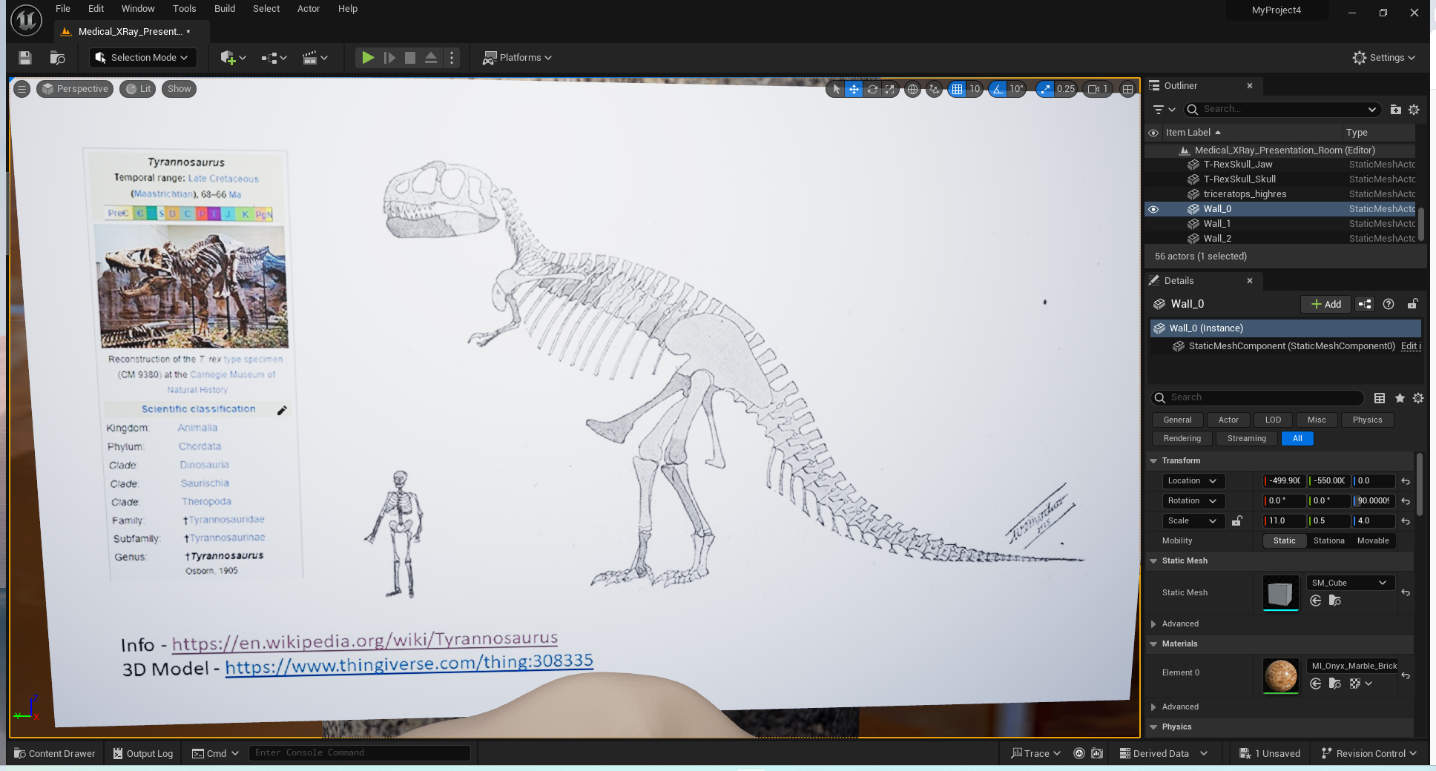
Developing VR Content for Unreal Engine - Making a poster
Finished poster.

Slide 20
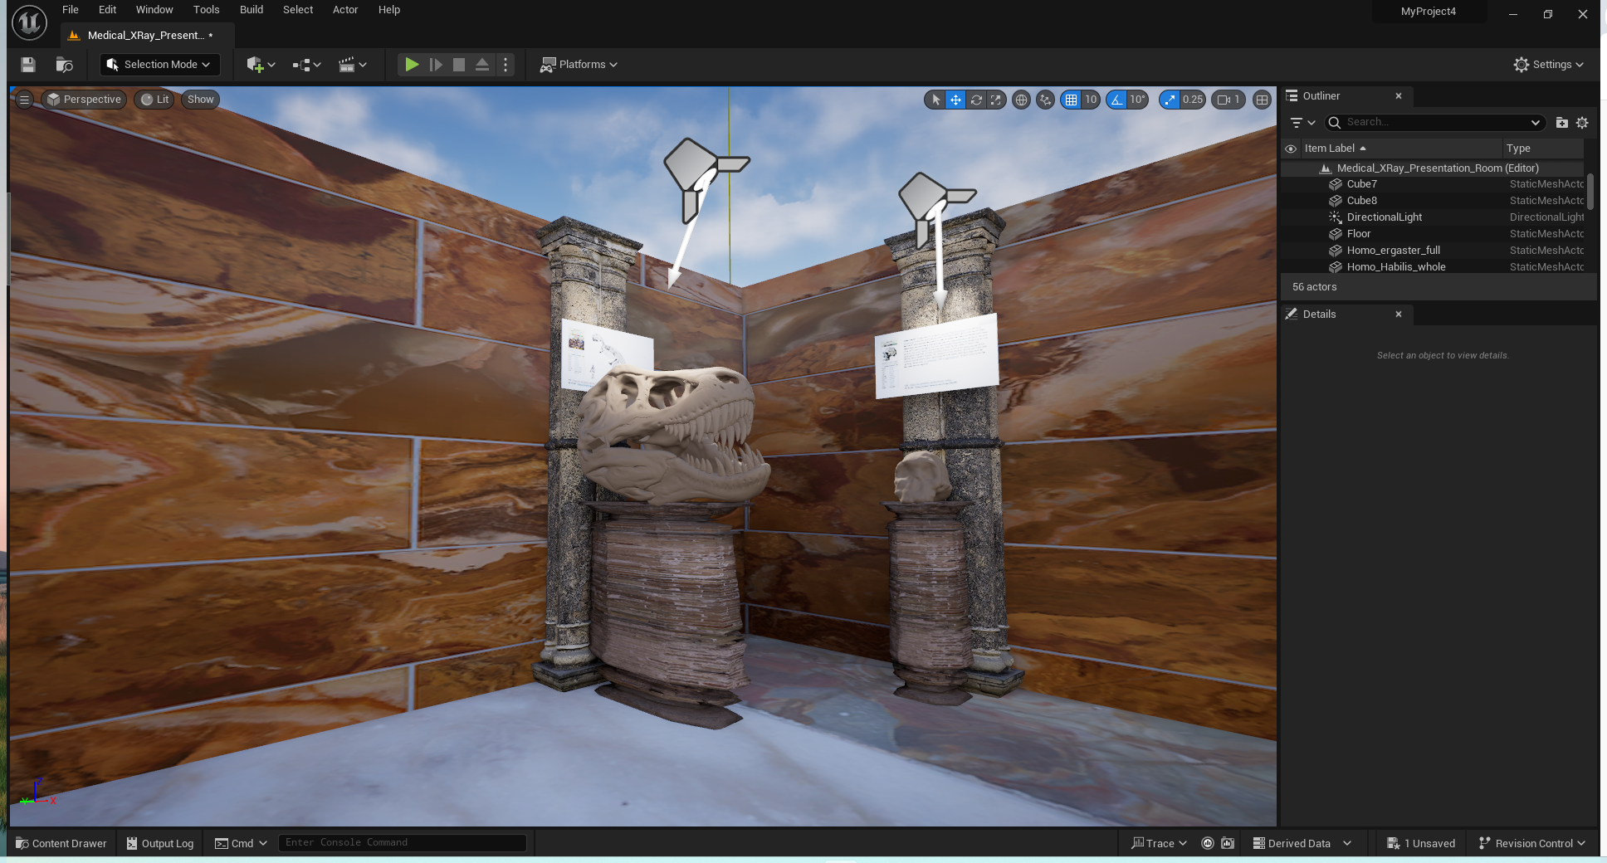
Developing VR Content for Unreal Engine - Making a poster

Slide 21
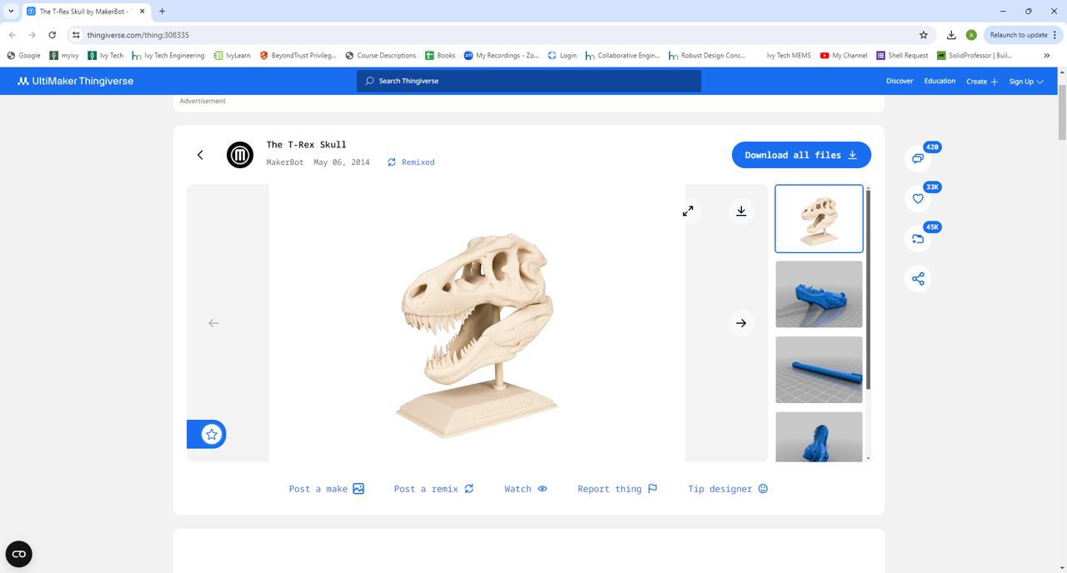
Developing VR Content for Unreal Engine - Getting a model
If you find something on the web you may need to convert it from an STL to a FBX or OBJ file. There are online tools you can use but I prefer to use Blender since you can also evaluate the complexity of the mesh.

Slide 22
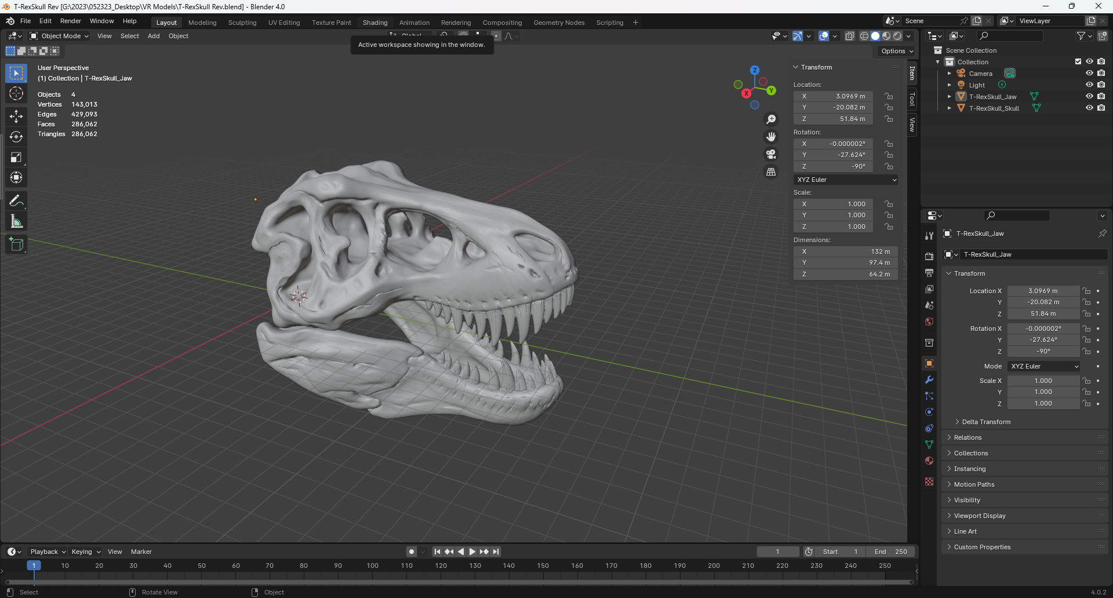
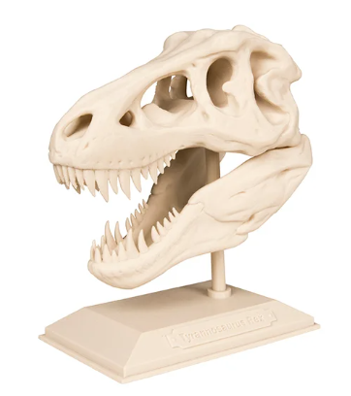
Developing VR Content for Unreal Engine - Getting a model
In Blender this is a very large model (286,062 tris). The physical size is 132 meters and needs to be scaled.
This is actually two models that were combined into a single model (skull and lower jaw)

Slide 23
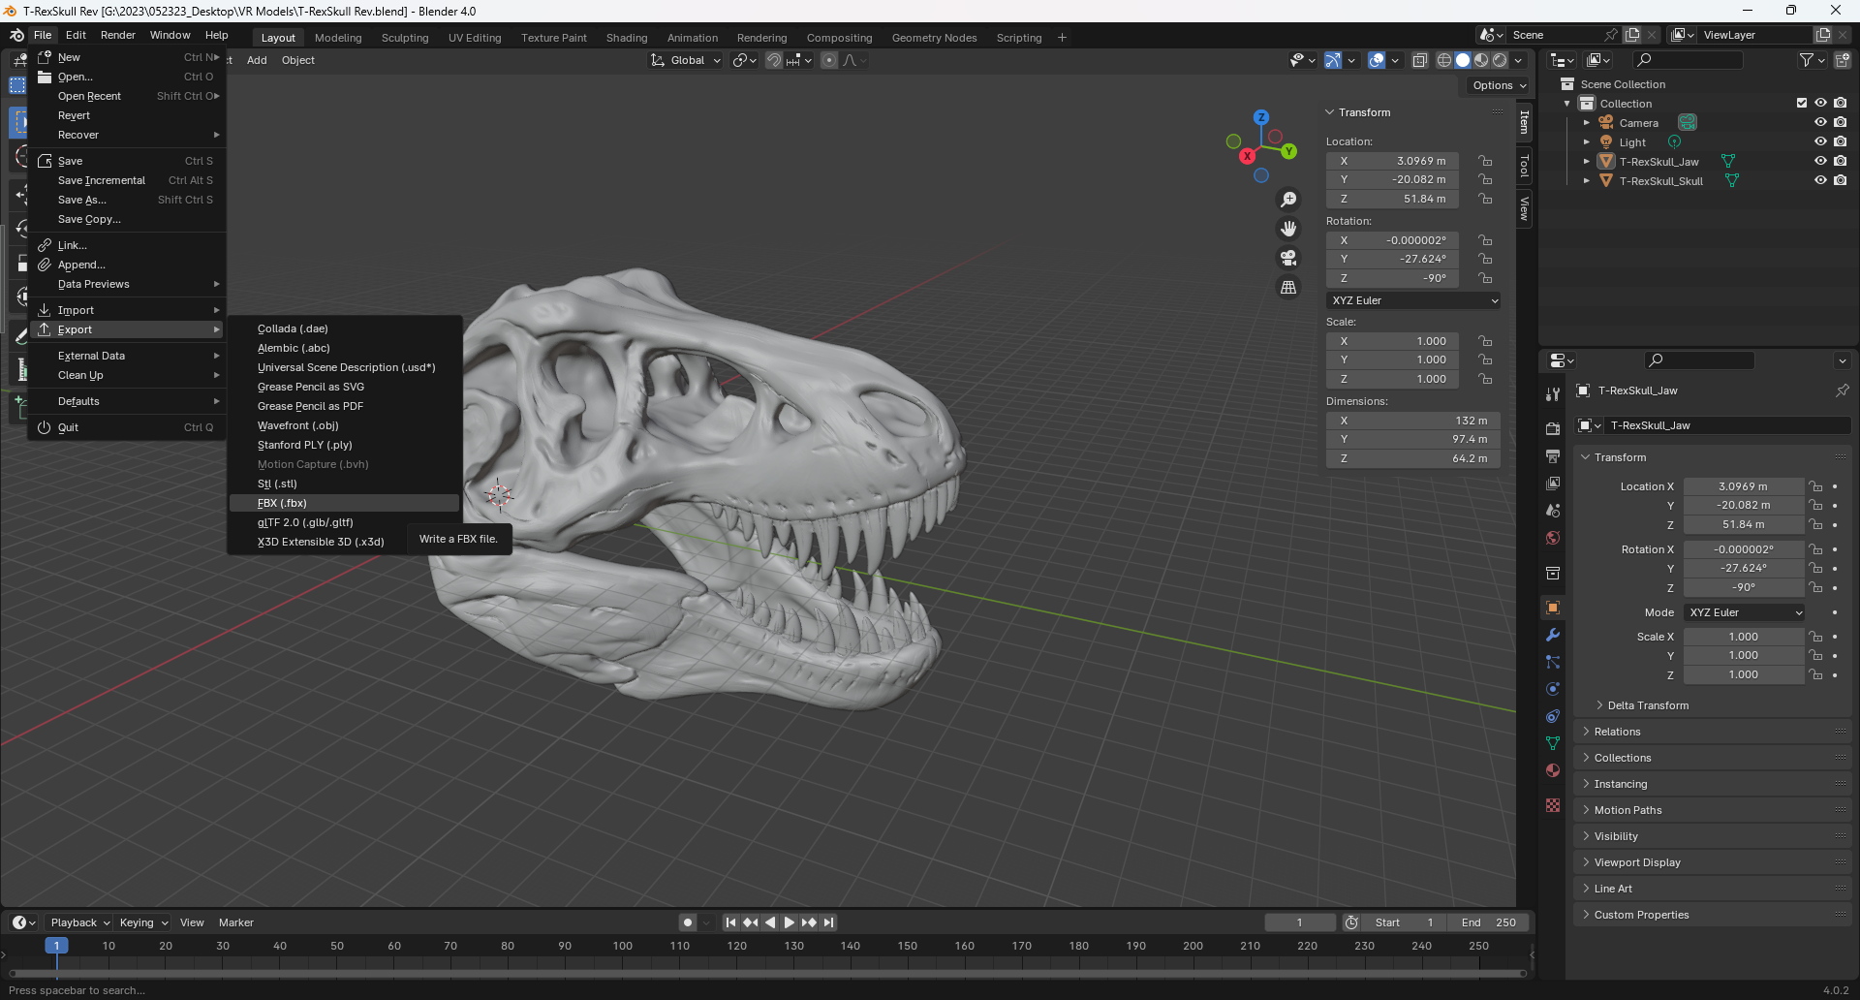
Developing VR Content for Unreal Engine - Getting a model
Model must be converted to be imported into Unreal Engine. We will use the FBX format.

Slide 24
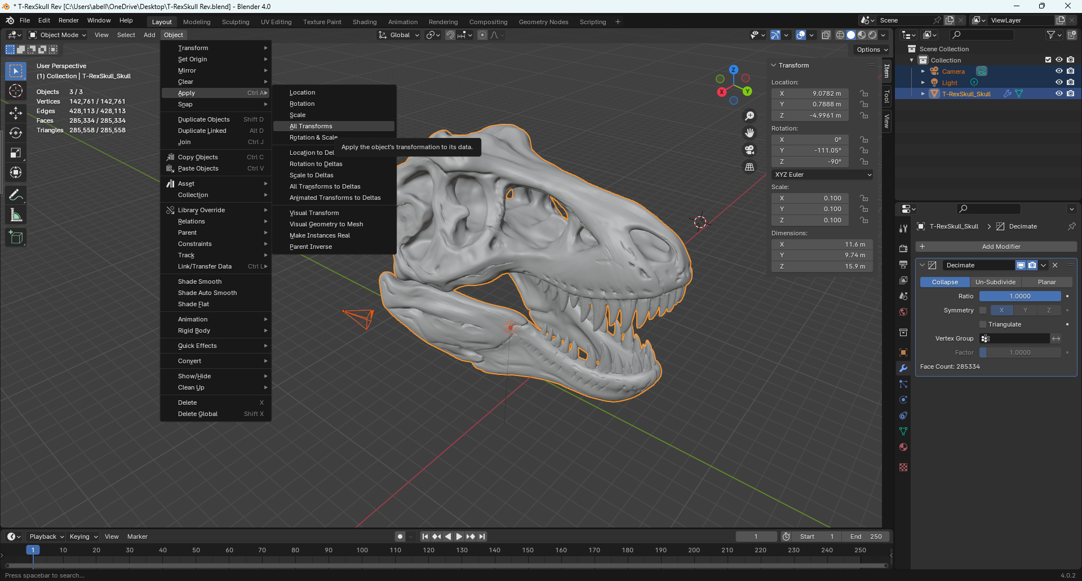
Developing VR Content for Unreal Engine - Getting a model
Prior to export it is a good practice to apply all transforms.

Slide 25
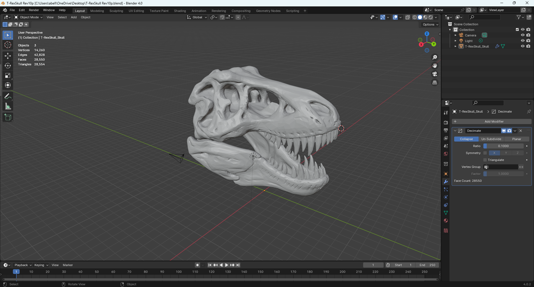
Developing VR Content for Unreal Engine - Getting a model
This is the decimated version of the model which should make it faster to render in Unreal Engine. Decimation can be performed in Blender and the technique used is a simple Collapse to 10% of the original mesh size.

Slide 26
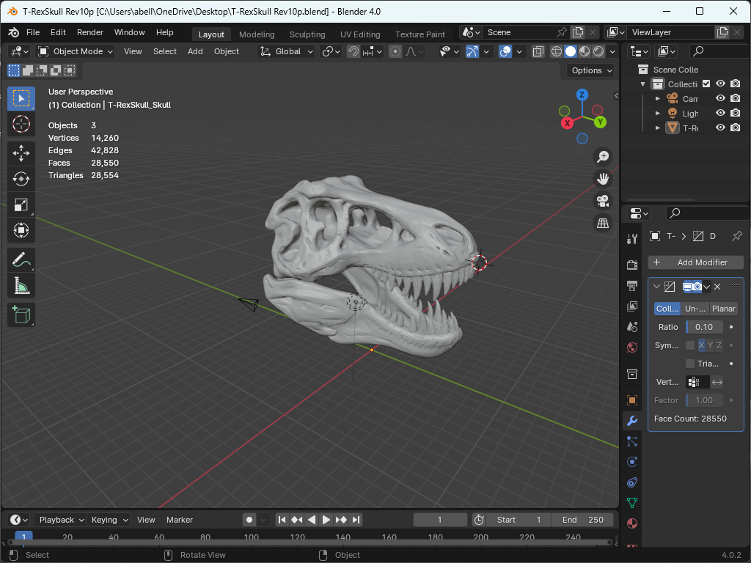
Developing VR Content for Unreal Engine - Getting a model

Slide 27
Developing VR Content for Unreal Engine - Getting a model
You can also build your own models using Solidworks, AutoCAD and/or Blender. Since we use Solidworks in our AS degrees this is how you would build models for Unreal Engine.
Step 1 – Design and build your model.
Step 2 – Export model as an STL file from Solidworks.
Should maintain dimensional integrity.
STL files can also be used for 3D printing.
Step 3 – Import STL file into Blender.
Model can be scaled and decimated to reduce the size of the mesh model.
Lower poly models should be your goal, but model complexity should be
balanced against how the model looks in VR.
Step 4 – Export STL file from Blender as an FBX.
Blender can support the model but may want to add face smoothing.
Always save your Blend file.
Step 5 – Import FBX file into Unreal Engine.
There is actually more details that could be shared regarding UV Maps, textures and materials using Blender. I would strongly encourage that you learn and use Blender to support developing VR content.

Slide 28
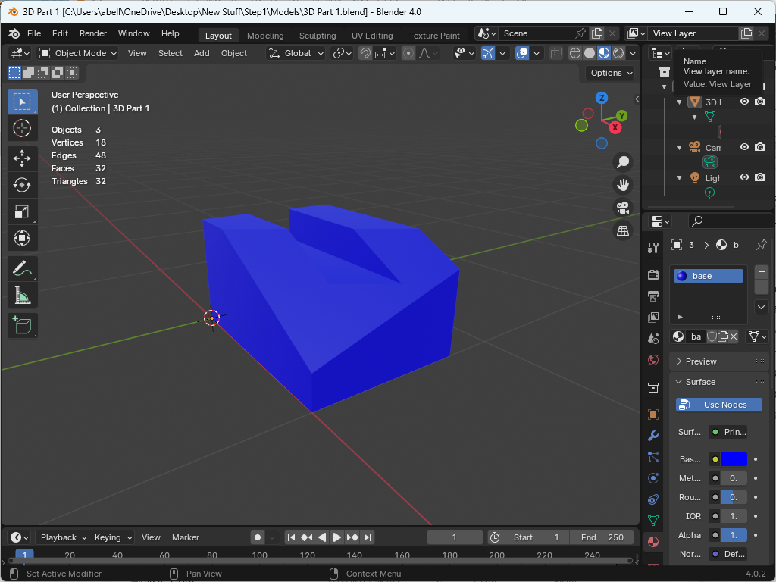
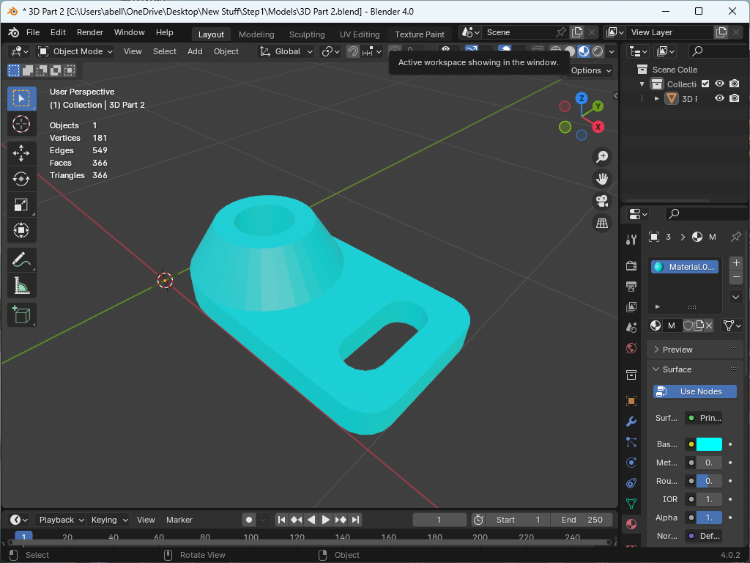
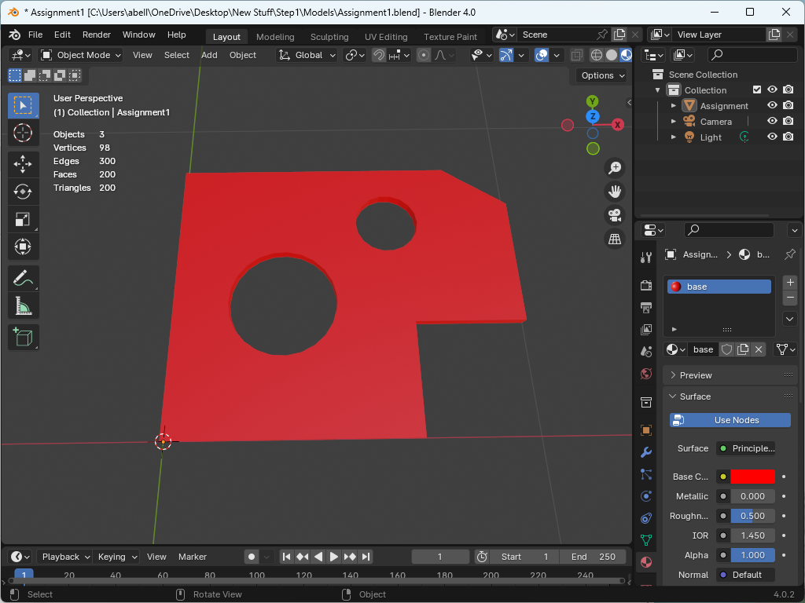
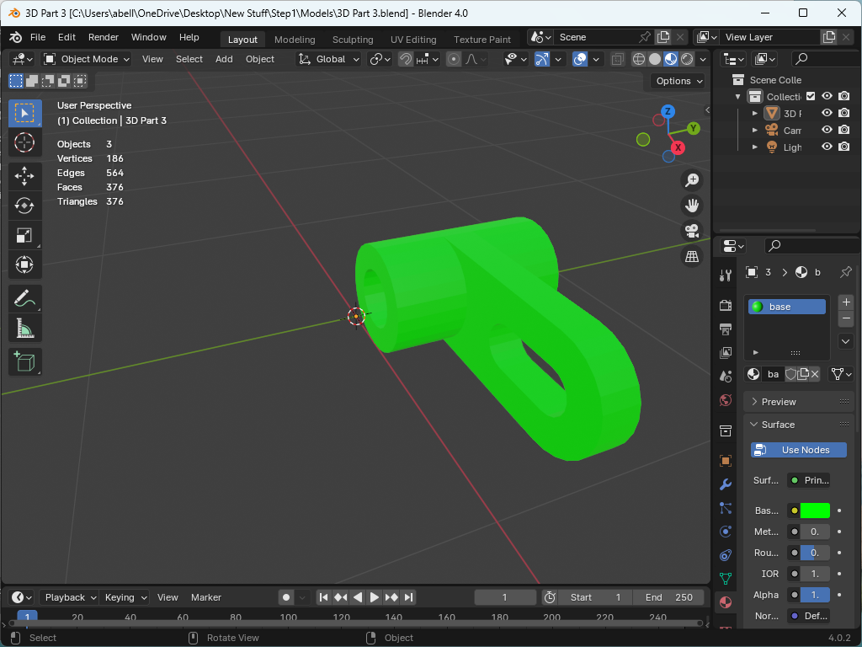
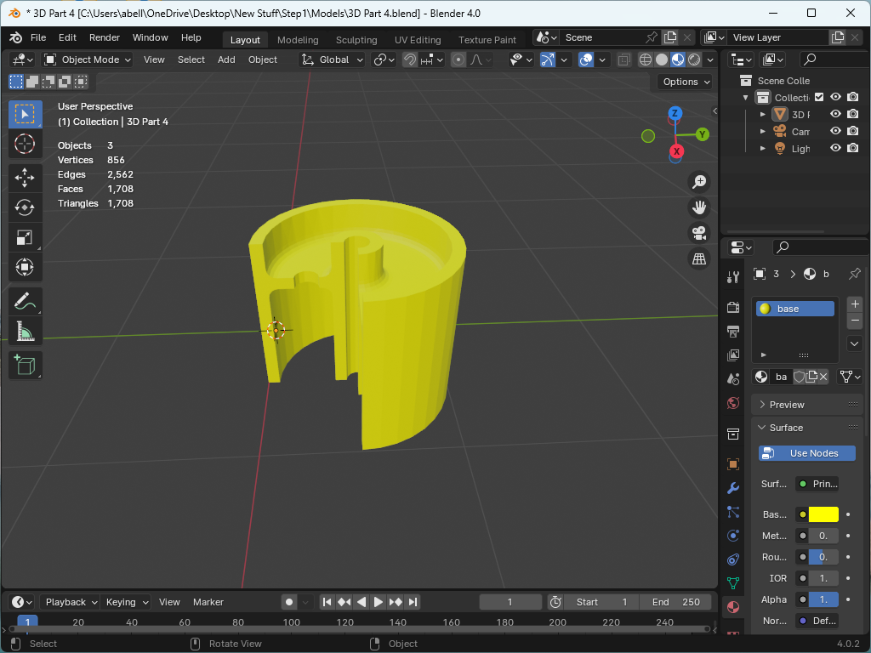
Developing VR Content for Unreal Engine - Getting a model
Here are examples of 5 CAD models built with AutoCAD and Solidworks. These models were exported as STL files and then converted to FBX files for Unreal Engine. (Note the number of the “Triangles” is relatively low so these would be low poly models.

Slide 29
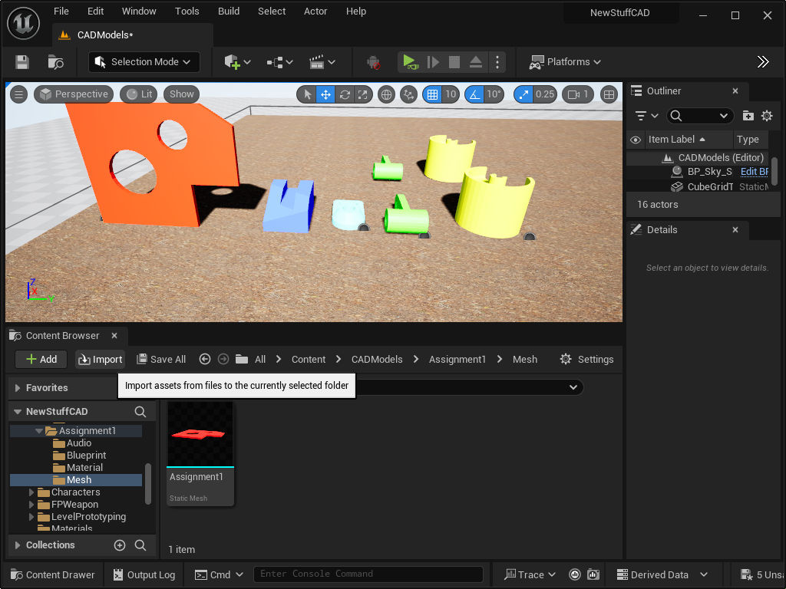
Developing VR Content for Unreal Engine - Getting a model
Within Unreal Engine you should create a folder for each model and import the mesh (FBX file) into the folder you create called “Mesh”. You can also import the material (texture) of the model as well or add the texture within Unreal Engine.
All five models were imported into a folder call CAD Models and then placed within a scenario to view and interact with.

Slide 30
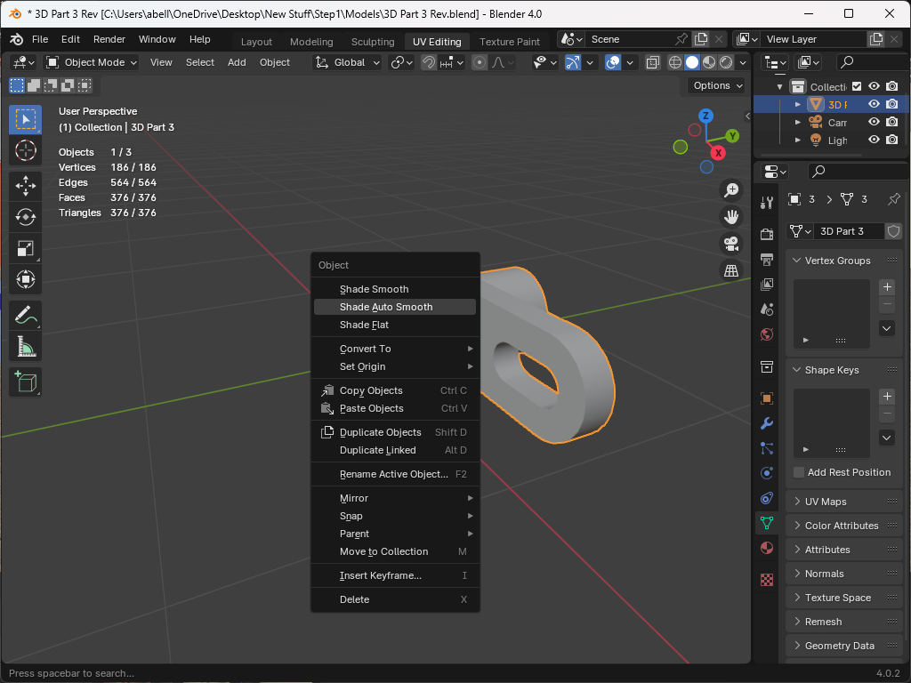
Developing VR Content for Unreal Engine - Getting a model
For the more complicated models that include circular faces I did a Shade Auto Smooth in Blender. This greatly improved the quality of the model in VR.
Mesh density and lighting will continue to be an issue as you use more complicated models. To get it “right” will take some research and experimentation.

Slide 31
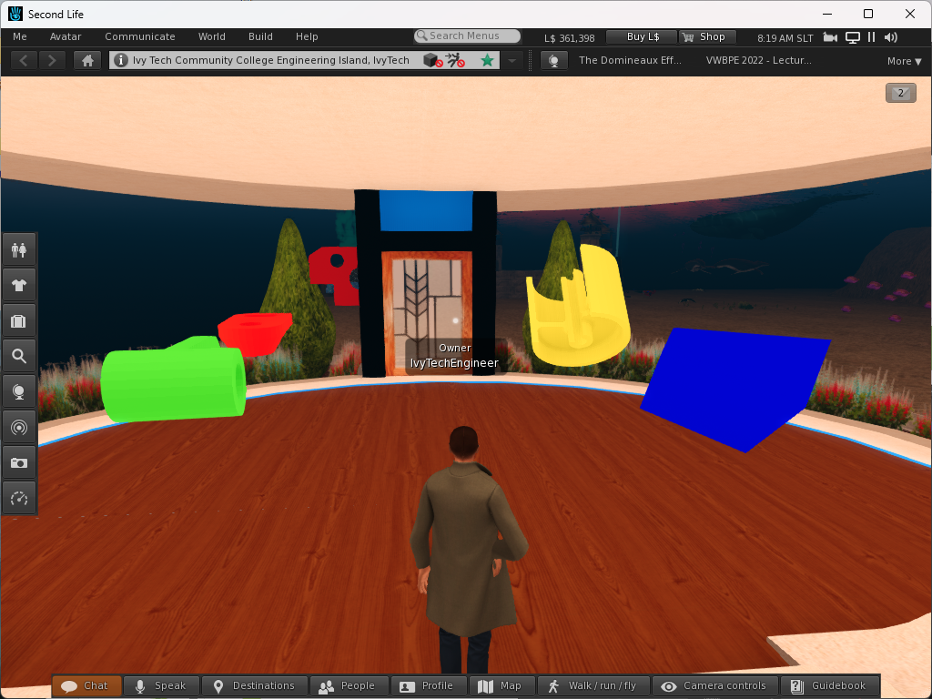
Developing VR Content for Unreal Engine - Getting a model
These are the five CAD models that were uploaded to Second Life. A script was also added to the models so they would freely spin. These models are DAE files but were produced using the same Solidworks (STL) models with Blender.
default
{
state_entry()
{
llTargetOmega(<1.0,1.0,1.0>*llGetRot(),0.1,0.01);
}
}

Slide 32
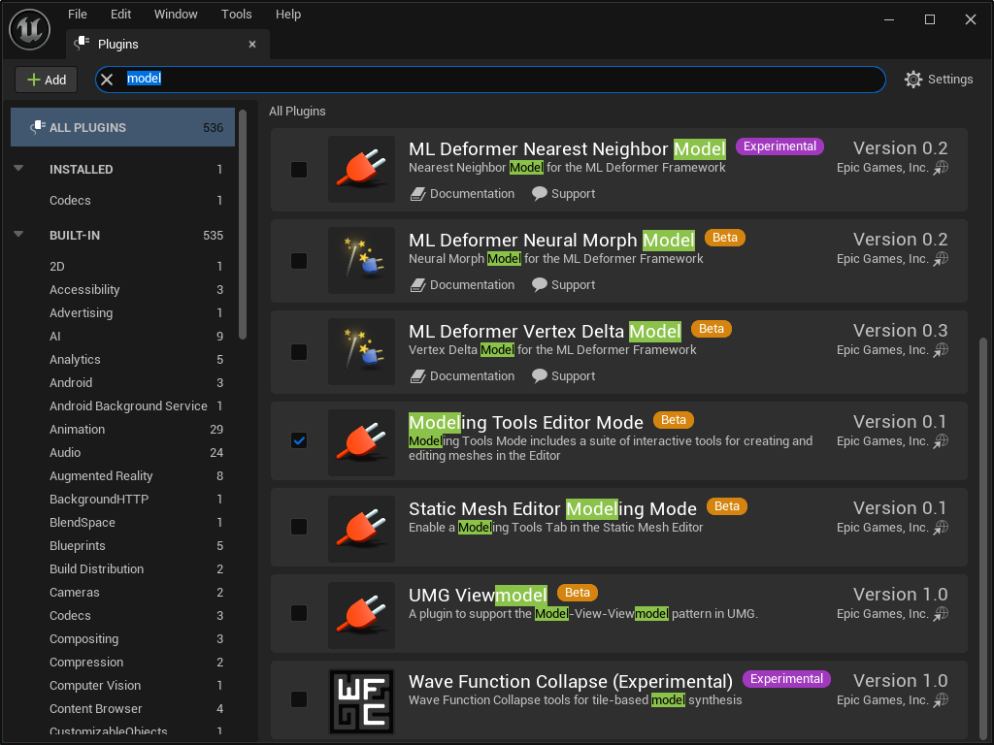

Slide 36
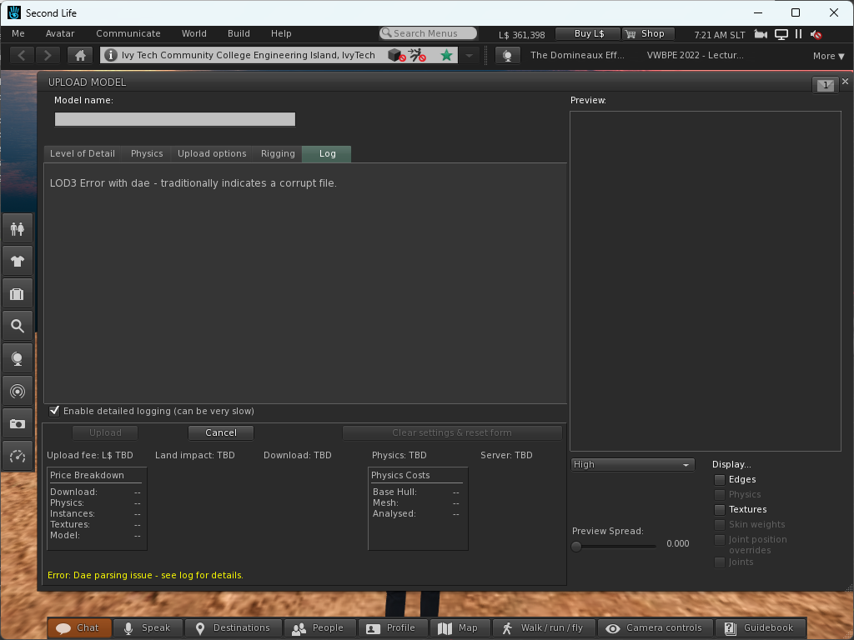
Developing VR Content for Unreal Engine

Slide 37
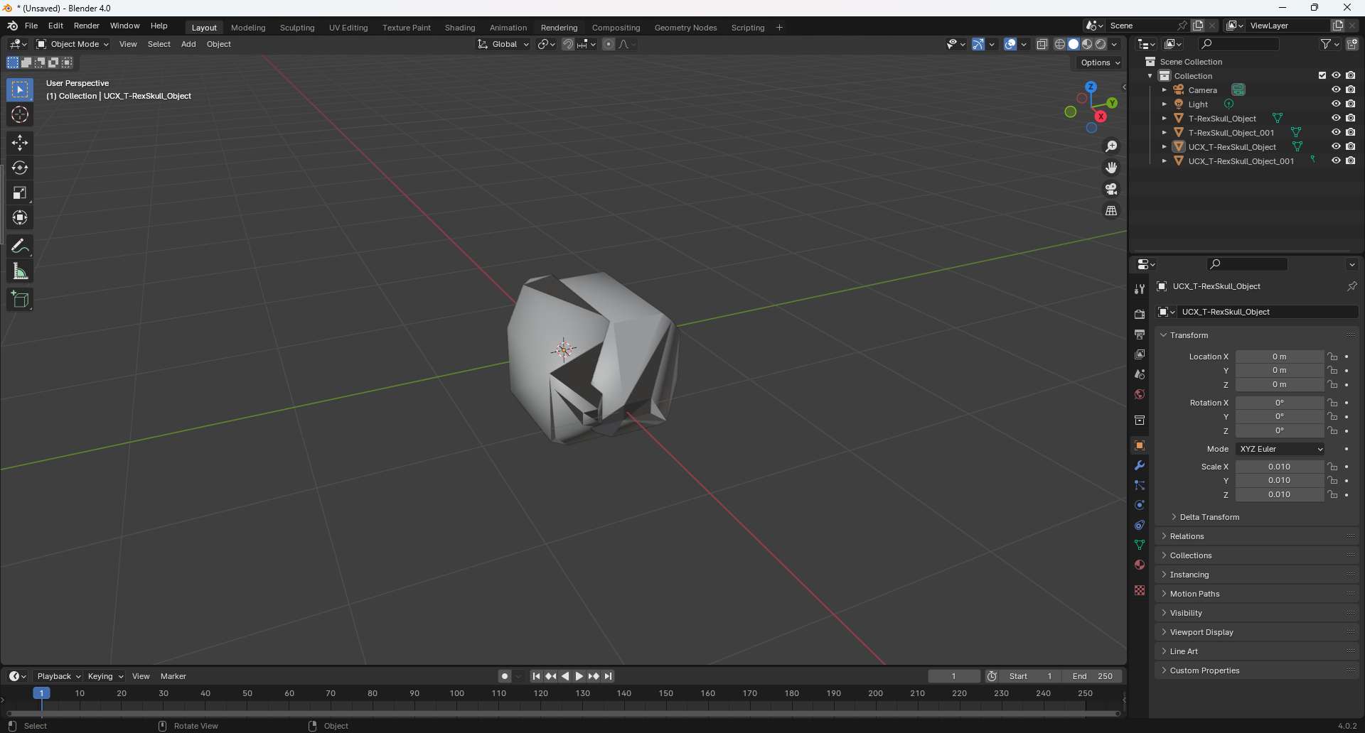
Developing VR Content for Unreal Engine
We can export the skull of the T-Rex as two FBX files and import them into Blender for review. 4 model items are imported to include the original models and a UCX which is like a shell around the model. The UCX are collisions files which would correlate to physics files in other programs.

Slide 38
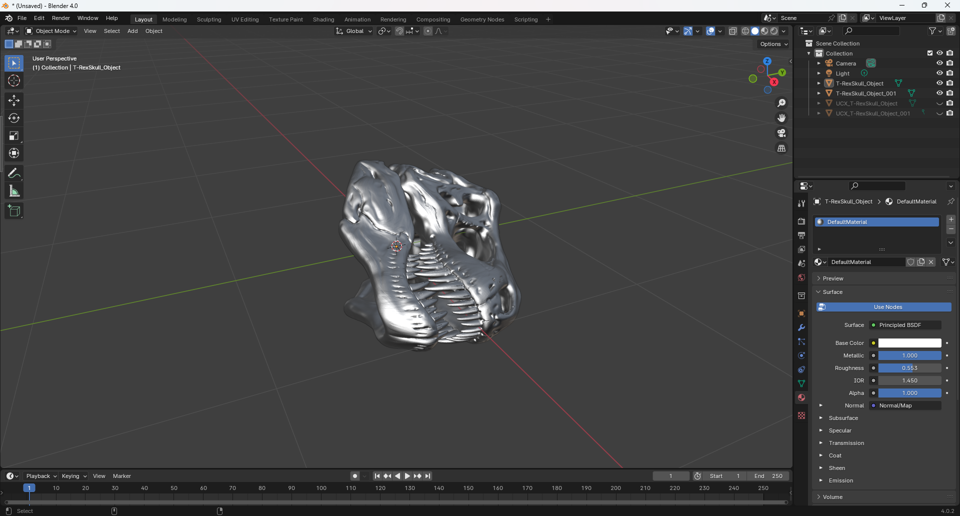
Developing VR Content for Unreal Engine
In addition, a material is also imported for both models. This material doesn’t look like the material used in Unreal Engine. Also, the model has a strange orientation. The Y and Z axis are switched. This is the original orientation of the model. This should have been changed in Blender before the FBX file was created.

Slide 39
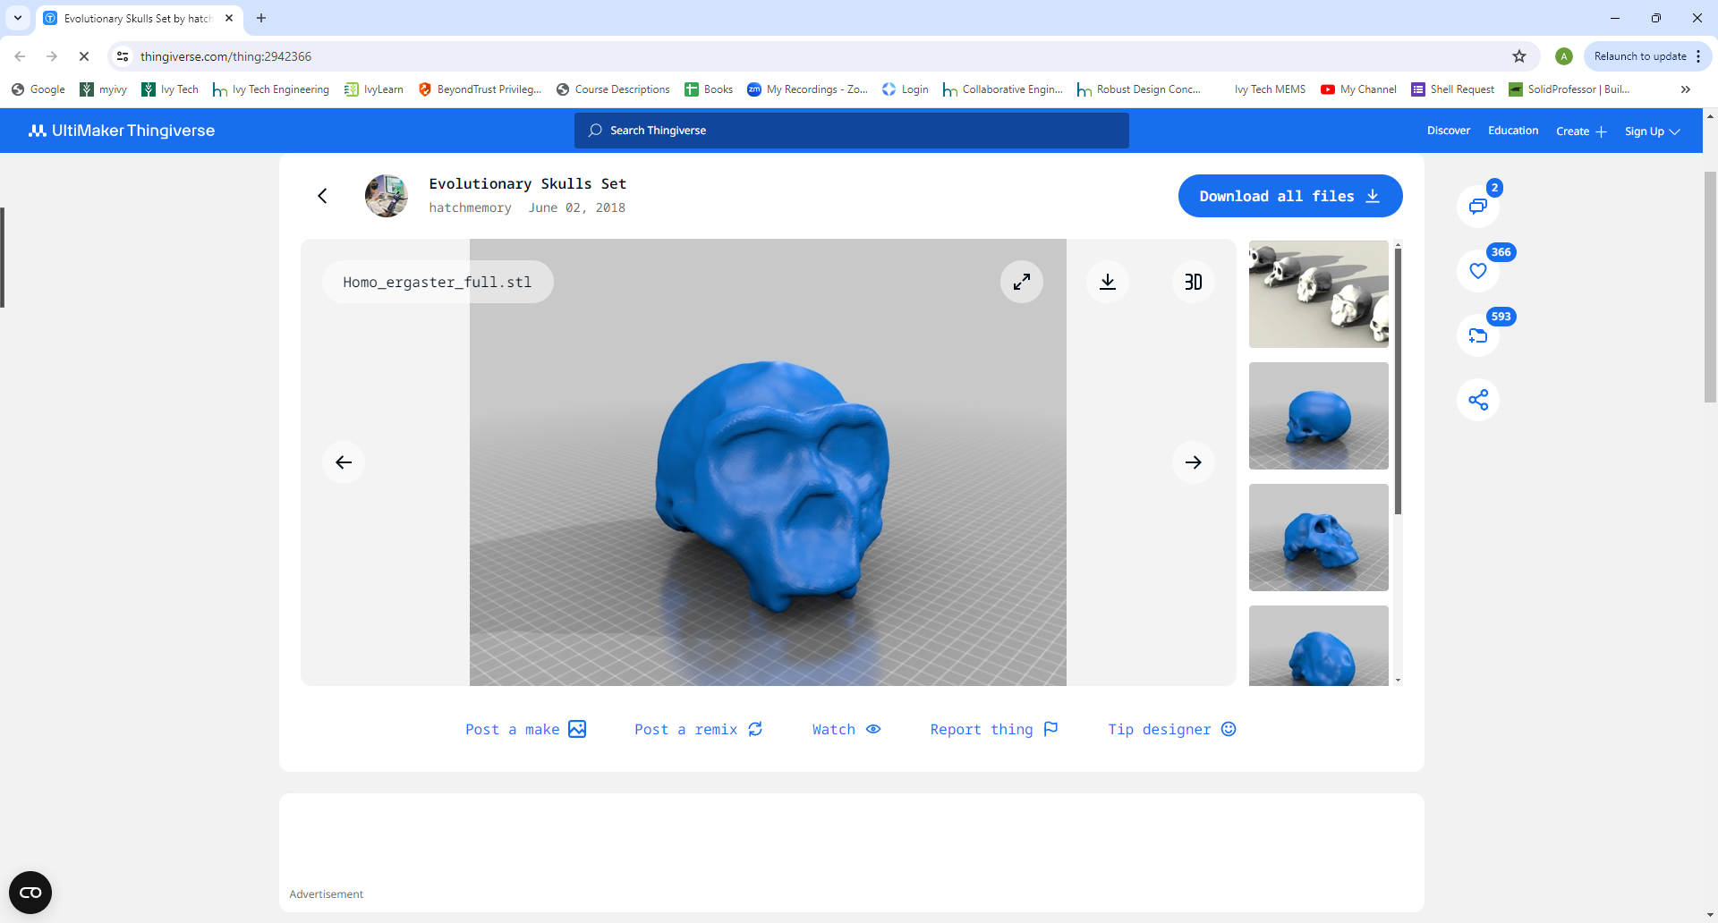
Developing VR Content for Unreal Engine

Slide 40
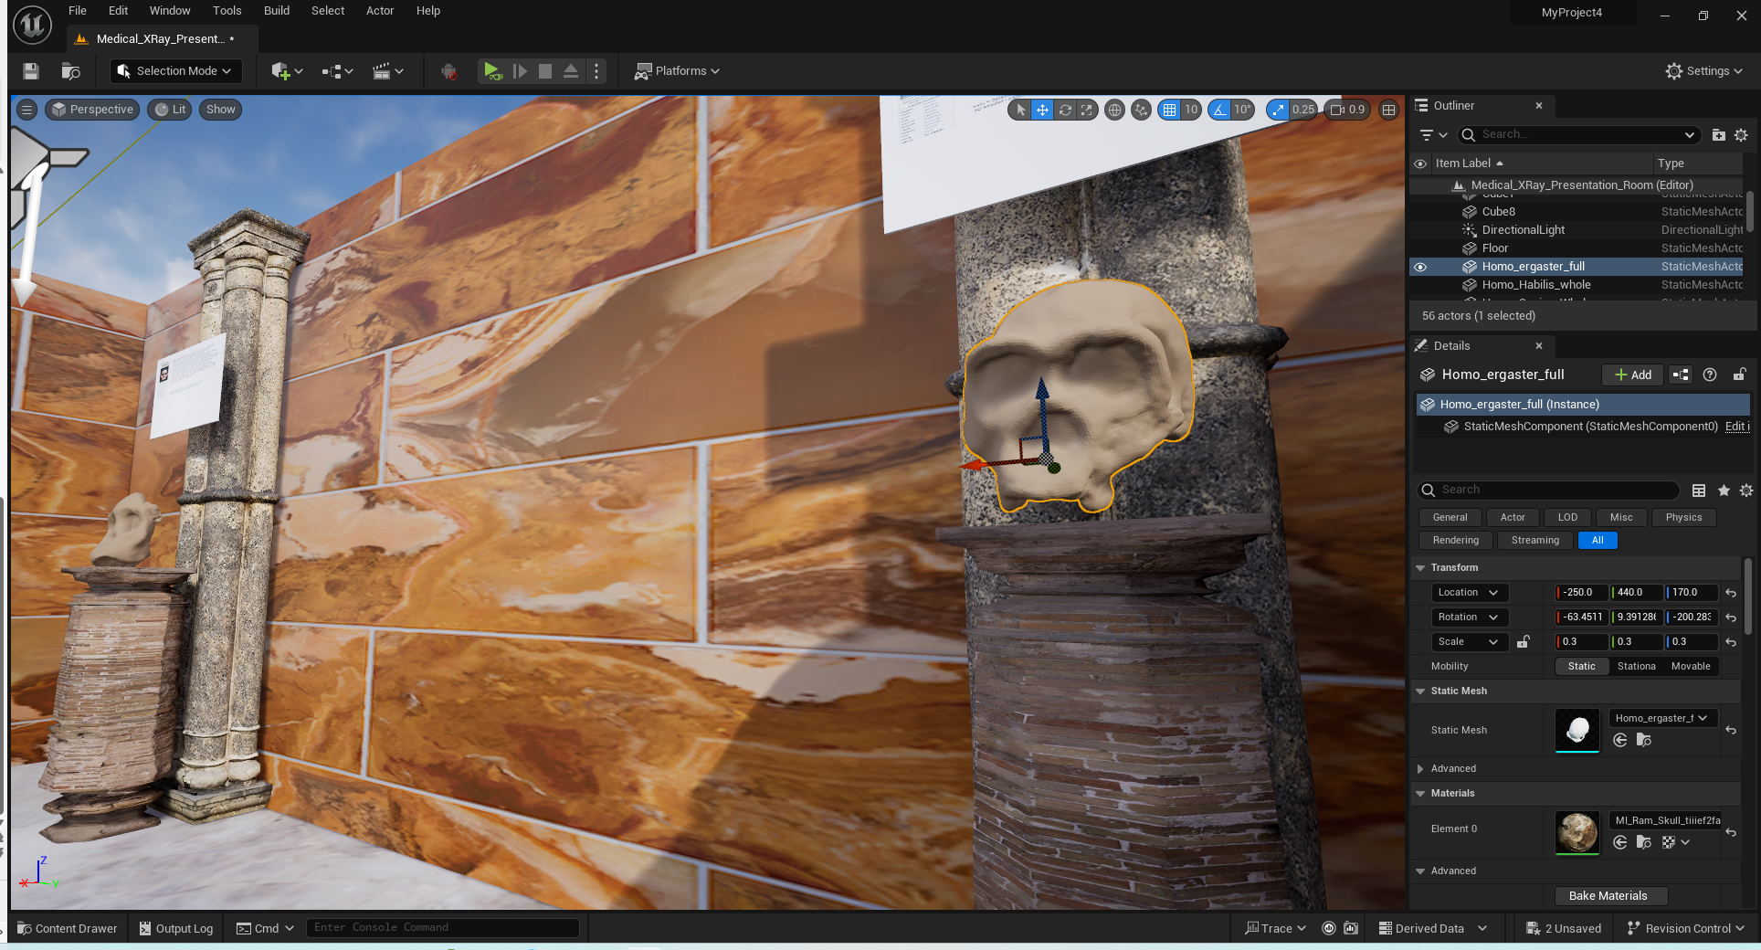
Developing VR Content for Unreal Engine

