Slide 1
Creating Solidworks Model for SCME Pressure Sensor
AGBell – 7/24/2019
Ivy Tech Community College

Slide 2
3D Models help student visualize the device
To visualize a part it is often helpful to use a 3D model
The SCME Pressure Sensor model is pretty straight forward but we could better used a model to understand its construction.
Can we use Solidworks (a popular 3D modeling tool) and the mask to create a model?

Slide 3
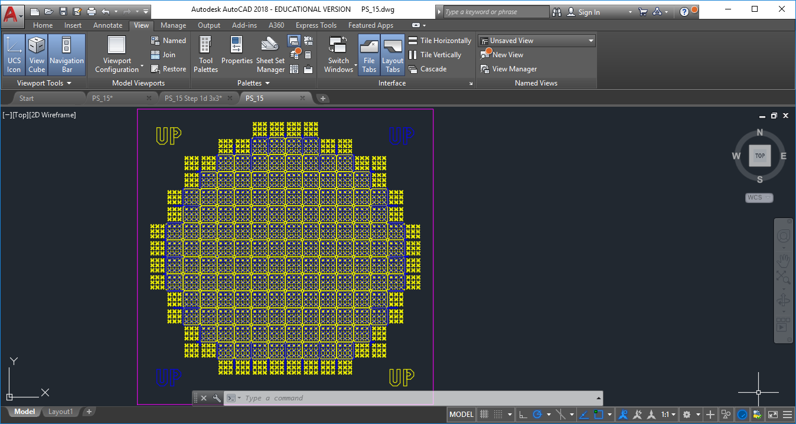
This is the original mask drawing opened in AutoCAD but it was not designed in AutoCAD so there are some issues that make it difficult to use in its original for to create a 3D model.

Slide 4
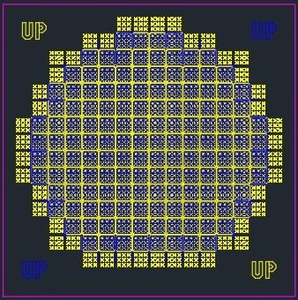
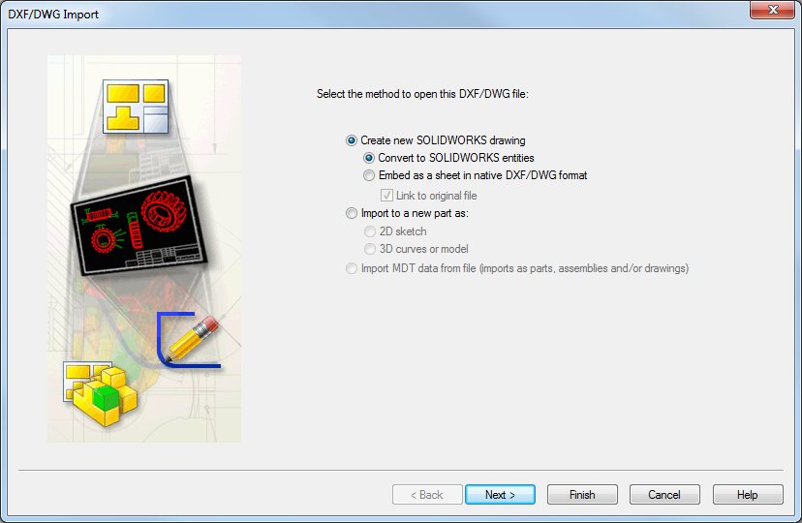
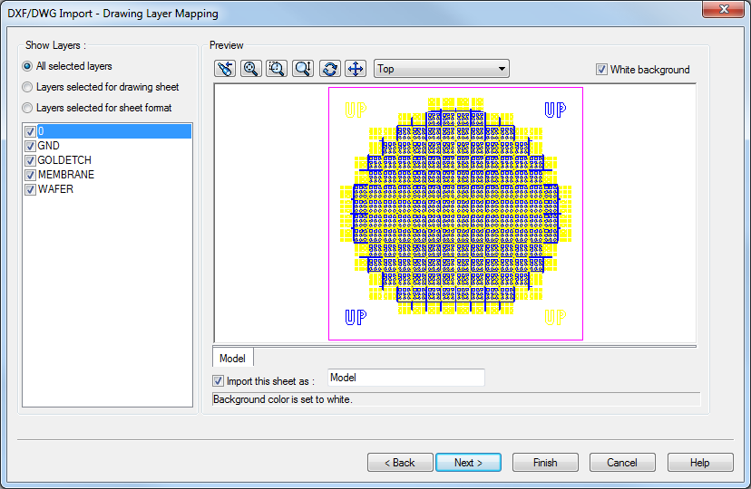
Step 1 – Import the mask into Solidworks
Solidworks can open a DWG file.

Slide 5
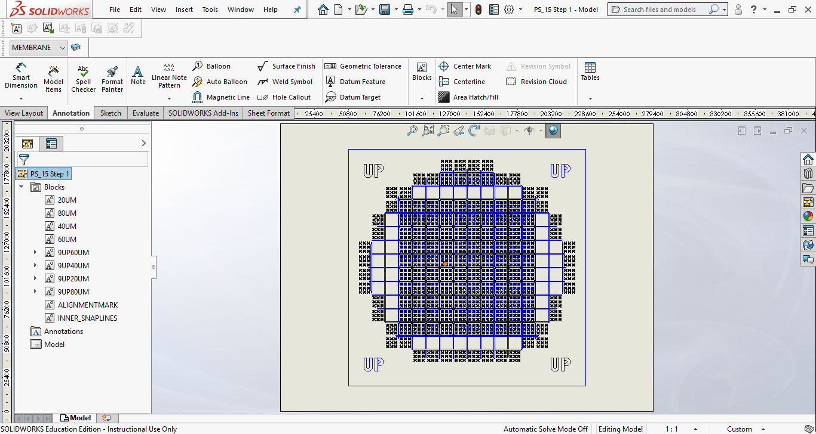
In Solidworks delete the portions of the mask you do not need. In our case part of the mask contains “block: so we will delete the 20UM, 80UM and 40uM blocks

Slide 6
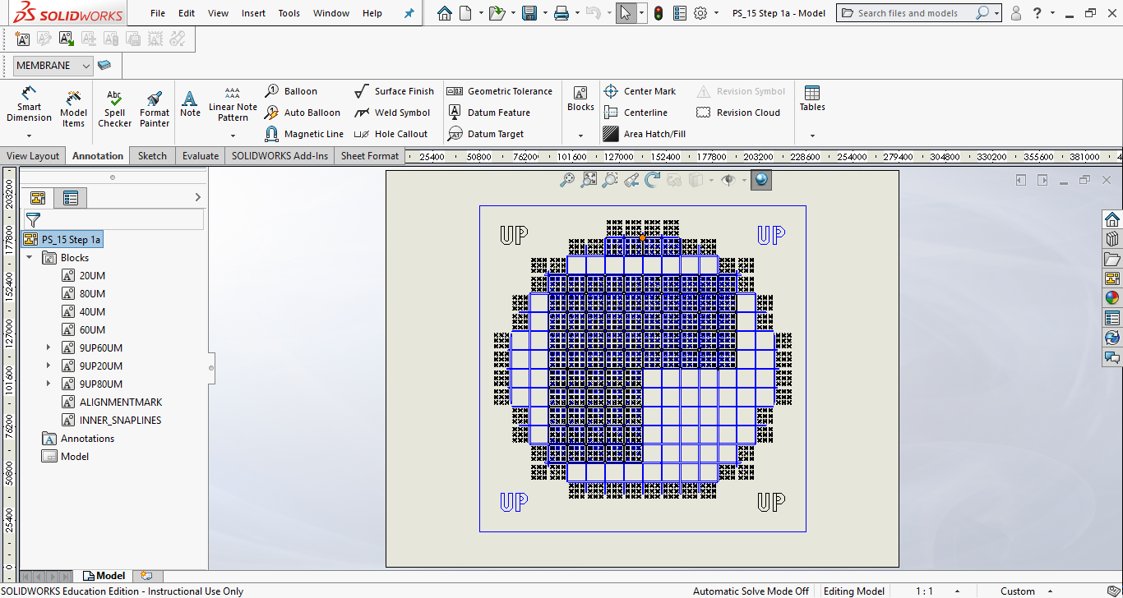
In Solidworks delete the portions of the mask you do not need. In our case part of the mask contains “block: so we will delete the 20UM, 80UM and 40uM blocks

Slide 7
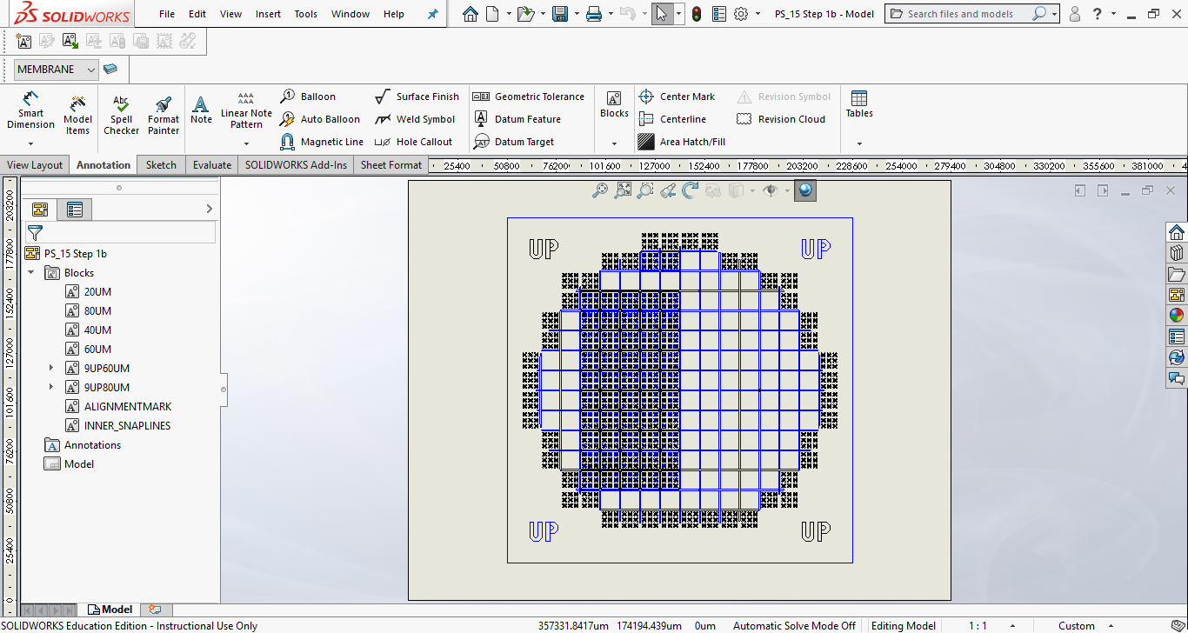
In Solidworks delete the portions of the mask you do not need. In our case part of the mask contains “block: so we will delete the 20UM, 80UM and 40uM blocks

Slide 8
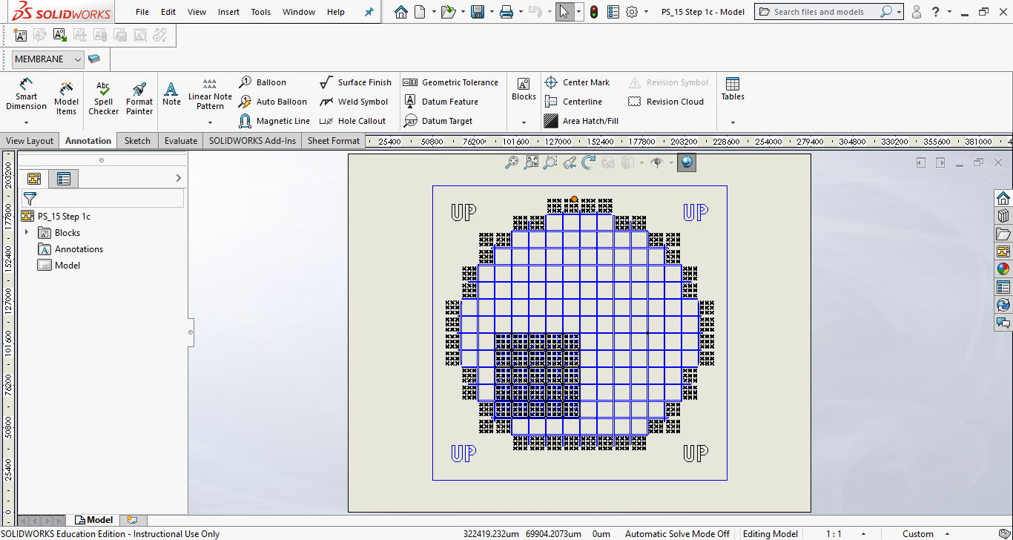
We are left with the 60UM block and some other shapes and lines that we need to whittle down still

Slide 9
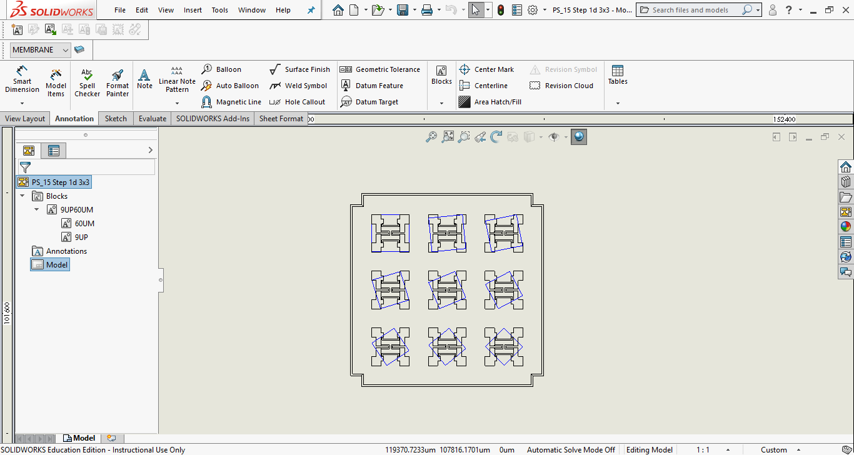
Finally we have something smaller we can work with and actually save as a DWG and/or SLDDWG.

Slide 10
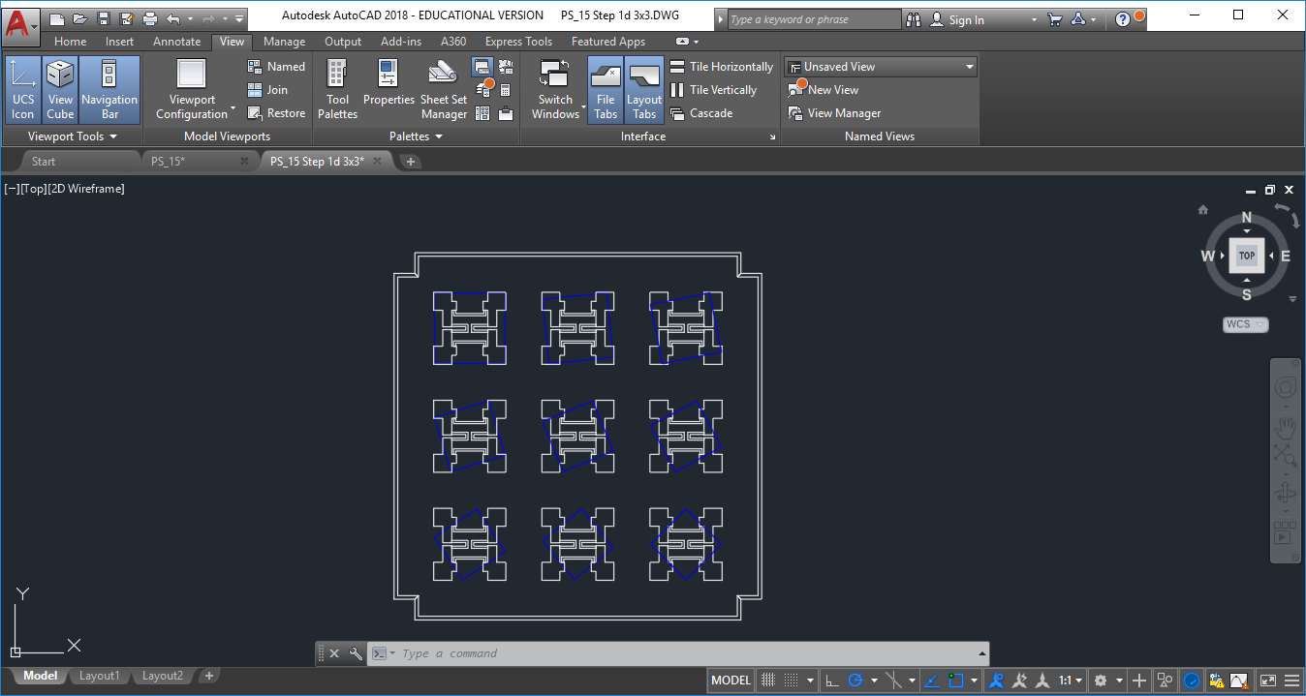
Here is the new drawing in AutoCAD. If we have skills to edit this drawing in AutoCAD we should reduce to the drawing in the top left shape. Instead we will stay with Solidworks.

Slide 11
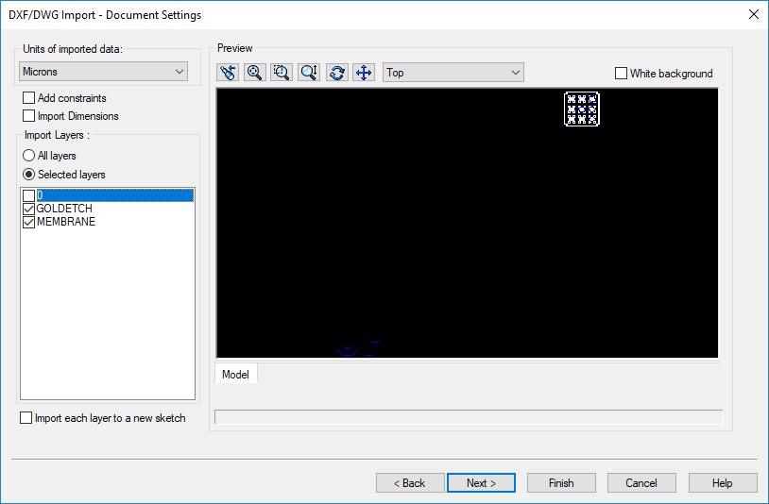
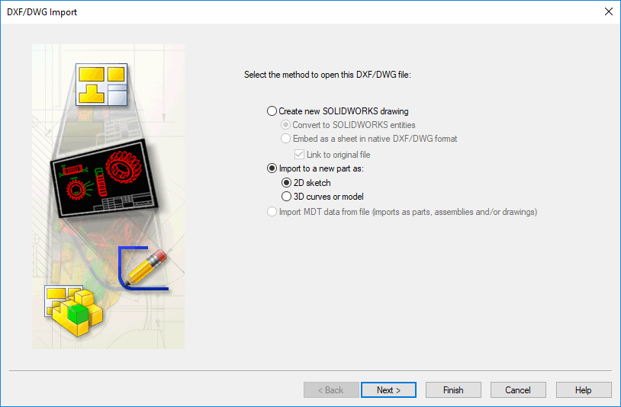
Step 2 – Import again into Solidworks
Change to import a new 2D part and select only the GOLDETCH and MEMBRANE layers
We can also import using the dimensions “microns”, this is very cool!

Slide 12
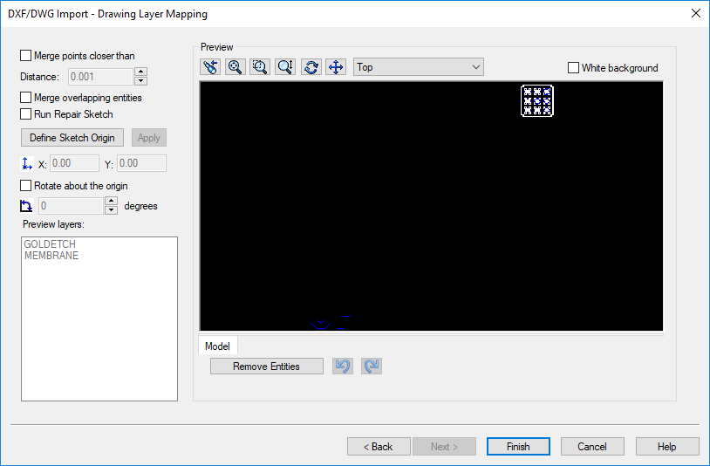
Step 2 – Import again into Solidworks
Also deselect the “Merge points”

Slide 13
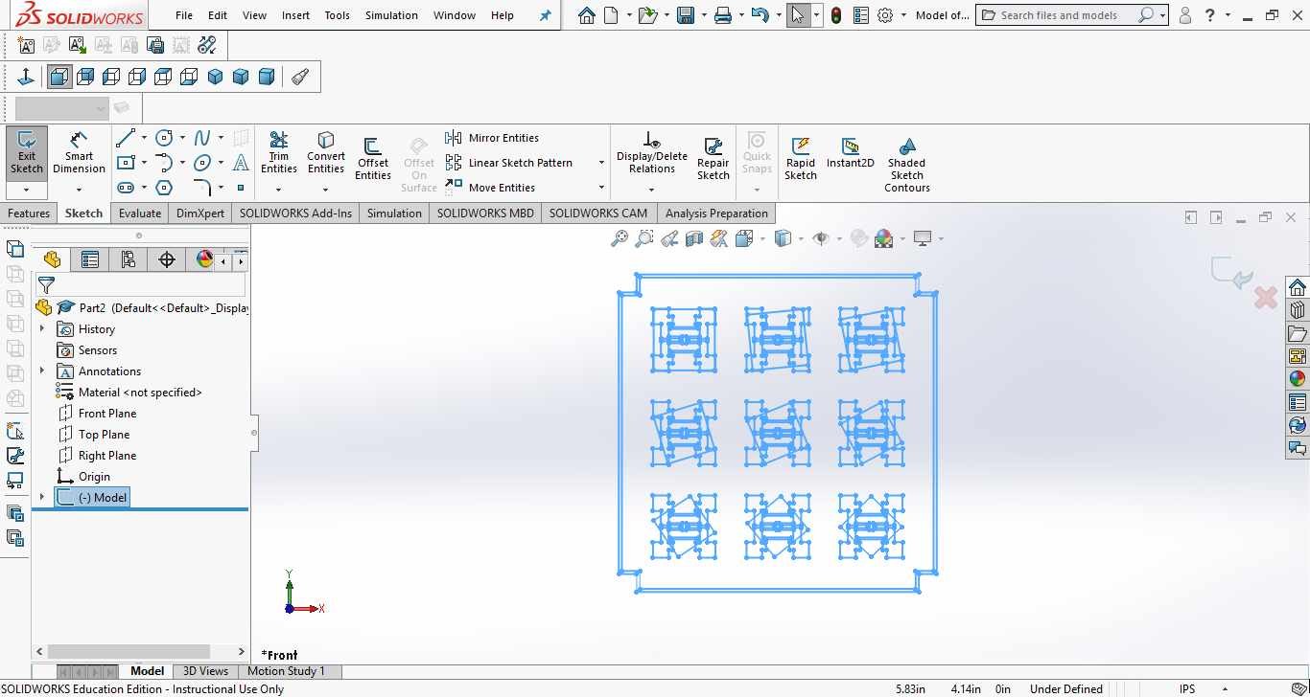
Now we have something to work with an we need to do a few more steps to get down the drawing we want to use to build the 3D model

Slide 14
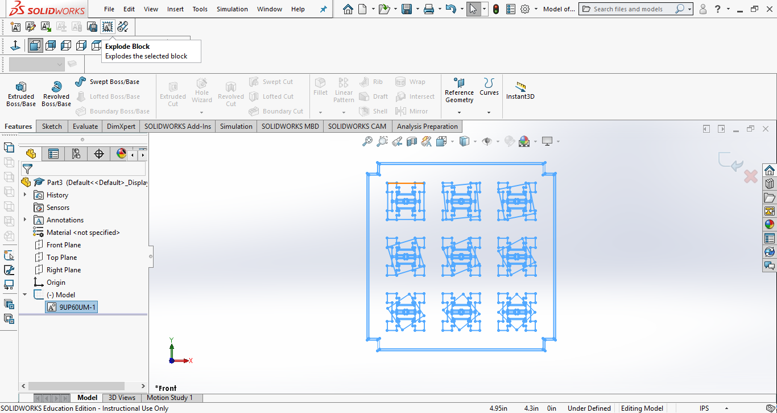
We first need to “explode” the block that contains the drawing we want.

Slide 15
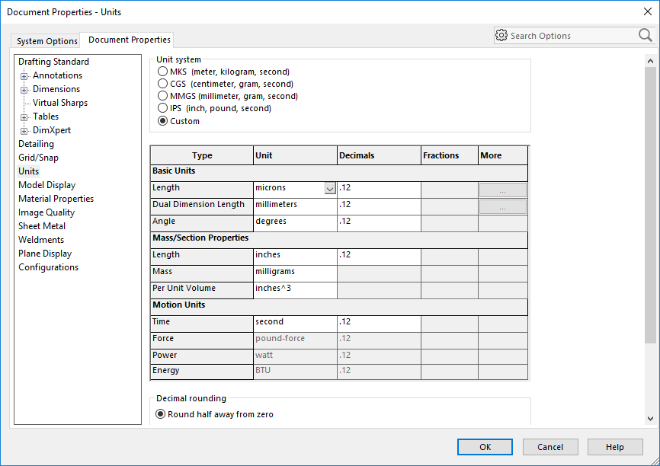
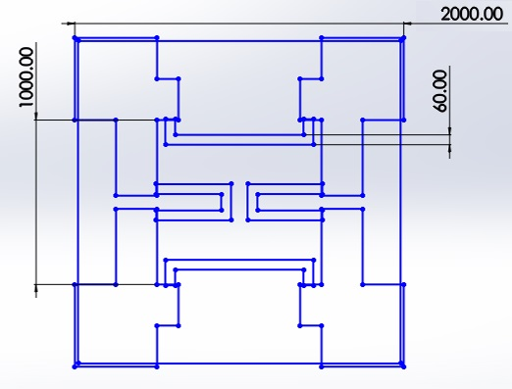
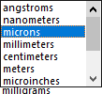
Step 3 – Change the Units to “microns”
Change the units to microns using the “custom” option
We can also use “microns” as our unit of measure.

Slide 16
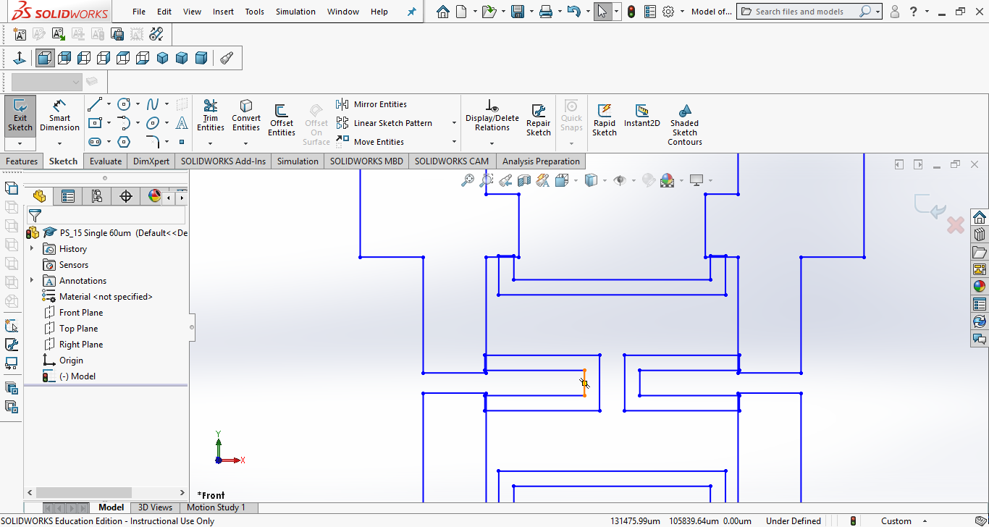
Use this tool to clean up the overlaps
Next we need to eliminate overlaps in the drawing. Otherwise it will make it difficult to extrude. OBTW we also deleted the Diaphragm from the drawing because we are now focused on the circuit.

Slide 17
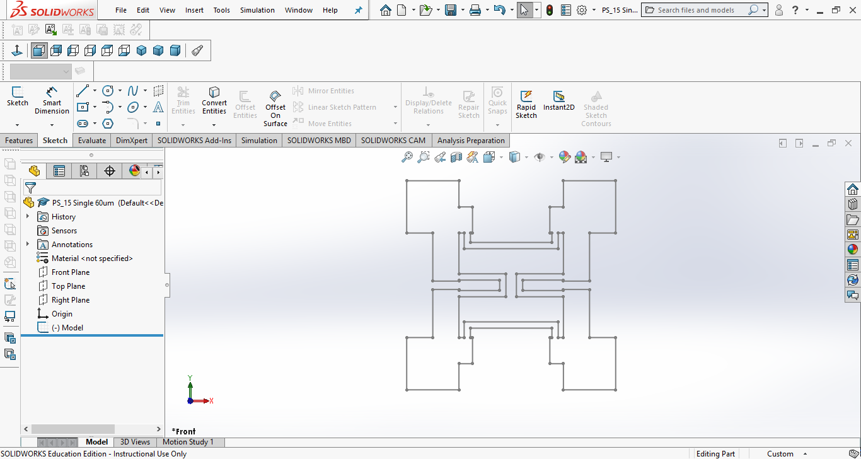
We can now build (extrude) the circuit, In this example we will extrude 5UM

Slide 18
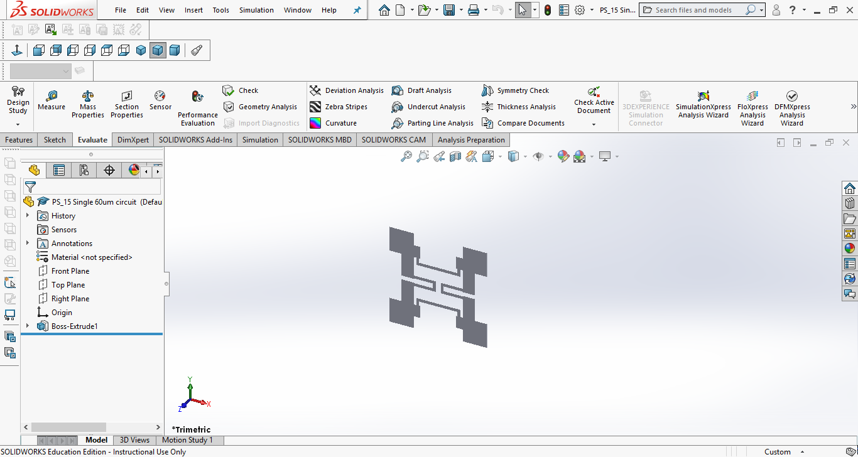
In an isometric view the circuit looks good, next we do the “diaphragm” and it will be 1UM, also we will make it 2200UM square, i.e. A little bit bigger than the circuit.

Slide 19
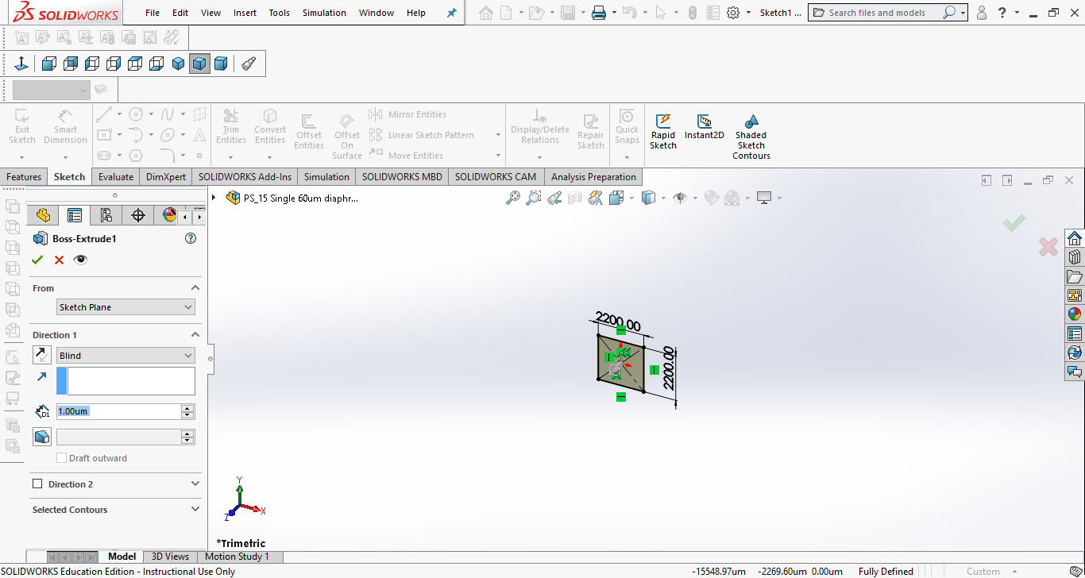
In an isometric view the diaphragm looks good, next we do the “wafer” and it will be 500UM

Slide 20
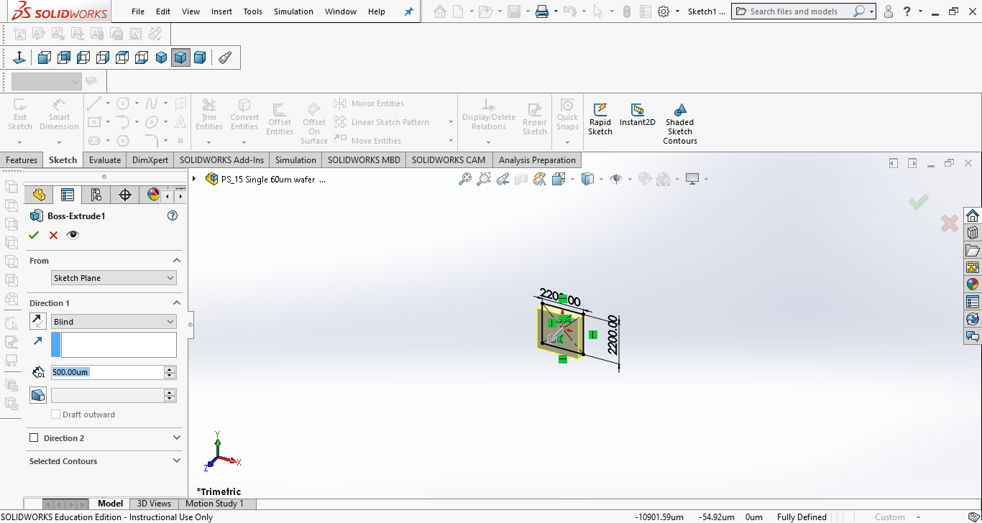
In an isometric view the wafer looks good but now we need to add the cavity through the wafer so that the angle between the bottom of the wafer and the cavity wall is 54.7 degrees.

Slide 21
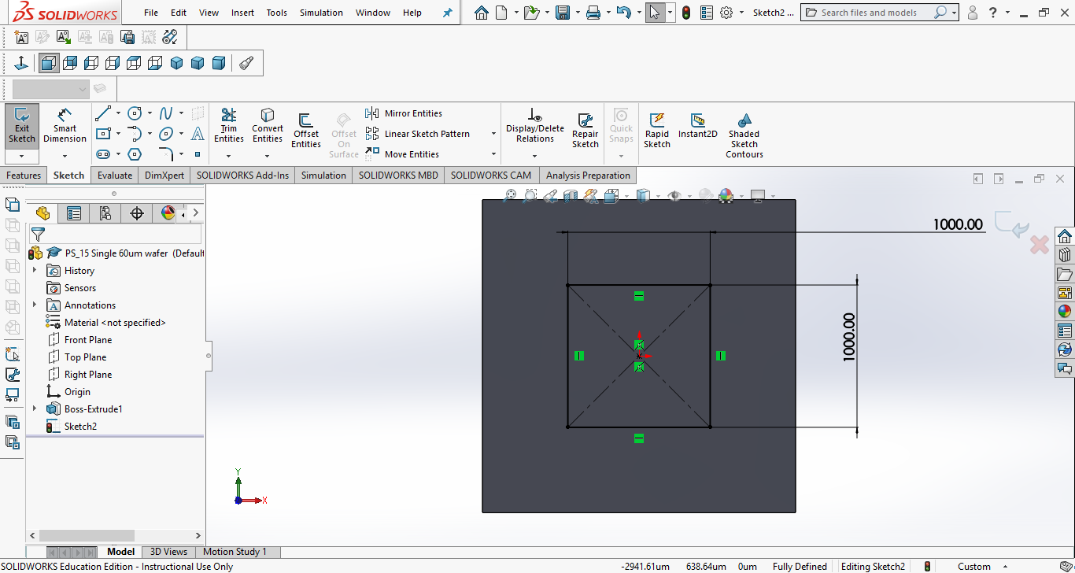
Draw the top of the cavity as a 1000UM square centered at the center of the wafer

Slide 22
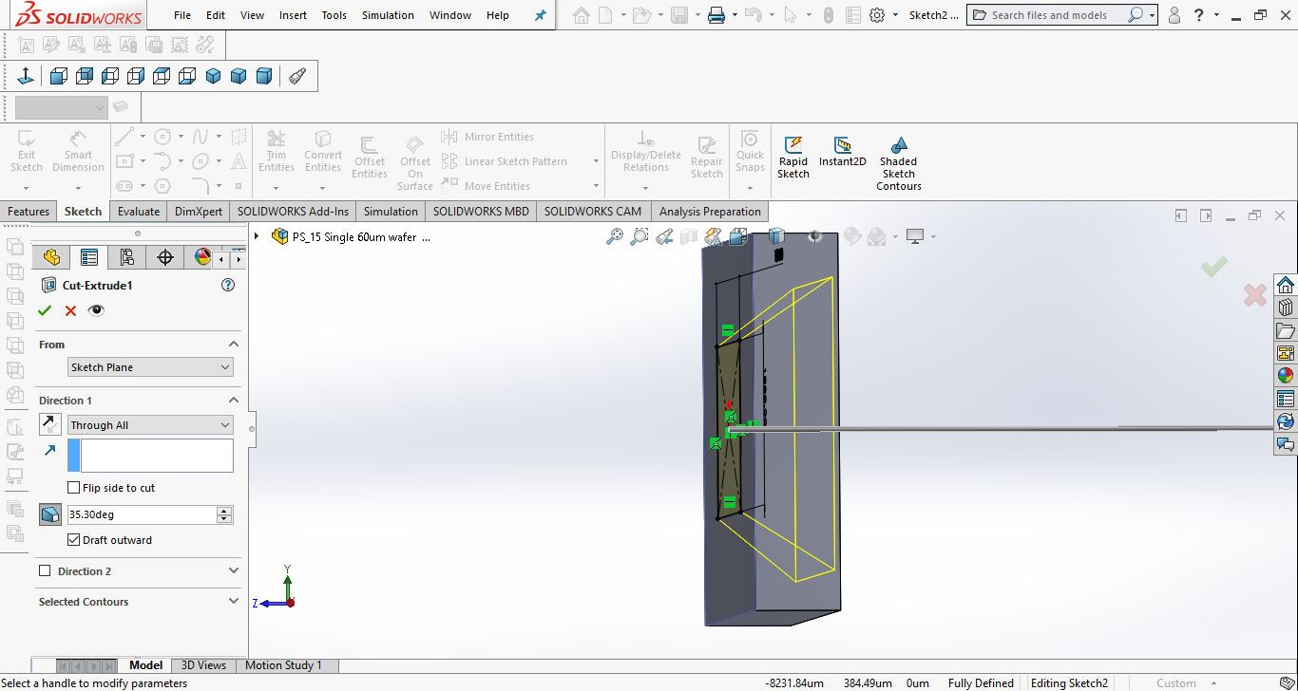
The do a extrude cut at
90-54.7 – 35.3 outward, through all

Slide 23
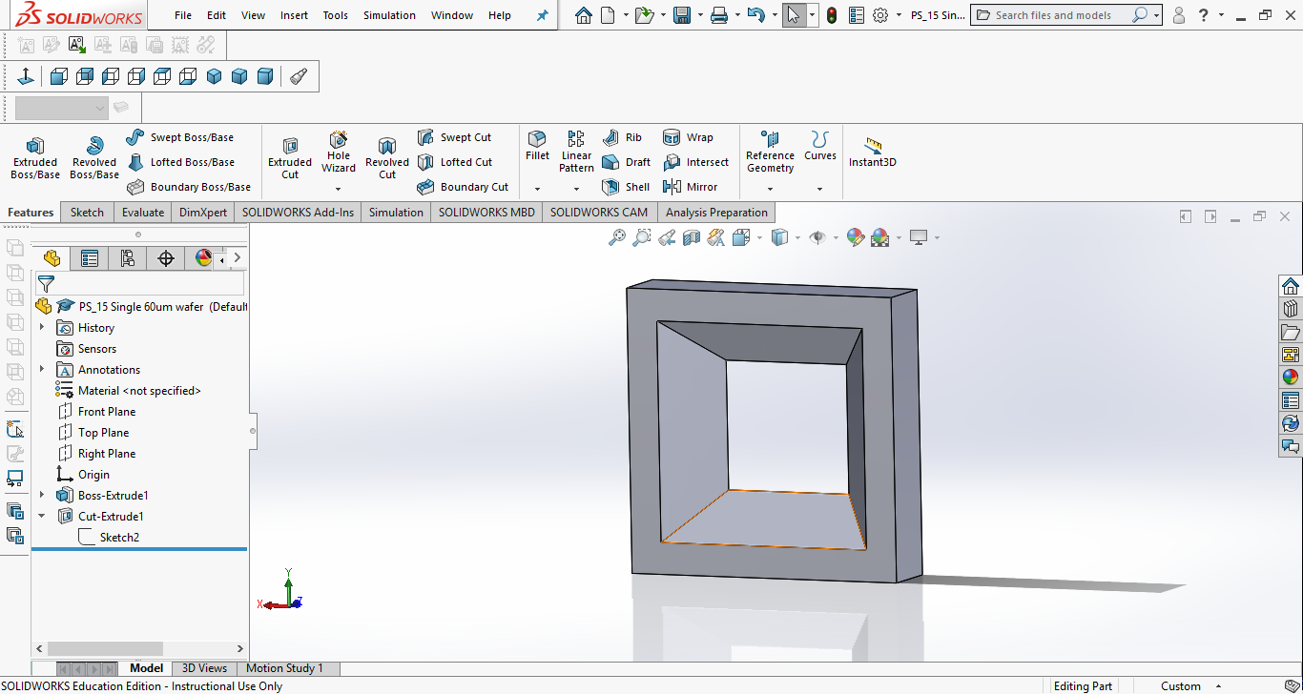
This is what it looks like.

Slide 24
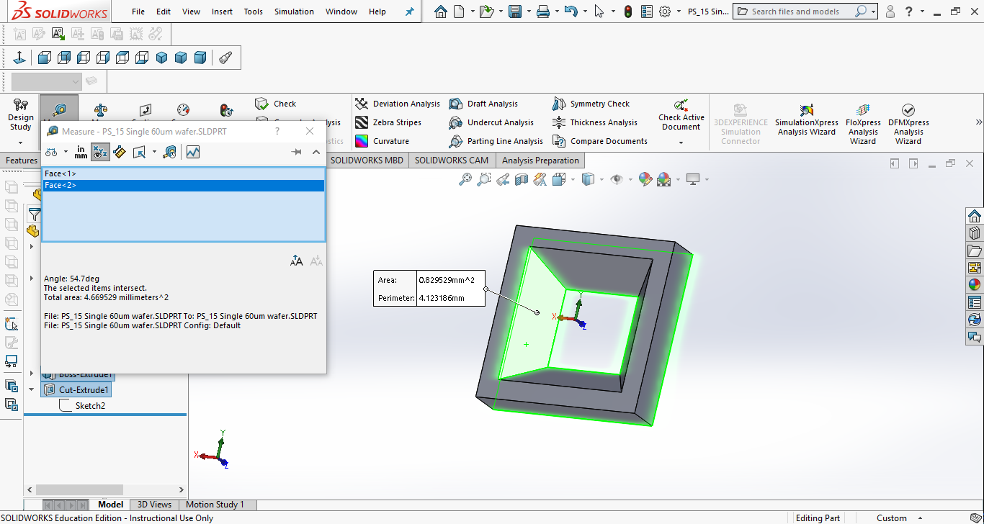
A measurement of the angle of the cavity wall shows the desired 54.7 degrees so the wafer with cavity is done

Slide 25
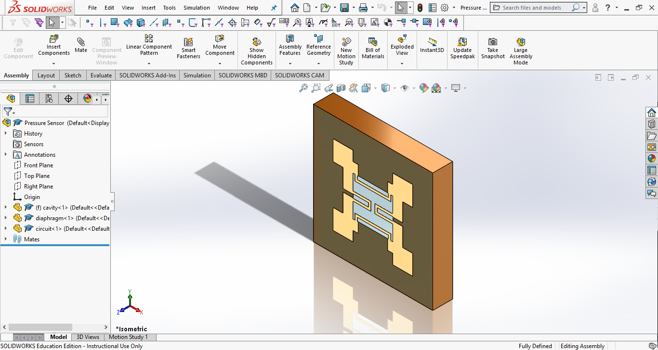
3D Models help student visualize the device
At this point the hard work is done. An Assembly can be colored, created and parts mated to create the 3D model of the SCME Pressure Sensor.

Slide 26
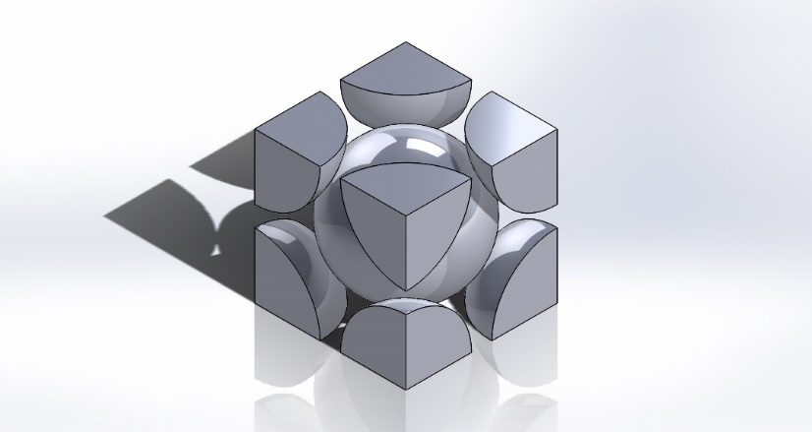
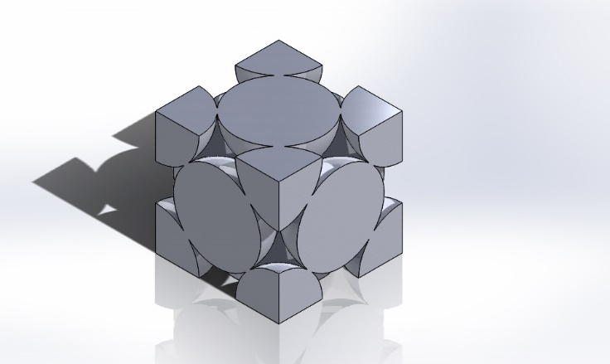
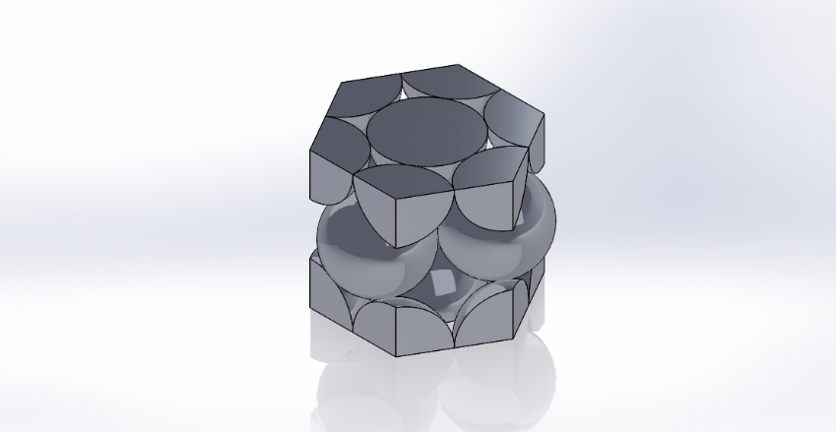

3D Models help student visualize the device
Questions?
http://scme-support.org/
http://www.ivytech-mems.org/
http://faculty.ivytech.edu/~abell118/
BCC Unit Cell
Andy Bell
Department Chair – Engineering
Ivy Tech Community College – Northeast
Phone: 260-481-2288 : Fax: 260-480-2052 : abell118@ivytech.edu
SDKB Technology Center, Room TC1240R, 3800 N. Anthony Blvd.,
Fort Wayne, IN 46805
FCC Unit Cell
HCP Unit Cell

