Slide 1

MTTC Pressure Sensor Process
Process Storyboard
(Process parameters may change due to process improvements.)

Slide 2
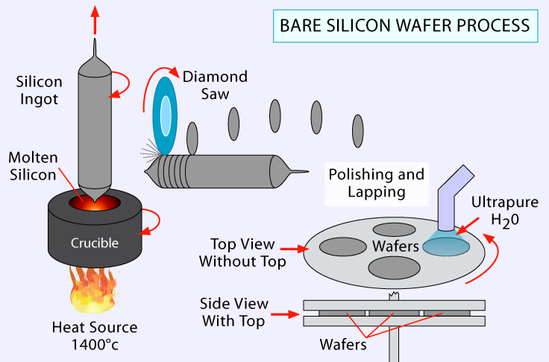
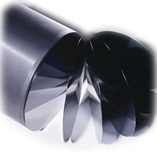
Bare Silicon
Step 1
Description and Parameters:
Standard 150mm monocrystalline silicon wafer having <100> crystal orientation
Thickness: 675+/- 25 µm
Dopant (An intentional impurity to alter the resistivity): Boron
Resistivity (The resistance to current flow and movement of electrons in the silicon): 20 Ω-cm
Revised 6/30/10

Slide 3
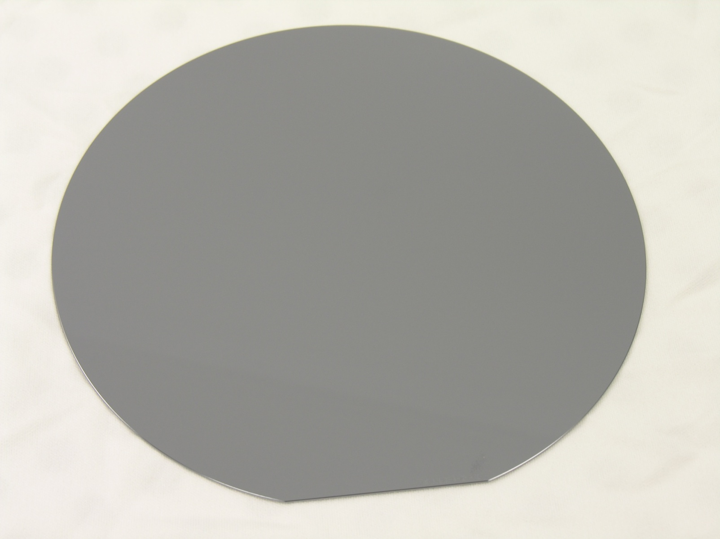
Bare Silicon
Step 1

Slide 4
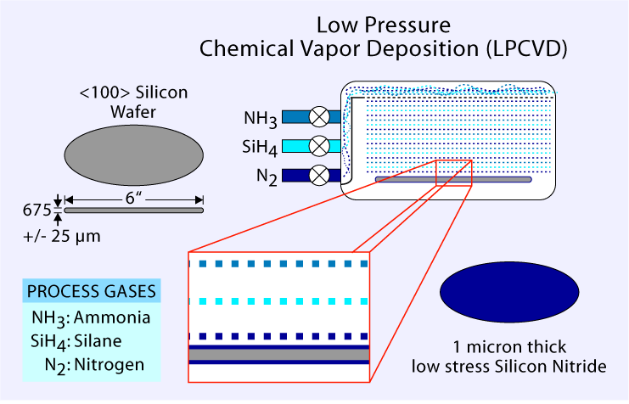
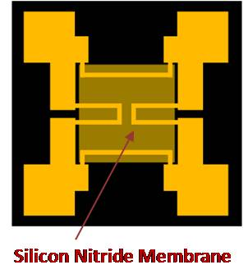
Silicon Nitride Deposition
Step 2
Description and Parameters:
LPCVD deposited
1 µm low stress silicon nitride on both sides of wafer

Slide 5
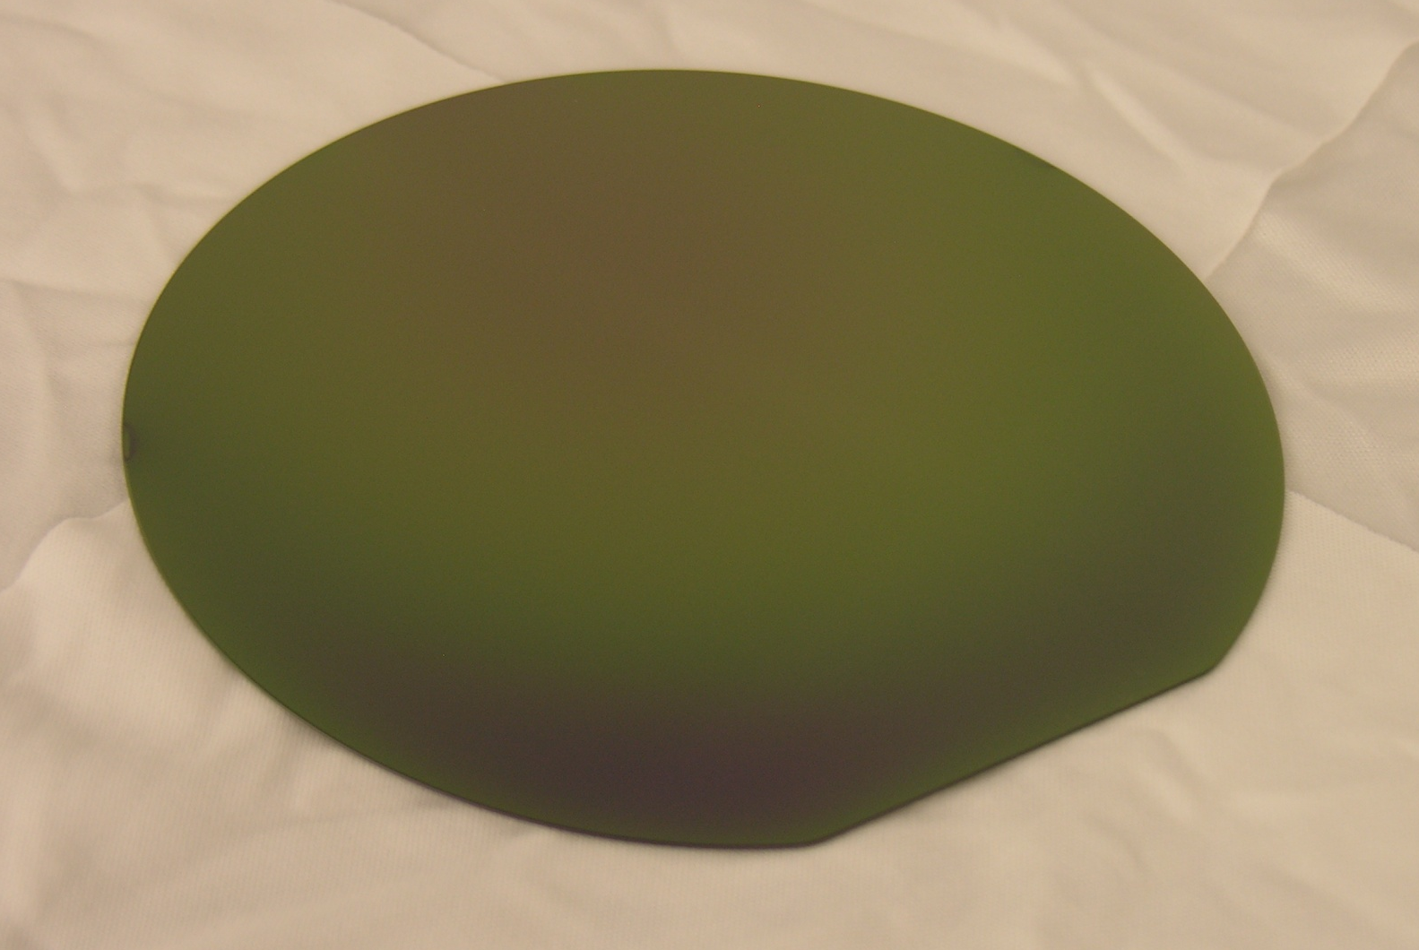
Silicon Nitride Deposition
Step 2

Slide 6
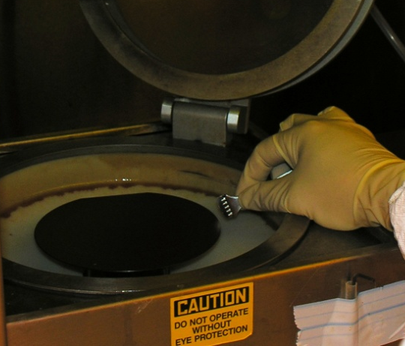
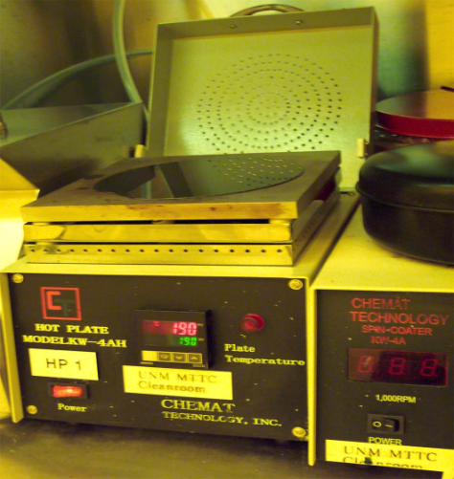
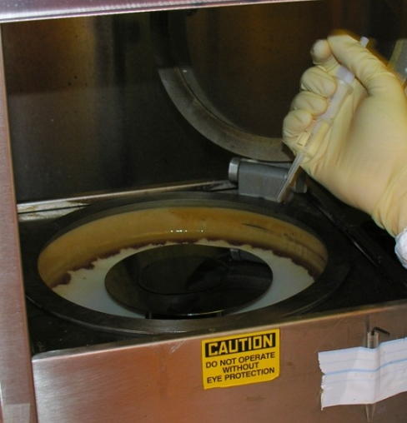
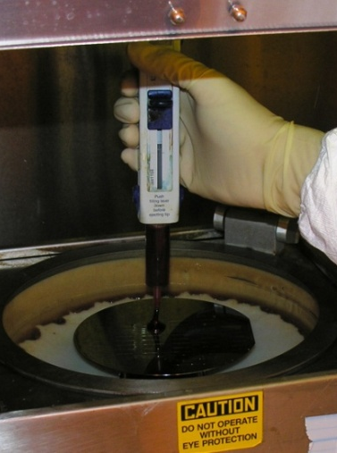
Backside Photolithography - Coat
Step 3a
Process Description:
Pattern the backside of the wafer with a photoresist window to expose the silicon.
This step will coat the frontside of the wafer first for protection against scratches, then the backside of the wafer.
Coat Parameters:
Frontside coat - Carefully align and center wafer on vacuum chuck – Visually check for misalignment
Bake wafer for 2 minutes at 110ºC / Cool wafer on metal table to bring wafer back to room temp
Dispense HMDS w/pipette/Spin (HMDS is a primer to allow photoresist to stick to the wafer)
Dispense photoresist (AZ9260) w/pipette/Spin
Backside coat - Carefully align and center wafer on vacuum chuck – Visually check for misalignment
Dispense HMDS w/pipette/Spin
Dispense photoresist (AZ9260) w/pipette/Spin
Bake wafer for 2 minutes at 110ºC to cure and remove solvents / Cool wafer on metal table to bring wafer back to room temp
1,5
2,8
3,6
4,7

Slide 7
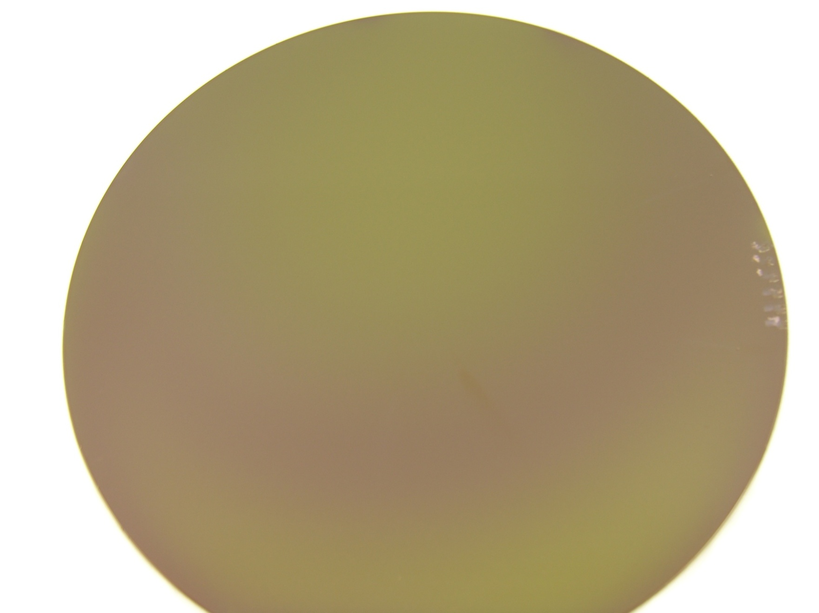
Backside Photolithography - Coat
Step 3a

Slide 8
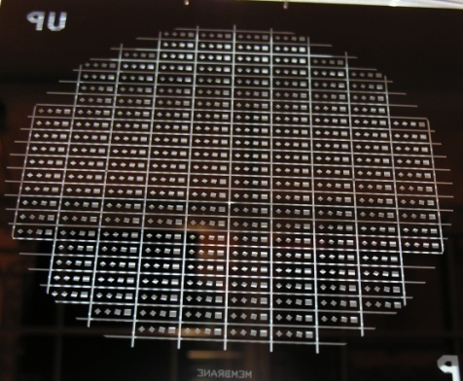
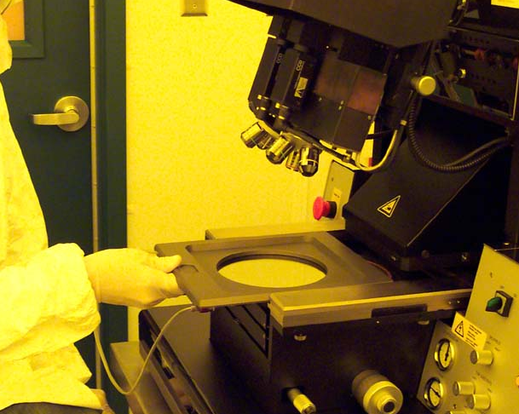
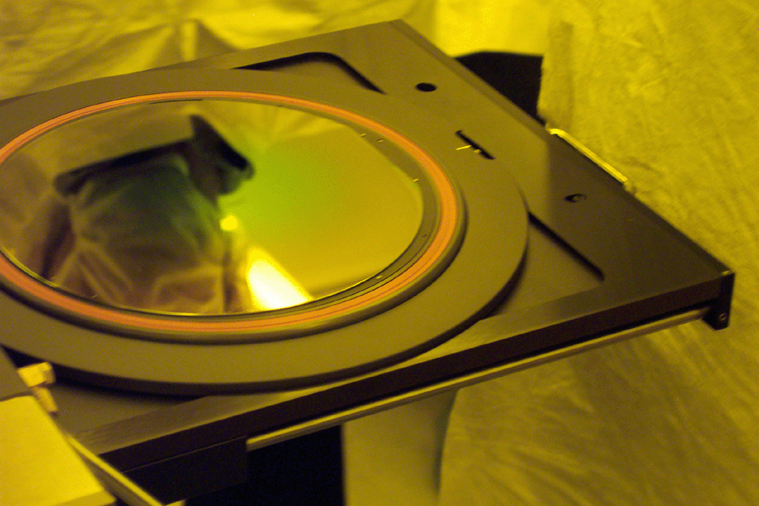
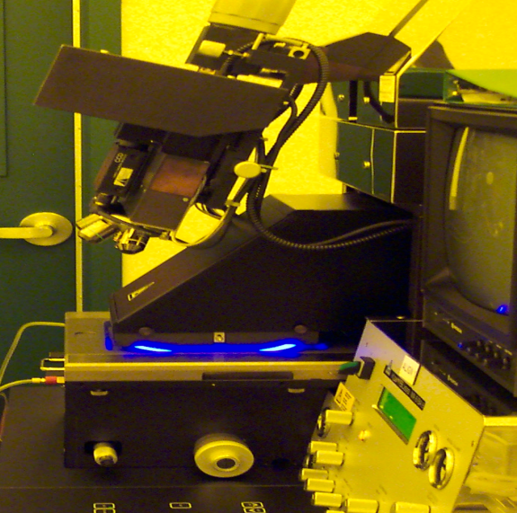
Backside Photolithography - Expose
Step 3b
Process Description:
Pattern the backside of the wafer with a window to expose the silicon.
The photoresist will become soluble when exposed to the ultraviolet light. The mask contains the window pattern.
Expose Parameters:
Load Mask Into Holding Tray and slide the tray into the Karl Suss alignment system
Load Wafer Into Karl Suss Contact Aligner
Expose wafer to UV light for approximately 300 seconds
Mask Pattern
1
2
3

Slide 9
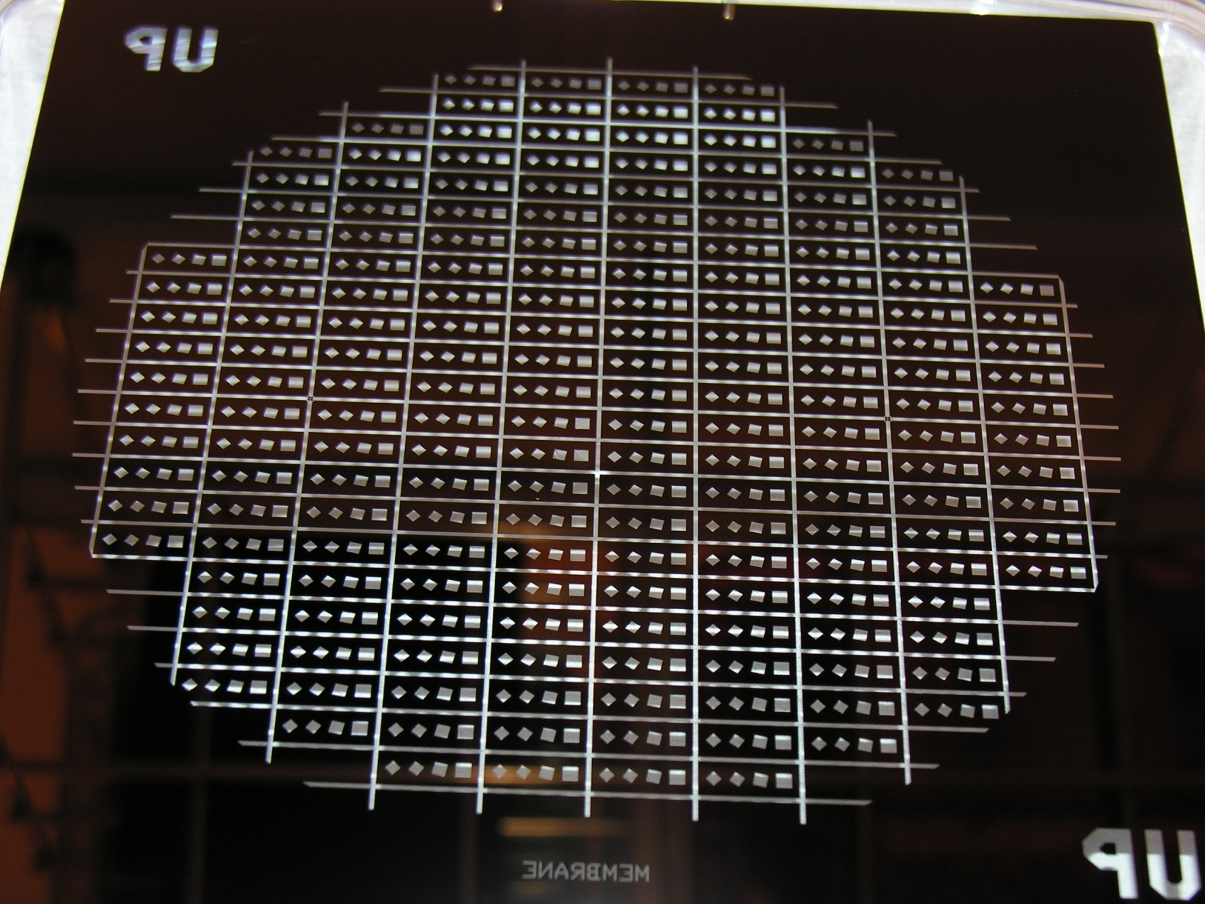
Backside Photolithography - Expose
Dark Field Membrane Mask
Step 3b

Slide 10
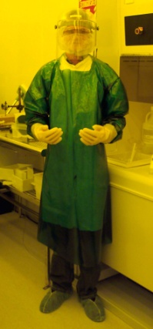
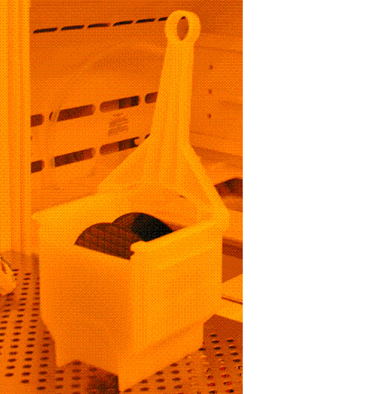
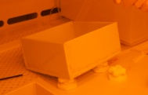
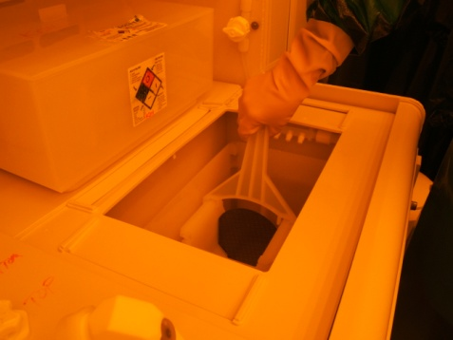
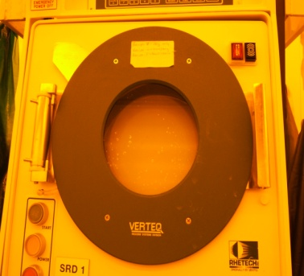
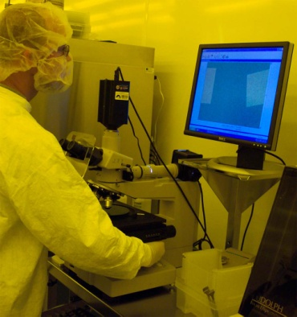
Backside Photolithography - Develop
Step 3c
Process Description:
Develops the exposed photoresist to open the windows and expose the silicon for a subsequent etch. The develop solution uses a small amount of Potassium Hydroxide (KOH).
Develop Parameters: Performed at Caustic Wet Bench, USE ACID GEAR
Place exposed wafer in last slot of white Teflon boat (closest to H bar)
Pour develop solution (1:3 concentration of KOH/deionized water) into container and insert boat so entire wafer is submerged
Allow wafers to develop for 15 minutes
Remove boat from develop solution at a 45° angle to allow excess mixture to drip off
Place in QDR (Quick Dump Rinse) and Rinse 5X
Remove at 45° angle to allow for run-off
Place entire boat into SRD (Spin Rinse Dryer) (H-bar in first) until unit reaches 15MΩ
Do a microscopic inspection to check for defects
1
5
7
2
8

Slide 11
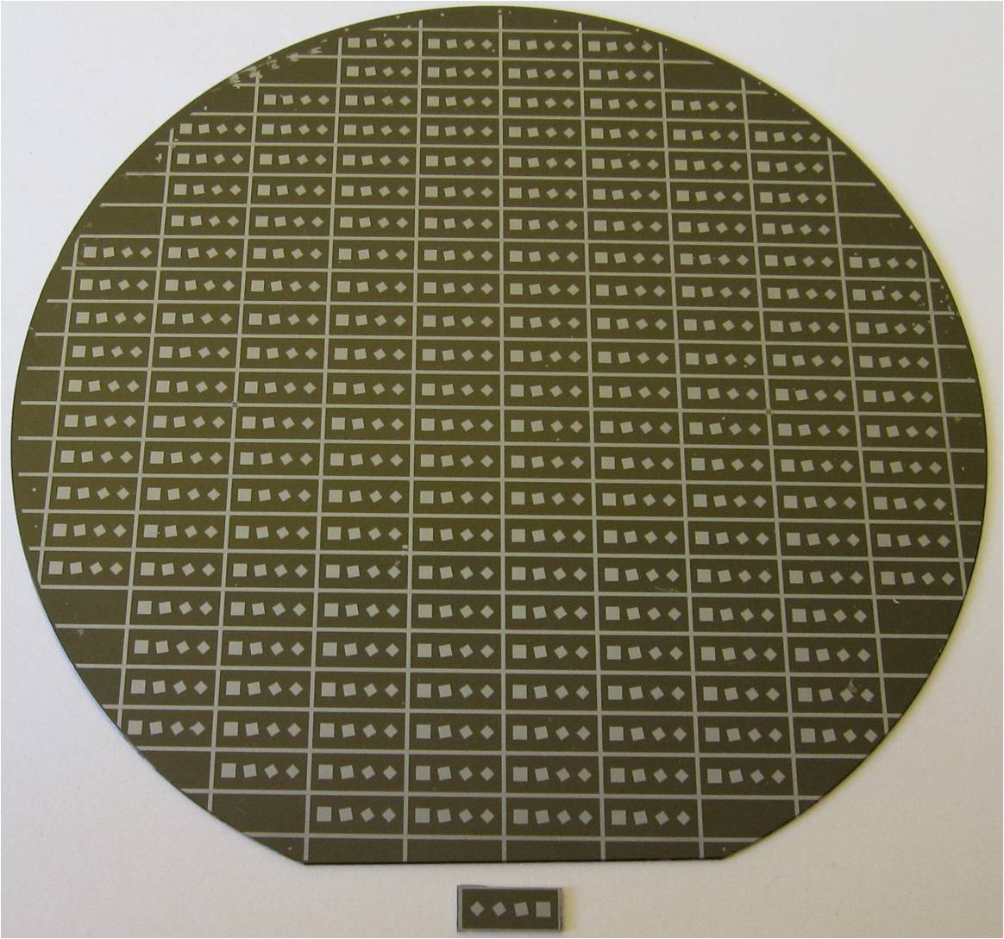
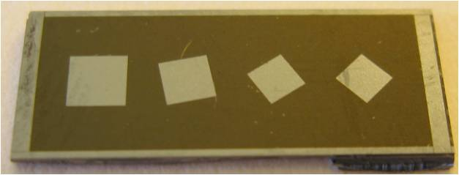
Backside Photolithography - Develop
Step 3c

Slide 12
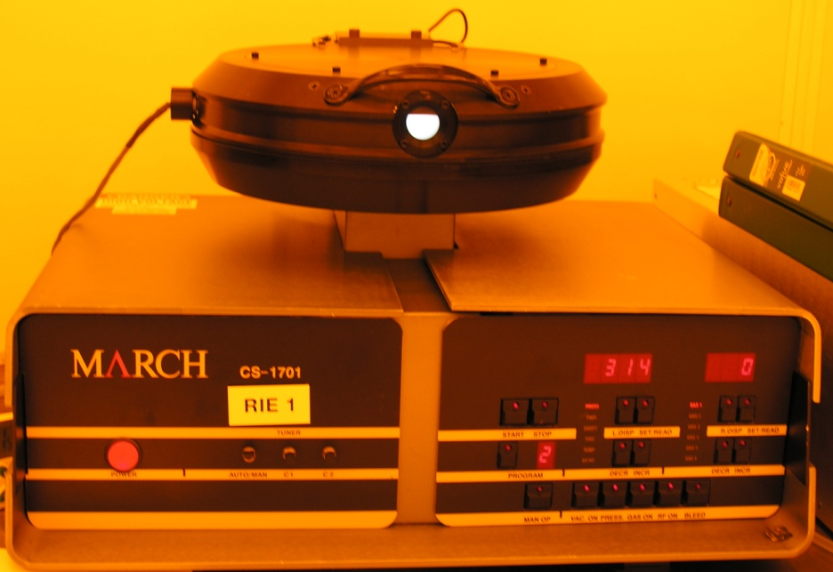
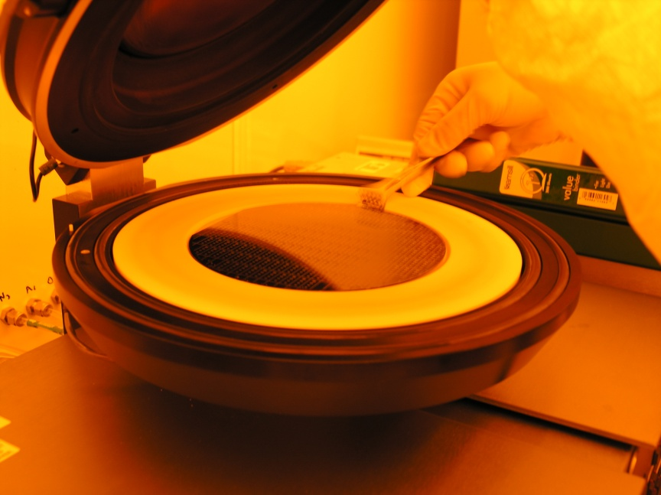
Backside Etch – RIE
Step 4
Process Description:
This step uses a plasma etcher to etch the backside silicon nitride layer through the open resist windows, exposing the
underlying monocrystalline silicon wafer. The March Reactive Ion Etcher (RIE) is used for a very highly selective
etch. The RIE uses13.56 MHz (RF) to energize the plasma. The positive ions bombard the wafer’s surface to create
openings in the silicon nitride layer using this dry etching technique.
RIE Parameters:
Place wafer in the RIE for 300 seconds
Turn wafer 180º and etch for another 300 seconds, this insures a uniform etch
Remove wafer

Slide 13
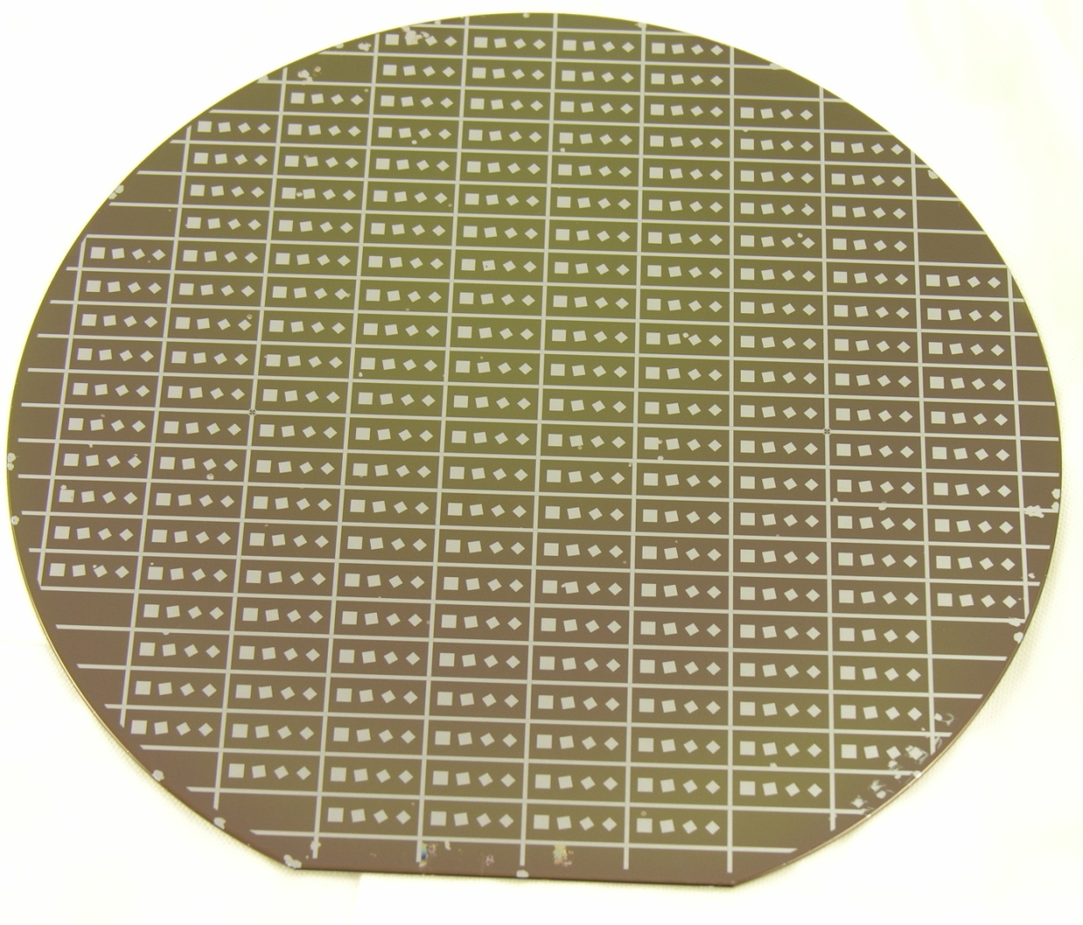
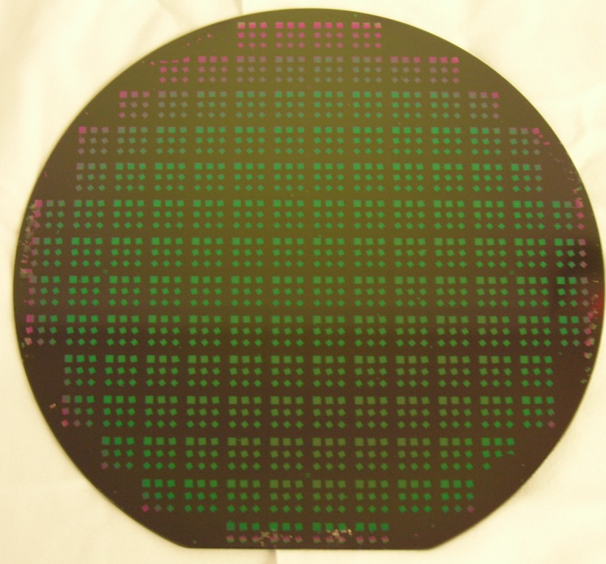
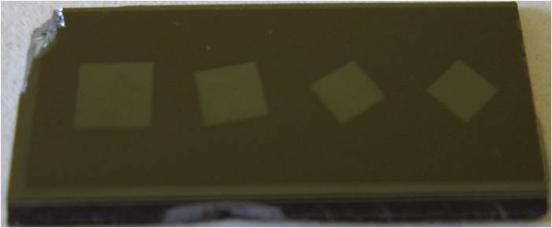
Backside Etch – RIE
Fully Etched
Partially Etched
Step 4

Slide 14

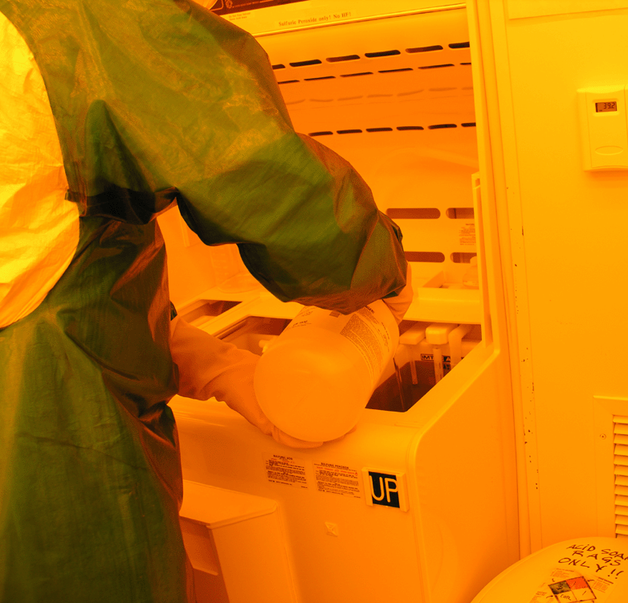
Backside Photoresist Strip
Step 5
Process Description:
The wafers are now placed in a Piranha bath. Piranha refers to the mixture of H₂SO₄/ H₂O₂. This chemical solution aggressively removes photoresist. Extreme care should be taken when using a Piranha solution. The acid will interact with skin very quickly. Be sure to use the appropriate personal protective equipment (PPE) when performing the photoresist strip.
Photoresist Strip Parameters: USE ACID GEAR
Piranha Clean Mixture (Heated to 100ºC)
  4.5 gallons of Sulfuric Acid
  200 mL Hydrogen Peroxide
Always add Peroxide to the Acid!!!!!
Chemicals Used: H₂SO₄/ H₂O₂
Process Time: 15 minutes

Slide 15
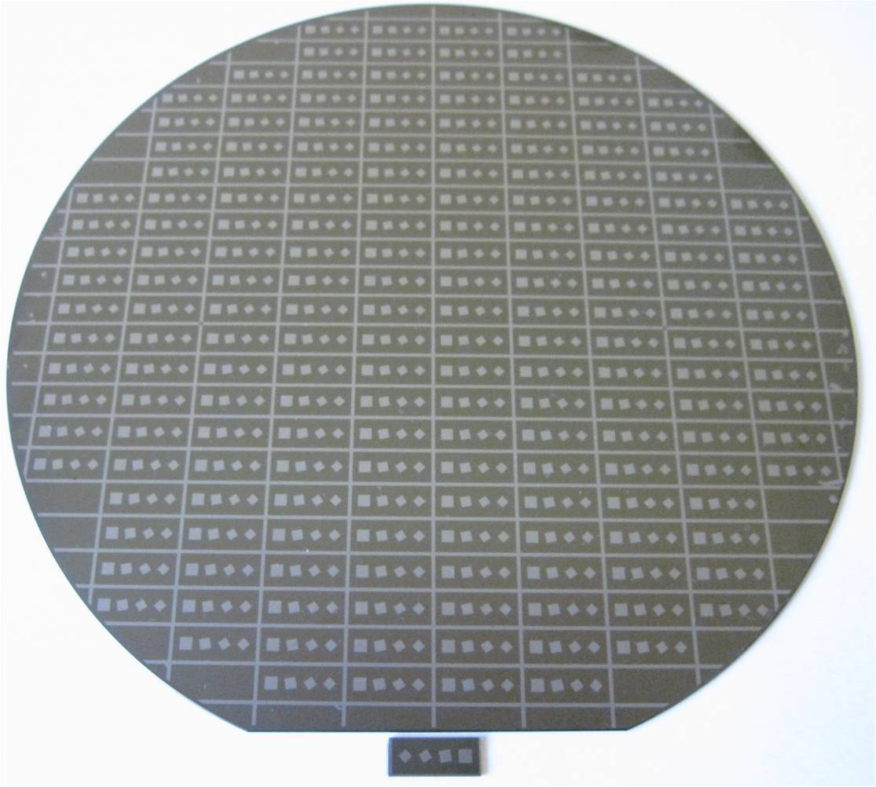
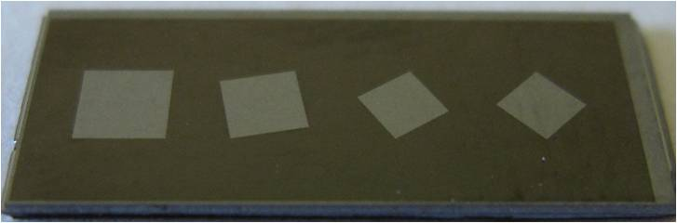
Backside Photoresist Strip
Step 5

Slide 16
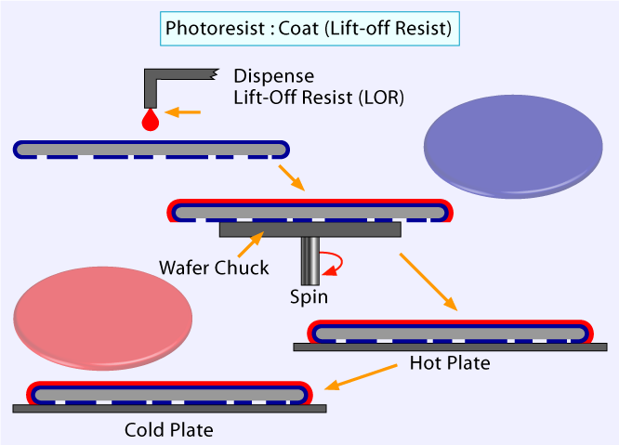
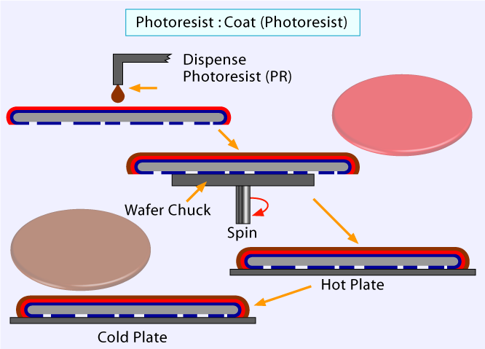
Frontside Photolithography - Coat
Step 6a
Process Description:
The next step in the process is to pattern the frontside of the wafer with the Wheatstone Bridge pattern. In this step, a lift-off resist is applied to create a desired undercutting during the develop process.
Frontside Coat Parameters:
Carefully align and center wafer on vacuum chuck – Visually check for misalignment
Dispense Lift off Resist (LOR) w/pipette and spin
Bake wafer for 2 minutes at 190ºC to cure and remove solvents
Cool wafer on metal table to bring wafer back to room temp
5. Carefully align and center wafer on vacuum chuck – Visually check for misalignment
6. Dispense photoresist (AZ5214) w/pipette and spin
7. Bake wafer for 2 minutes at 100ºC to cure and remove solvents
8. Cool wafer on metal table
Chemicals Used: LOR, HMDS, Photoresist

Slide 17
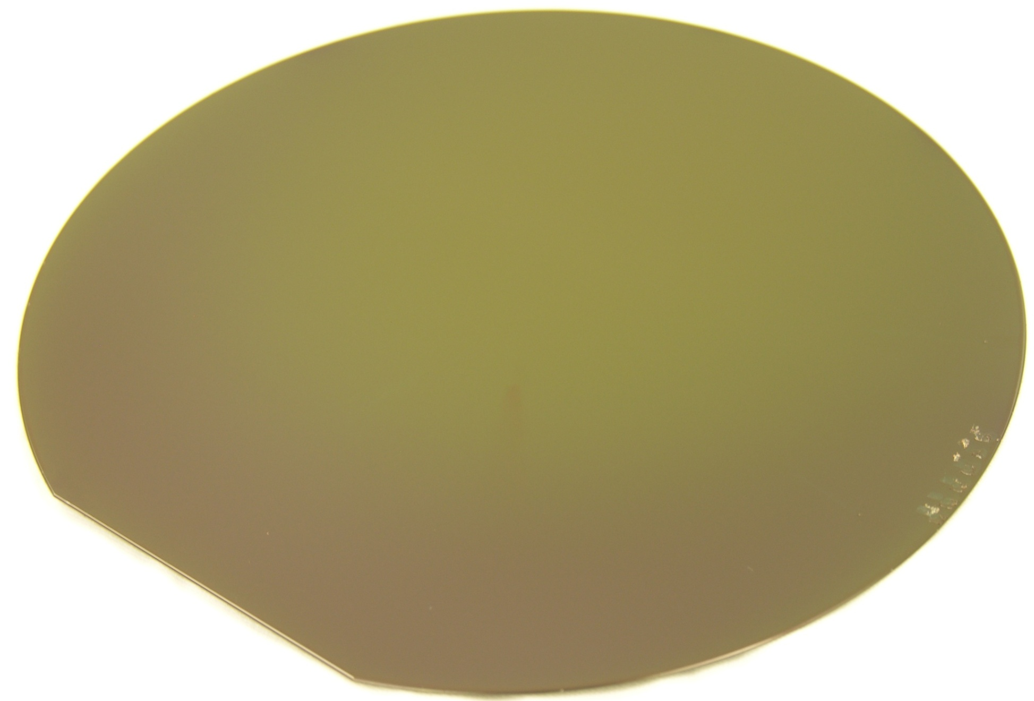
Frontside Photolithography - Coat
Step 6a

Slide 18
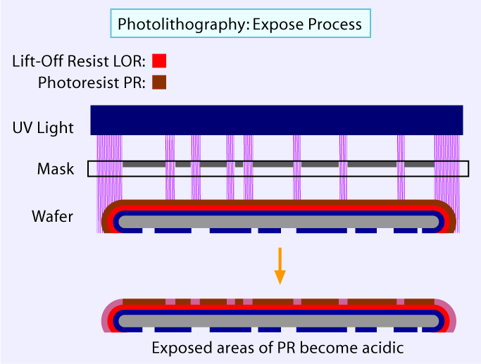
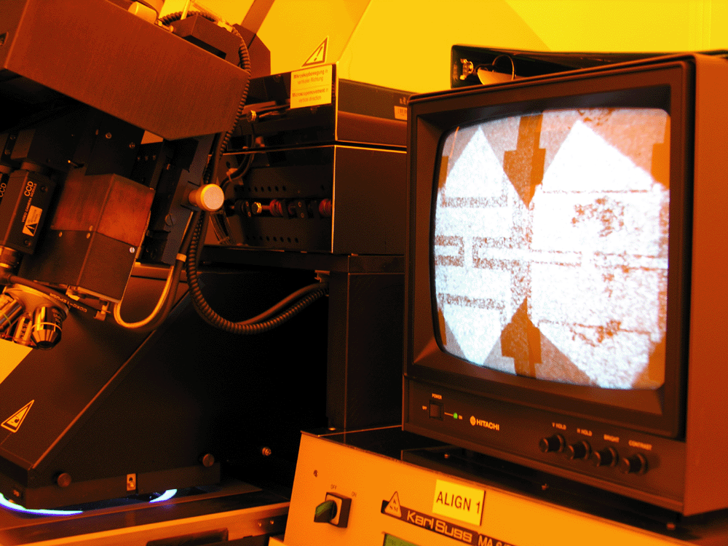
Frontside Photolithography - Expose
Step 6b
Process Description:
Exposes the Wheatstone Bridge circuit pattern.
Mask Pattern
Frontside Expose Description & Parameters:
Load Mask Into Holding Tray and slide the tray into the Karl Suss alignment system
Load Wafer Into Karl Suss Contact Aligner
Align wafer using alignment system
Expose wafer to UV light for 40 seconds
3

Slide 19
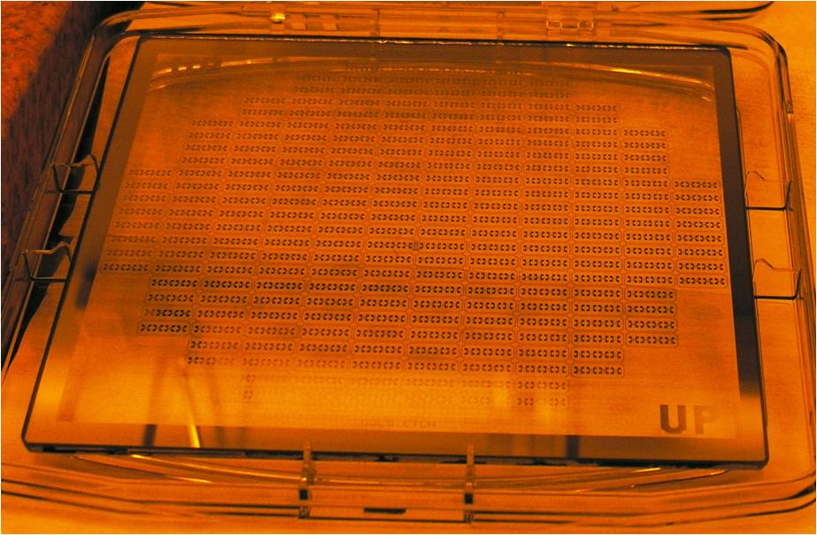
Frontside Photolithography - Expose
Step 6b

Slide 20

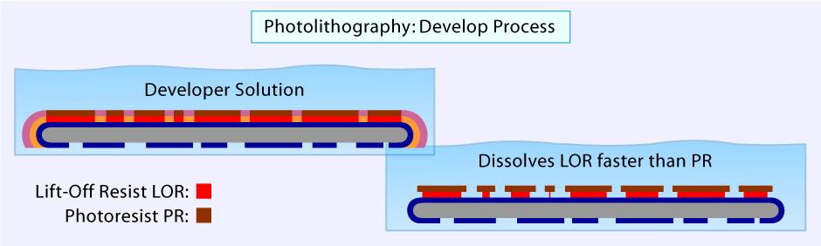
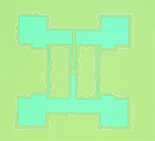
Frontside Photolithography - Develop
Step 6c
Process Description: Develops the photoresist & creates the resist undercut.
Frontside Develop Parameters: Performed at Caustic Wet Bench, USE ACID GEAR PPE
Place exposed wafer in last slot of white Teflon boat (closest to H bar)
Pour develop solution (1:5 concentration of KOH/DI Water) into container. Insert boat so entire wafer is submerged
Allow wafers to develop for 60 seconds
Remove boat from develop solution at a 45° angle to allow the solution to drain off without splashing
Place in QDR (Quick Dump Rinse) and Rinse, repeat this 5 times
Remove at 45° angle to allow for smooth run off
Place entire boat into SRD (Spin Rinse Dryer) until unit indicates 15MΩ rinse water resistivity
Perform a microscopic inspection to check for defects
Bad LOR Develop

Slide 21
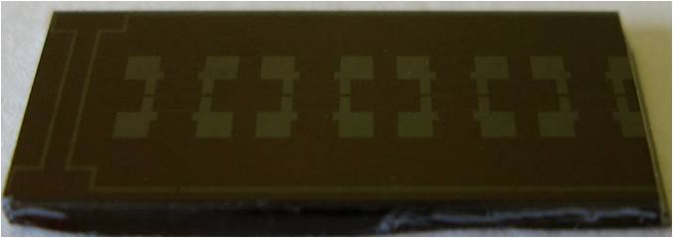
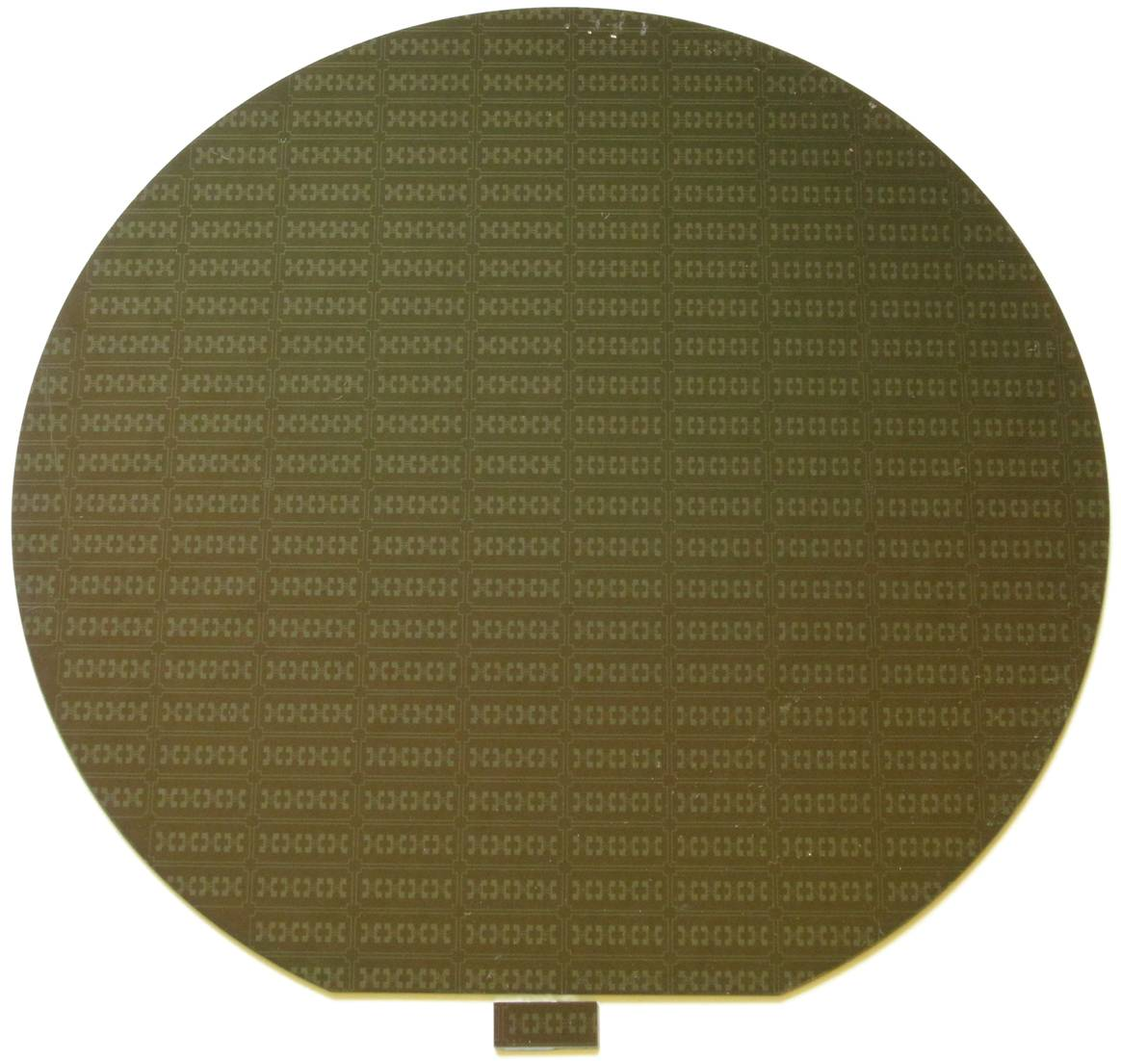
Frontside Photolithography - Develop
Step 6c

Slide 22
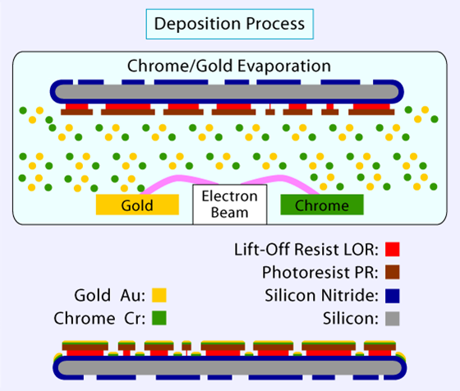
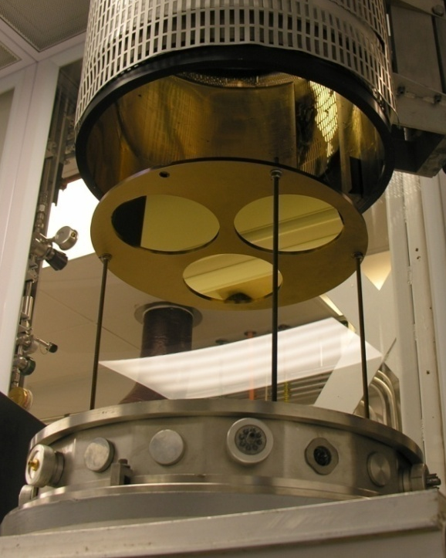

Metal Deposition
Step 7
Process Description:
A vacuum evaporator is used to deposit chrome and then gold onto the wafer. Chrome is used because it
adheres well to the silicon nitride and the gold adheres well to the chrome. The gold acts as the conductive
layer and strain gauge for the resistor bridges in the Wheatstone Bridge.
Deposition Parameters:
Mount wafers in the vacuum evaporator
Deposit 100 Angstroms of chrome onto the wafer – Process Time: 90 seconds
Deposit 4000 Angstroms of gold over the chrome – Process Time: 5 minutes
Wheatstone Bridge pattern after metal deposition

Slide 23
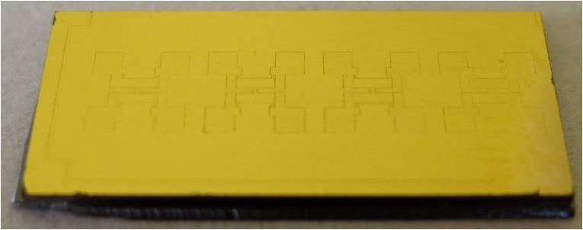
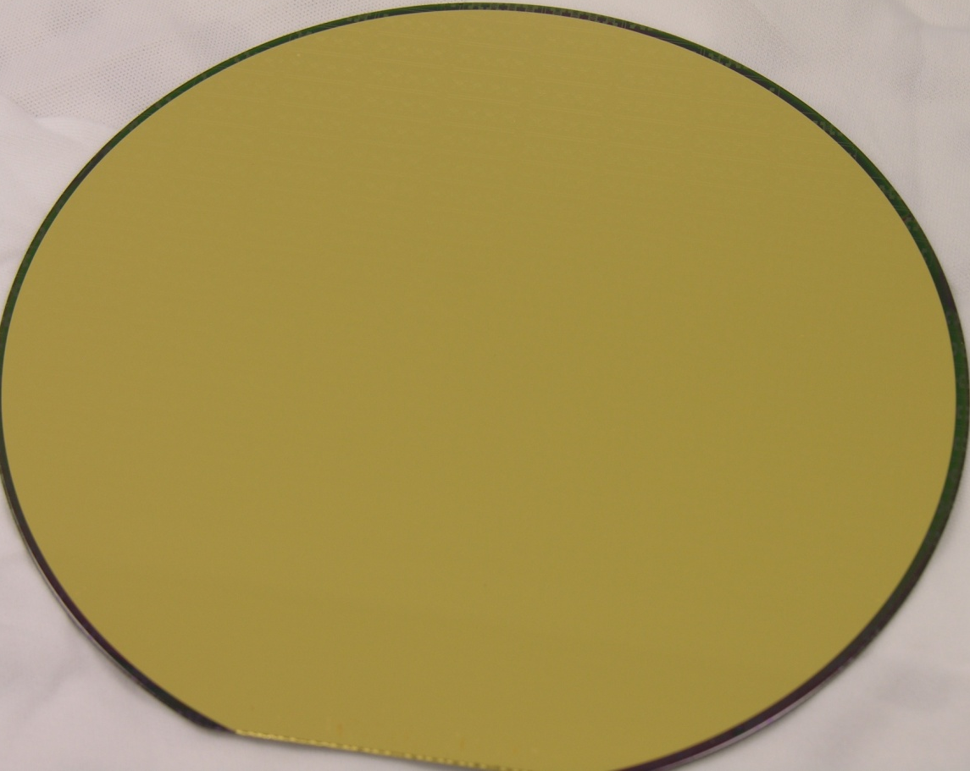
Metal Deposition
Step 7

Slide 24
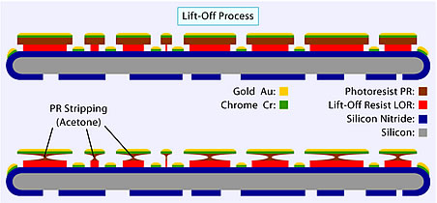

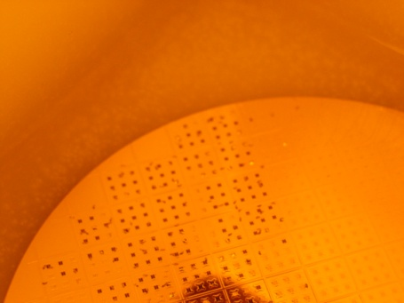
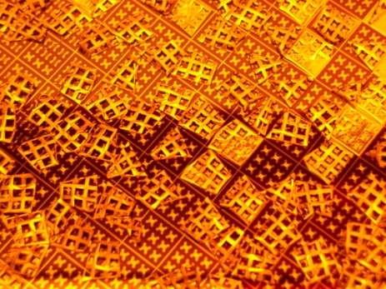
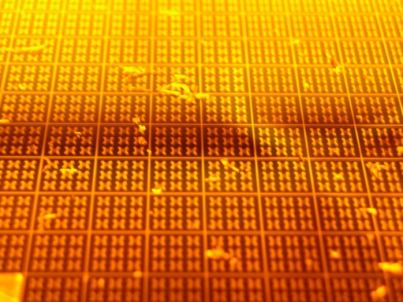
Metal Liftoff
Step 8
Process Description:
The wafer is soaked in acetone to dissolve the photoresist causing chrome/gold leads to lift off. The wafer must stay wet or the metal may stick randomly to the wafer surface. LOR will remain.
Liftoff Parameters:
Chemicals Used: Acetone
Process Time: Approximately 30 minutes
Stage 1: Chrome/Gold beginning to liftoff
Stage 2: Wheatstone bridge structures beginning to be revealed
Stage 3: Chrome/Gold liftoff complete
Microscope photo of Wheatstone bridge after liftoff

Slide 25


Metal Liftoff
Revised 6/30/10
Step 8

Slide 26


LOR Strip
Step 9
Process Description and Parameters
Wafers are now submerged in develop solution to strip the LOR.
Chemicals Used: Develop solution at room temperature
Process Time: Approximately 2 minutes

Slide 27


LOR Strip
Step 9

Slide 28





KOH Etch
Step 10
Process Description and Parameters : Performed at a Wet Bench, USE ACID GEAR PPE
Wafers are now submerged in a heated Potassium Hydroxide (KOH) bath. The silicon nitride acts as a hard mask and the exposed silicon etches anisotropically following the crystal planes. At the end of the etch, the wafers will be fragile since the bulk of the Si is removed.
KOH Etch Parameters :
Place wafers in a Teflon boat and place very gently into a 105ºC KOH bath, process for 2 hours
Reduce the temperature to 95ºC and leave for 90 minutes
Reduce the temperature to 80ºC for approximately 45 minutes, or until etch is complete
Place wafers in QDR
Rinse with Isopropyl Alcohol (IPA) and carefully blow dry with nitrogen
Chemicals Used: KOH, IPA, nitrogen
Process Time: Approximately 4 1/2 hours
1
Good KOH Etch
Bad KOH Etch
cavity pattern before KOH
cavity during KOH shows silicon nitride pattern
Blown Silicon Nitride Membrane due to over etch
Silicon Nitride Membrane

Slide 29


KOH Etch
Step 10

Slide 30




Testing and Probing
Process Description and Parameters
Wafers are now placed on a probing station. A power supply is used to apply a voltage, causing the membrane
to deflect.
Final Product
Pressure Sensor wafer on probing station
Probing station and power supply
Probe on the Wheatstone Bridge

Slide 31

Testing and Probing

Slide 32
Acknowledgements
Copyright 2008 - 2011 by the Southwest Center for Microsystems Education and The Regents of the University of New Mexico.
Southwest Center for Microsystems Education (SCME)
800 Bradbury SE, Suite 235
Albuquerque, NM 87106-4346
Phone: 505-272-7150
Website: www.scme-nm.org email contact: mpleil@unm.edu
The work presented was funded in part by the National Science Foundation Advanced Technology Education program, Department of Undergraduate Education grants: 0830384 and 0402651.

